Slide 1


Enabling Operators to Outperform in an
AI-First Landscape
May 2026
brian@brightplace.ai

Slide 2










Combining Multifamily Expertise & Top AI Talent
FOUNDING AI ENGINEERS
3 Full-stack AI Engineers, AI & Agentic Architecture
ADVISORS
Eric Christianson
4x Startup CFO
Sara Graham
Multifamily Marketing Exec
Brian Lichtenberger
Founder
3x Founder with Multiple Exits
Two years as CEO of Vista Portfolio Company
INDUSTRY PARTNER | PROPTECH ACCELERATOR

Slide 3



Why Operators are Choosing brightplace
Operator Challenge
With IntentOS
“My properties are invisible in AI search”
Listings are enriched, aggregated and surfaced across AI platforms
“Renters leave my site to learn more about the neighborhood”
Rich context is surfaced on the website (neighborhood, commute, lifestyle)
“Leads arrive without any context”
brightplace delivers rich, intent-driven, lead cards

Slide 4
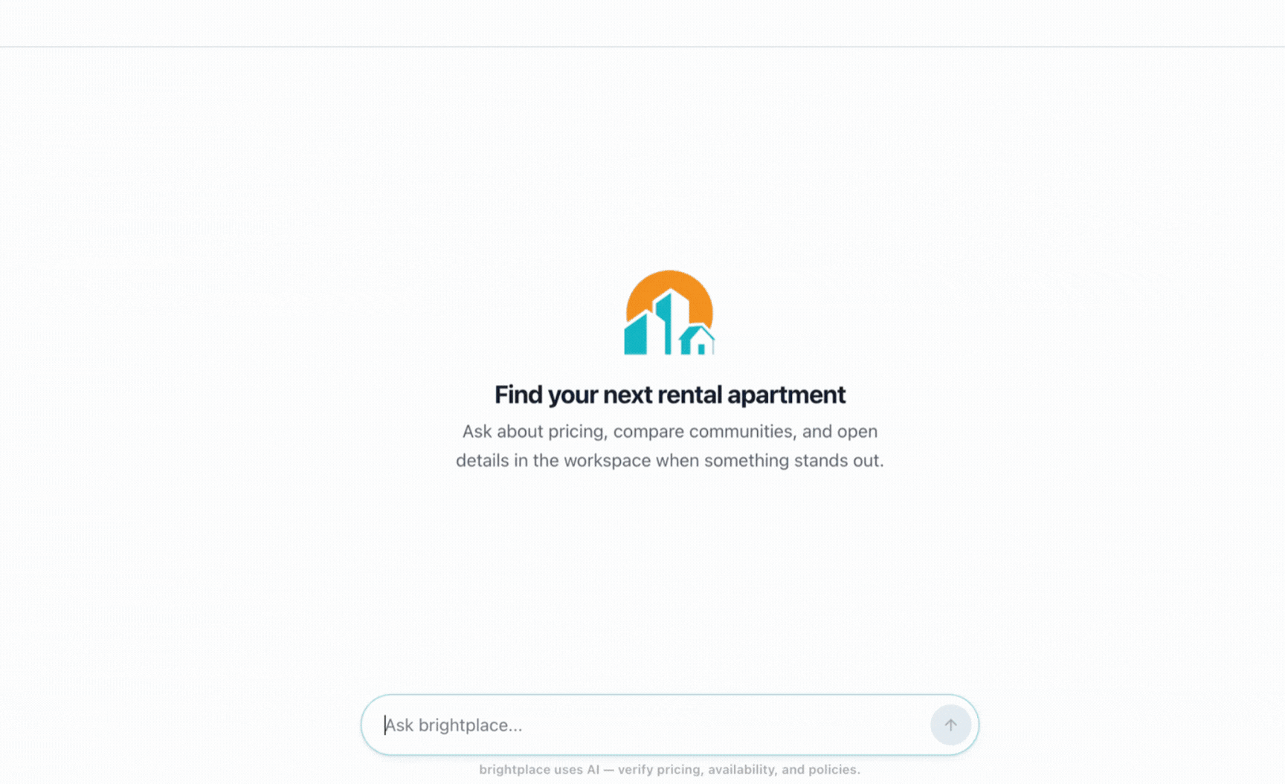

Slide 5
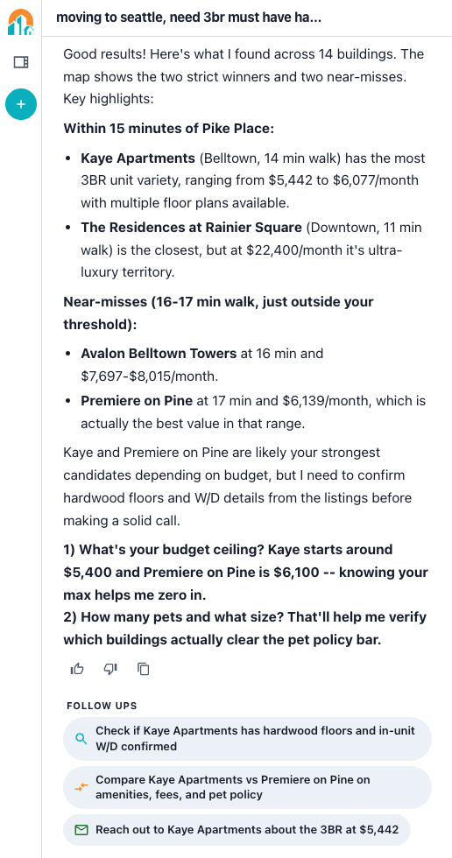
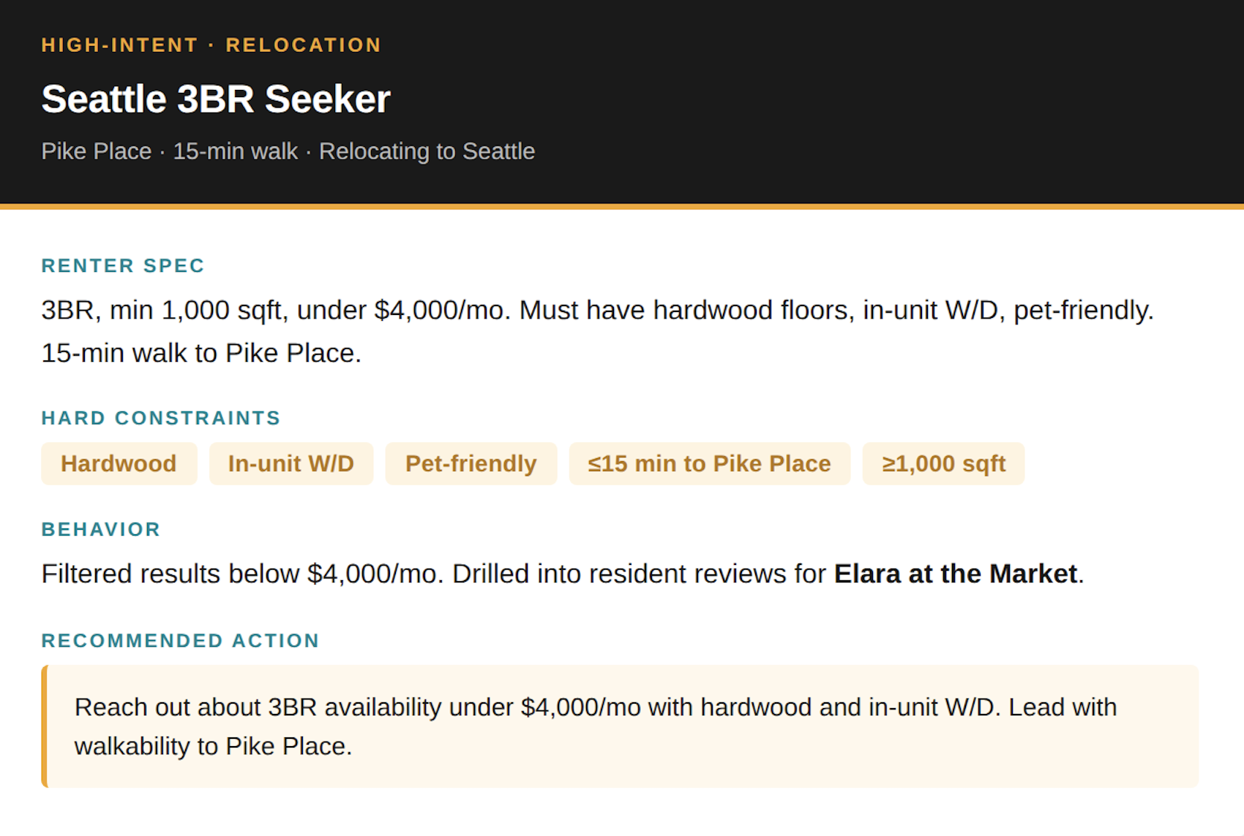
Enrich your CRM with Intent-Driven Lead Cards

Slide 6
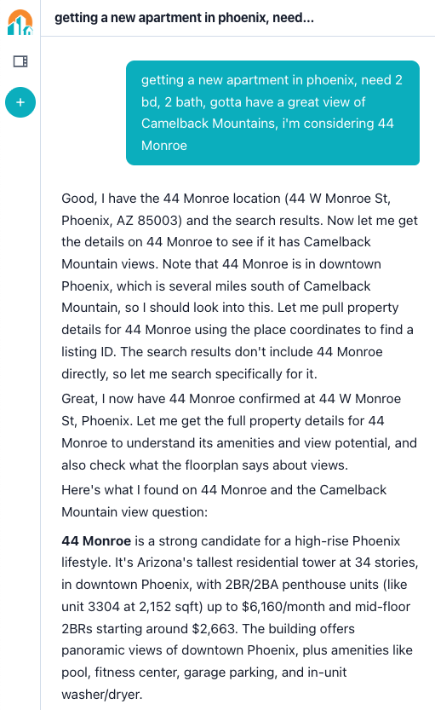
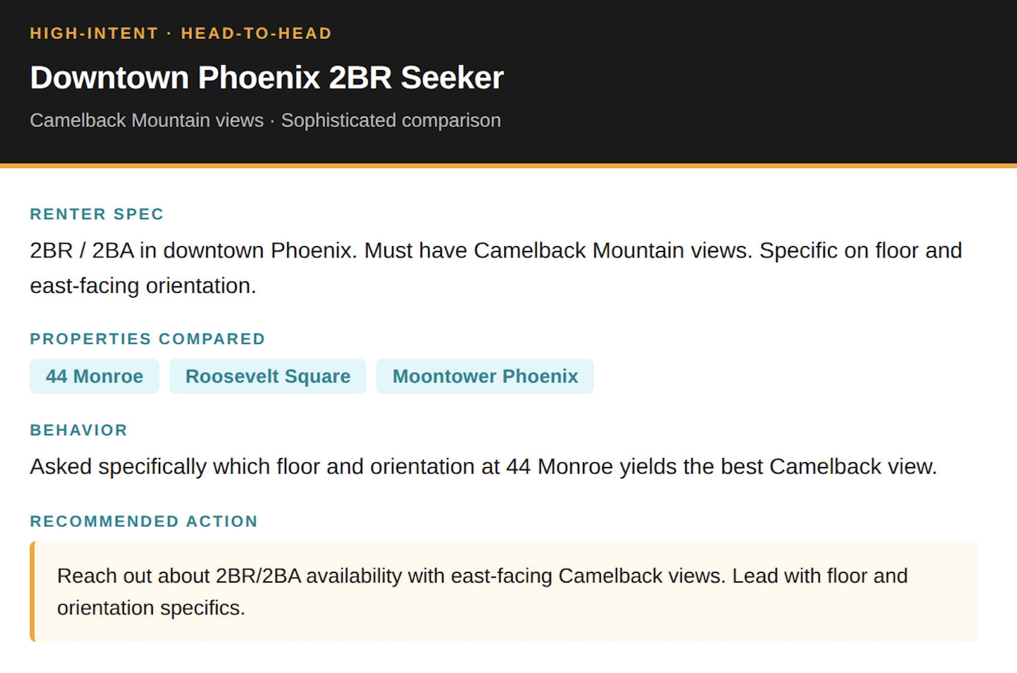
See the Full Picture Behind Every Lead

Slide 7
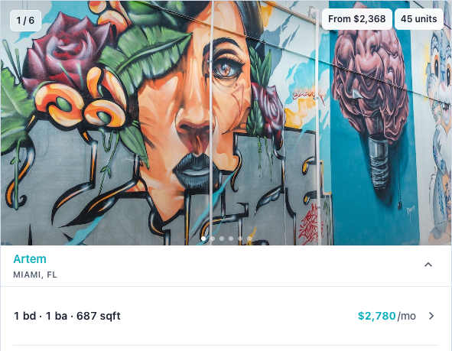
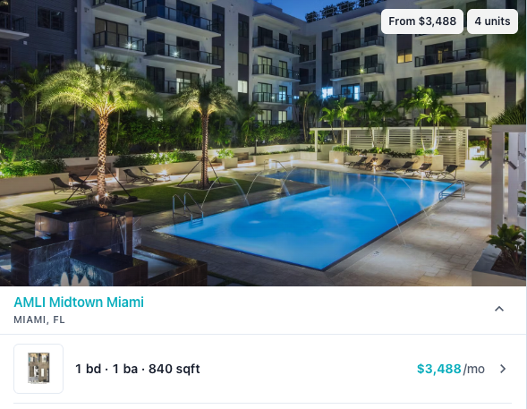
Two Ways to Partner: List with brightplace
No upfront cost to list
Success-based, pay per lease model
Distribution includes:
  brightplace app (web + mobile)
  Listing Source API for LLMs
brightplace is your AI readiness strategy
Listings are structured + enriched + documented
Delivers benefits of aggregation

Slide 8
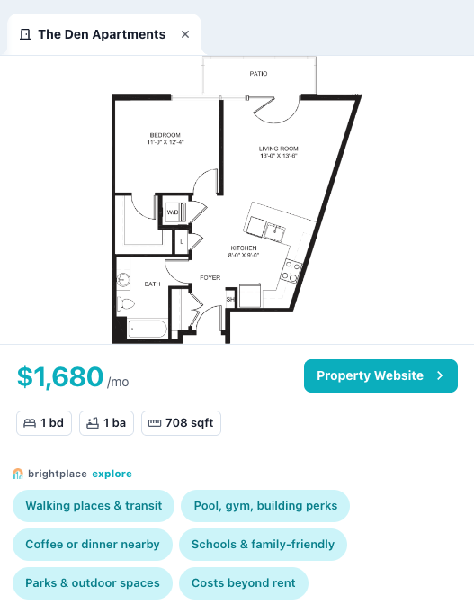
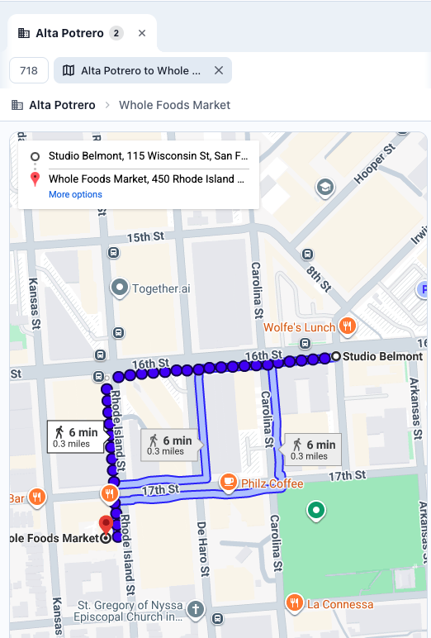
Two Ways to Partner: Put the Advisor on your site
Keep Renters on your site
Bring your content to life
Deliver a superior UX
Capture renter intent directly on site
  Priorities + preferences
  Important amenities
  Pricing concerns
  Neighborhood + lifestyle factors
brightplace helps renters understand what’s outside the property and unit

Slide 9
Enabling Operators to Outperform
Better leads, lower costs
Renters arrive with expressed intent
See what renters actually want
Access intent data no ILS provides
Show up where renters are actually searching
AI platforms, not just Google
Seamlessly fits in your tech stack
No rip and replace needed
High intent leads | AI Ready Listings
Lower CAC | Brand Control

Slide 10

brian@brightplace.ai

