Slide 1
The Missing Engine
Why Marketing Ops Must Become a Core Function in Multifamily (Before AI Eats Us Alive)
Rebecca Lyn Busse | VP of Marketing | Seldin, LLC

Slide 2

BRAND NEW AI Product
“Excitement Phase”
Spending on digitization and automation is projected to reach $3.4 trillion U.S. dollars by 2026 (doubling 2022 totals)
*Source: mckinsey.com
Notes:
Story on first iteration of implementing a major AI product in multifamily. Failures + Lessons Learned

Slide 3

Why
AI?
Notes:
“Powered by AI!” = powered by electricity
Figure out why you’re actually implementing the product. What issue is it solving?
Don’t be “distracted” or “driven crazy” by hype.

Slide 4

Sourcing Phase
Notes:
Process for sourcing/comparing features.
-Good training opportunity
-Table w/features/etc.

Slide 5

Implementation/Adoption
Notes:
Think through the departments that all need to be involved

Slide 6
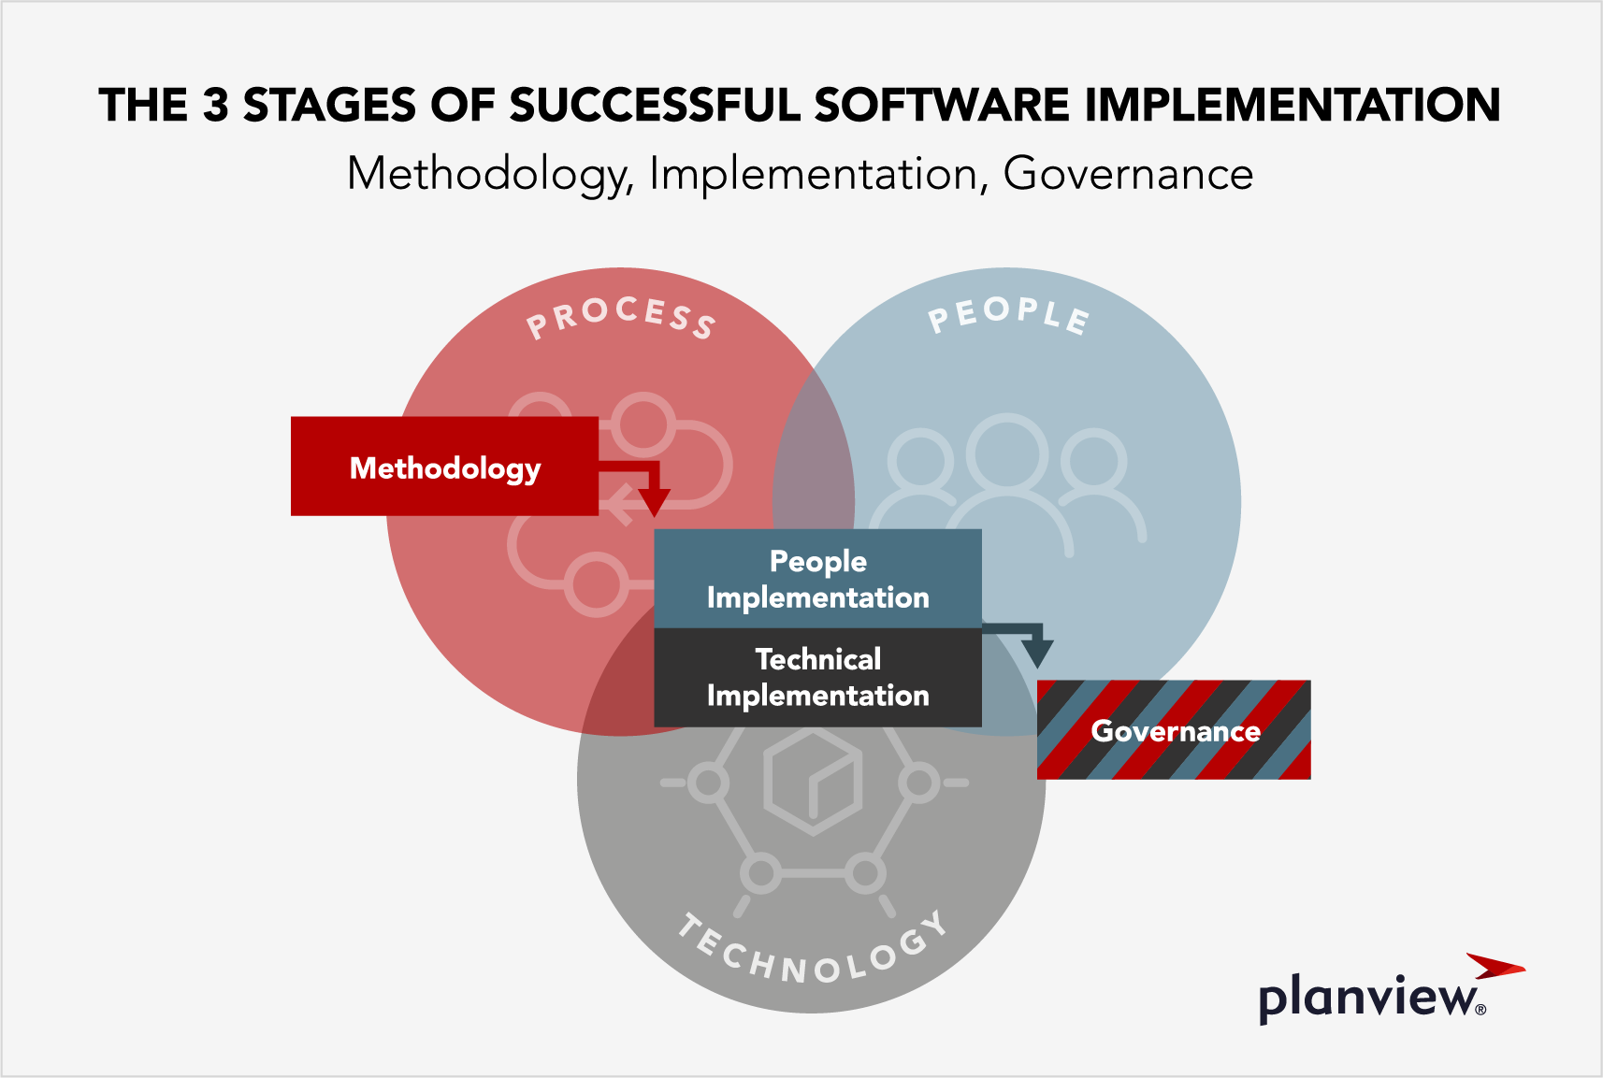
Notes:
Realizing it’s not just plug and play
Since it solves for problems using “automation” - it can seem to some that the kickoff of it is simply “automatic”
This can cause some frustrations w/internal stakeholders and onsite teams.
Especially if there was a disorganized process already in place/
Can seem to onsite teams as “more work” initially - since they weren’t doing that work in the first place. These systems can uncover that.

Slide 7
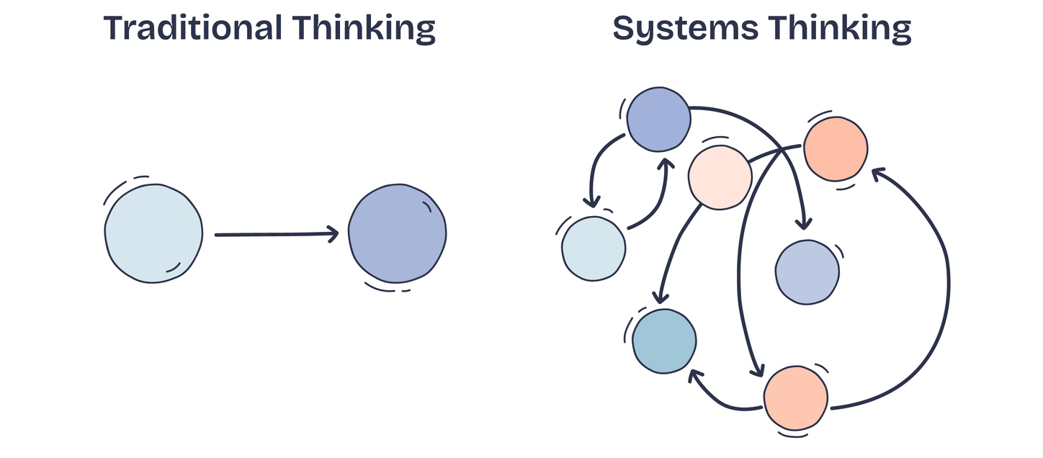
Ongoing Processes + Strategic Workflows

Slide 8

Operational WorkFlows

Slide 9

Implementation/Adoption

Slide 10


