Slide 1


AIM CONFERENCE · 2026
Real Estate Threat Intelligence Platform.
Q2 2026
How an industry response is reshaping fraud prevention.
Alex Fahsel · Property Shield

Slide 2


THE INSIGHT
THE SAME SCAMMER
IS HITTING TWELVE OF YOU.
NONE OF YOU KNOW.
Scammers operate as a network. Operators don't - yet.
propertyshield.co

Slide 3
LAST YEAR, ON THE PROPERTY SHIELD NETWORK ALONE
538,300
fraudulent rental listings detected and removed.
That's one new fake. Every minute. All year long.
Source: Property Shield 2025 Fraud Report

Slide 4
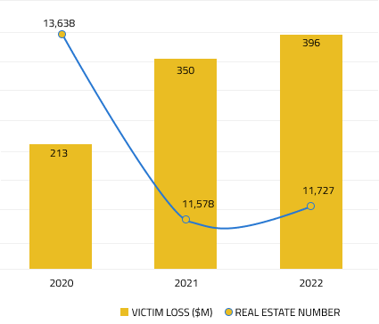

THE PROBLEM
US REPORTED LOSSES DUE TO RENTAL FRAUD
60%
$16B
19%
…of respondents faced fraudulent rental listings online
…estimated total yearly losses due to rental fraud
…of losses were more than $5,000.
1 in 5
Of property listings have a
duplicate fraudulent listing*
*Statistic is based on data from Property Shield current clients
propertyshield.co

Slide 5
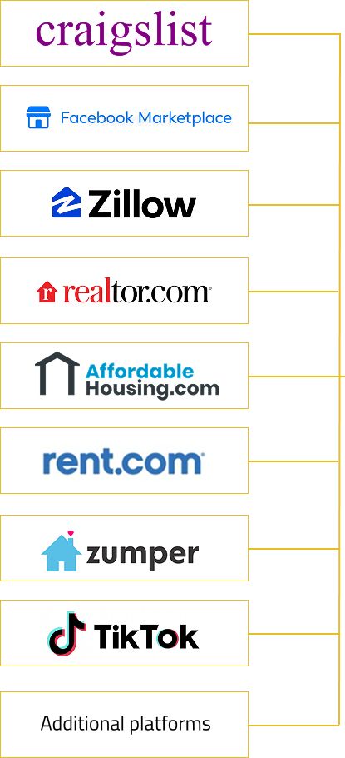
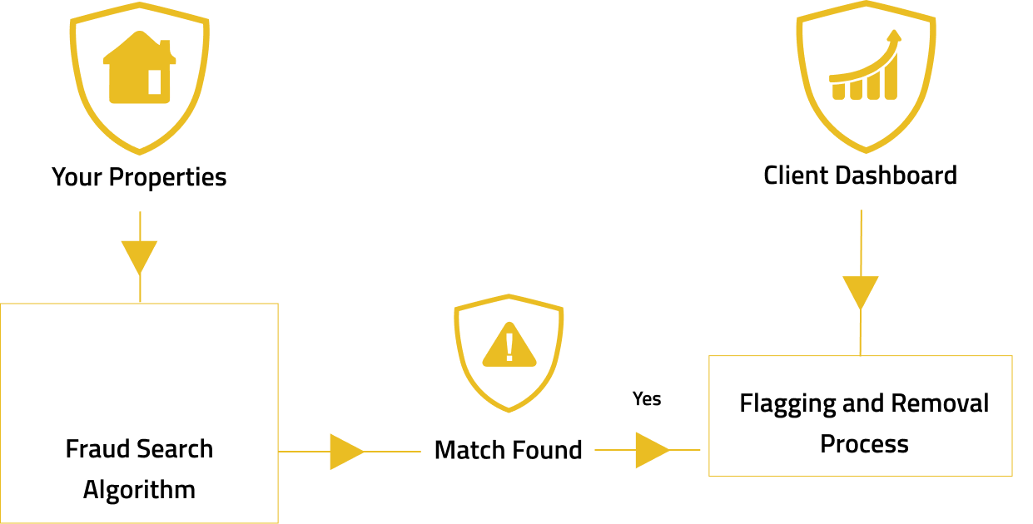

OUR FRAUD SOLUTION
propertyshield.co

Slide 6
THE INDUSTRY RESPONSE
Fraud is an industry problem.
The fix is an industry response.
Let’s build it together!
propertyshield.co
Find me at AIM - let's talk.

Slide 7




WHAT'S NEXT · COMING SOON
Introducing FAN — the Fraud Alert Network.
An industry intelligence layer across all of residential real estate — modeled after the banking (Verafin) and insurance (LexisNexis) shared fraud databases.
93% of MFR operators experienced rental applicant fraud in 2024.
24% of evictions involved fraudulent applications.
Source: NMHC, 2024
01
02
03
CONTRIBUTE
DETECT
LEARN
Members contribute confirmed fraud incidents from their own rental experience.
FAN matches each new applicant against the network's collective fraud history.
Members investigate. Outcomes refine the network for everyone.
WHAT GETS CONTRIBUTED
FLAGS RETURNED
OUTCOMES FED BACK
Identity hashes
Device + IP
Third-party fraud
Clear
Under inv.
First-party fraud
Suspect
Fraud
Contact signals
Document forensics
Synthetic identity
Victim of fraud
EVERY OUTCOME TEACHES THE NETWORK
Human-in-the-loop
FCRA-compliant
Privacy-by-design
FAN flags. You decide.
Identity verification, not eligibility.
Hashing · tokenization · audit logs.
Legal review: Hudson Cook, LLP

