Slide 1






WELCOME TO AIM 2026
WELCOME TO AIM
Into Our Future
APARTMENT INNOVATION &
MARKETING CONFERENCE
#aimconf

Slide 2

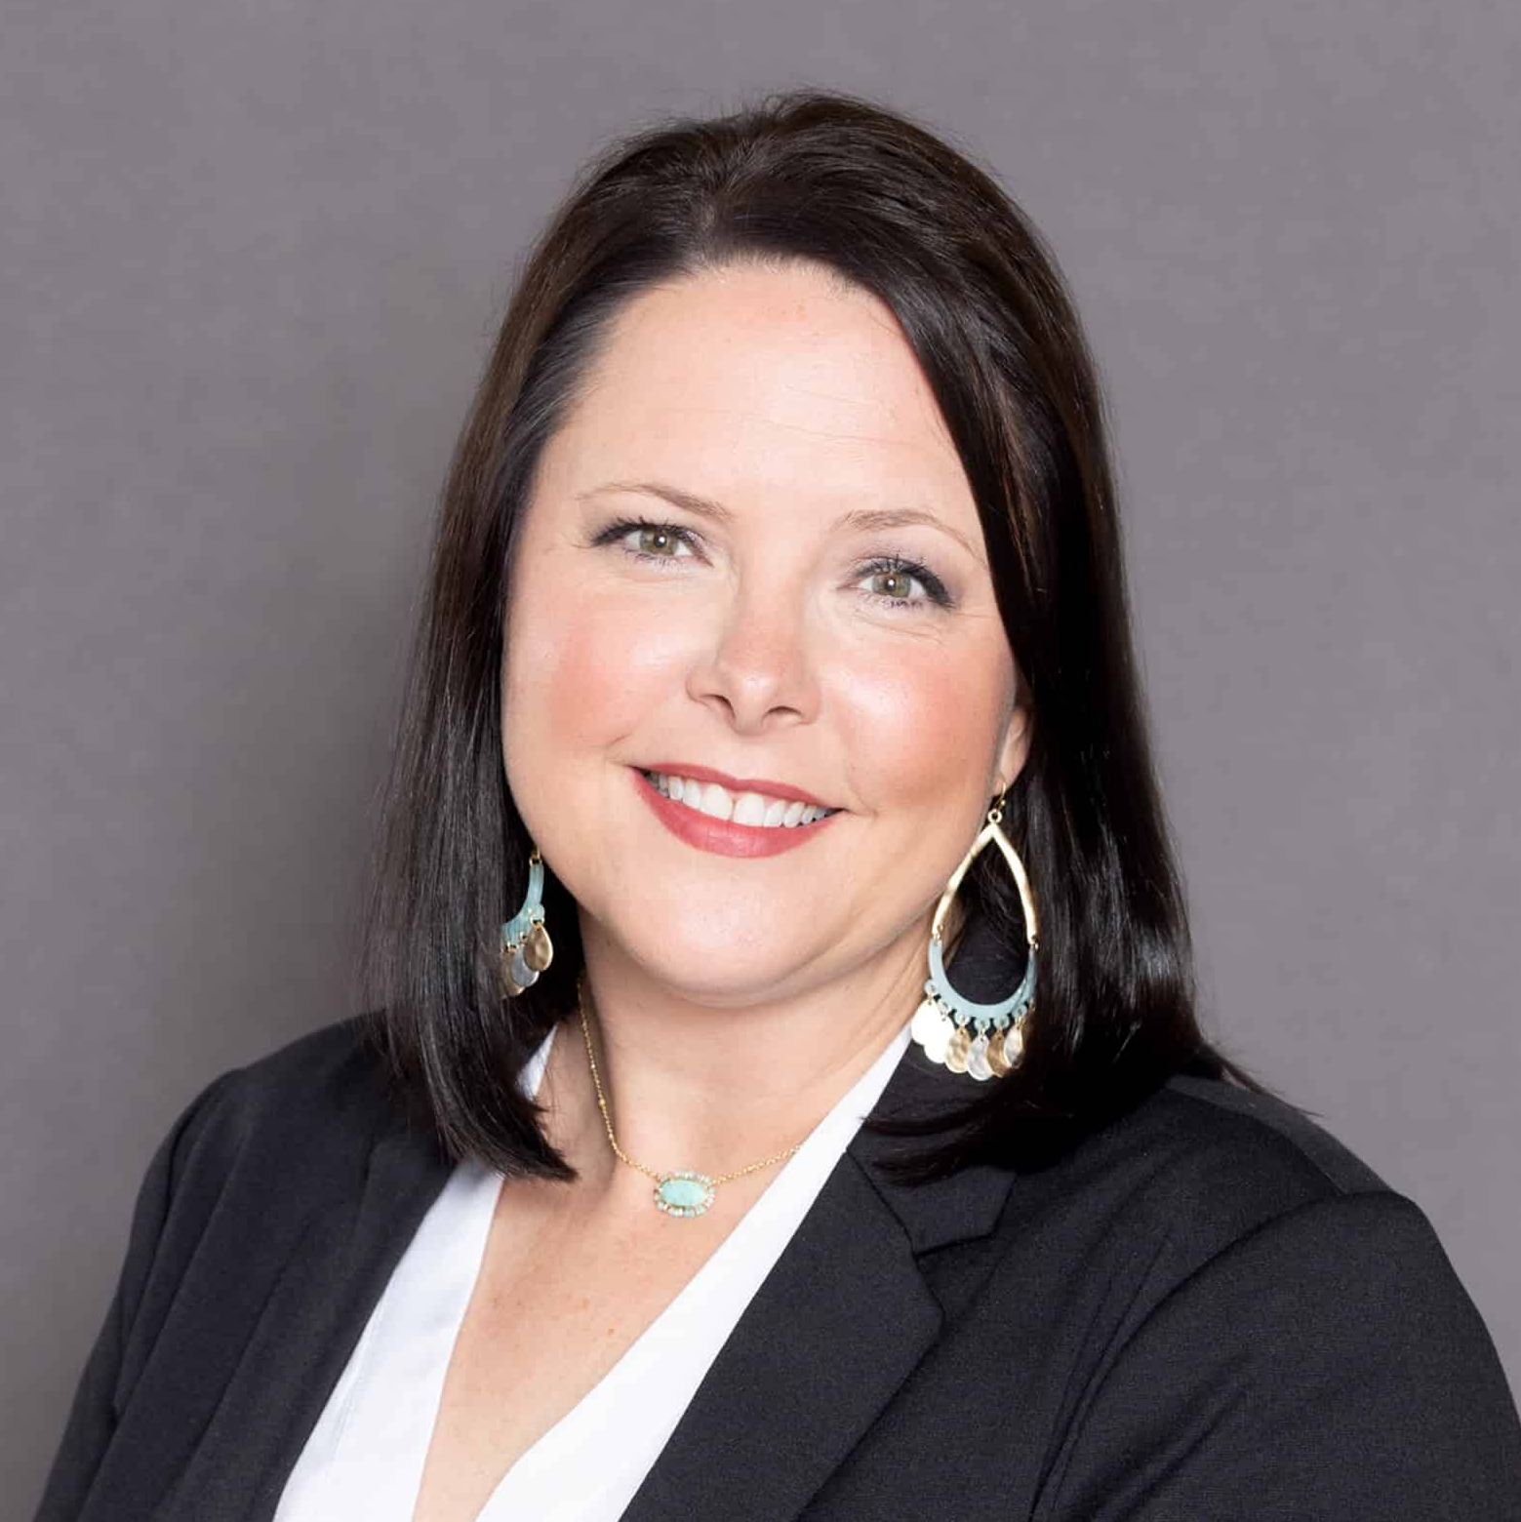
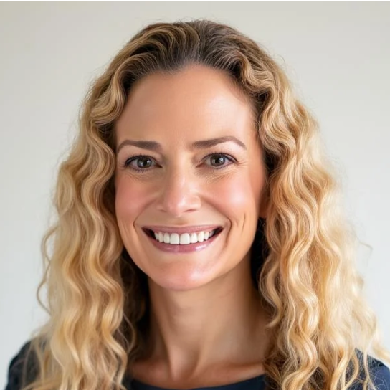
Tyler Christiansen
Christi Weinstein
Michelle Moriello
CEO, Funnel
COO, BH
VP, Marketing
Windsor Communities
#aimconf
Notes:
This slide: Tyler intros panel
Up next: Session openers
Can you share your name, title, ownership structure and how you see AI aiding your teams both in centralized and onsite workflows?
What feels most different to you right now about this moment in AI compared with the earlier waves of digital transformation our industry has already lived through?
When you think about the renter journey over the next few years, where do you believe this shift will show up first in a way that is real and meaningful for operators?

Slide 3
Tyler Christiansen
Christi Weinstein
Michelle Moriello
CEO, Funnel
COO, BH
VP, Marketing
Windsor Communities
#aimconf
Notes:
This slide: Session openers
Can you share your name, title, ownership structure and how you see AI aiding your teams both in centralized and onsite workflows?
What feels most different to you right now about this moment in AI compared with the earlier waves of digital transformation our industry has already lived through?
When you think about the renter journey over the next few years, where do you believe this shift will show up first in a way that is real and meaningful for operators?
Up Next: Michelle Moriello, VP, Marketing, Windsor Communities
Windsor took a different approach with a centralized website where prospects can explore your full portfolio in one place, almost like your own ILS. What did that work teach you about what a modern digital front door now needs to do? What is your team doing to take action to make sure your website not only extends into the LLMs but provides a branded experience today?
Slide: #1 Ranked Property Management Company for Resident Satisfaction by Grace Hill Excellence Awards for the fifth consecutive year

Slide 4

LLM AS THE NEW OS
New front door, same great service
#1
Ranked Property Management Company for Resident Satisfaction by Grace Hill Excellence Awards for the fifth consecutive year
#aimconf
Notes:
This slide: Michelle Moriello, VP, Marketing, Windsor Communities
Windsor took a different approach with a centralized website where prospects can explore your full portfolio in one place, almost like your own ILS. What did that work teach you about what a modern digital front door now needs to do? What is your team doing to take action to make sure your website not only extends into the LLMs but provides a branded experience today?
Slide: #1 Ranked Property Management Company for Resident Satisfaction by Grace Hill Excellence Awards for the fifth consecutive year
Up next: Christi Weinstein, COO, BH
Christi, BH, completed the world’s first ChatGPT rent payment. What does this first signal mean for how we are going to rethink and rebuild what the customer journey looks like to include LLMs and AI assistants deeply in property management operations?
Slide: GPT rent payment

Slide 5

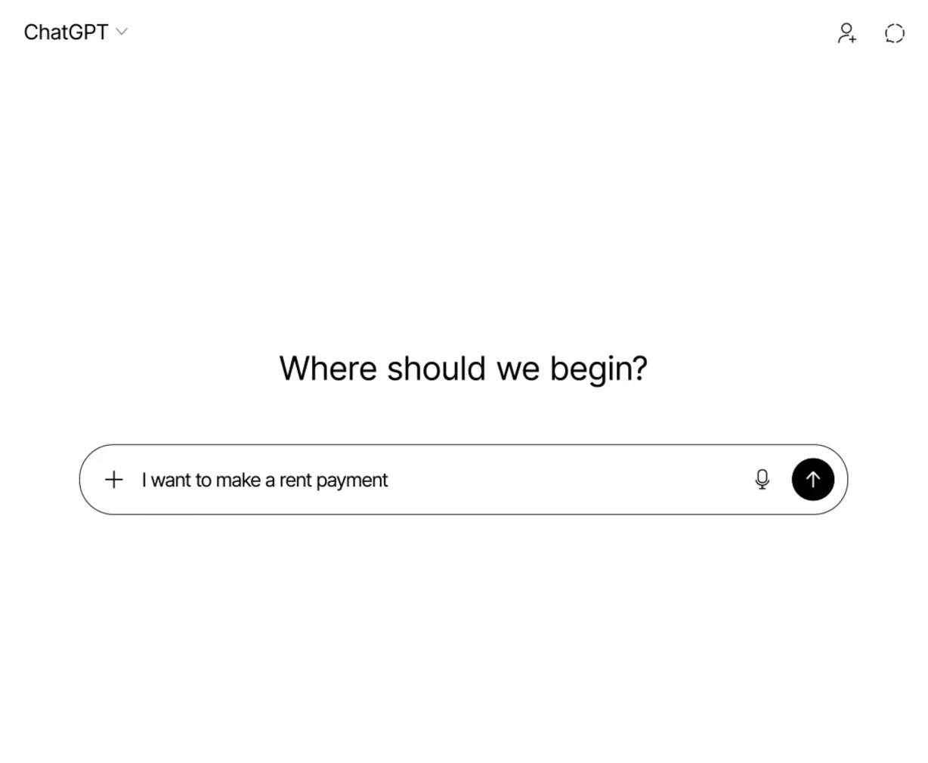
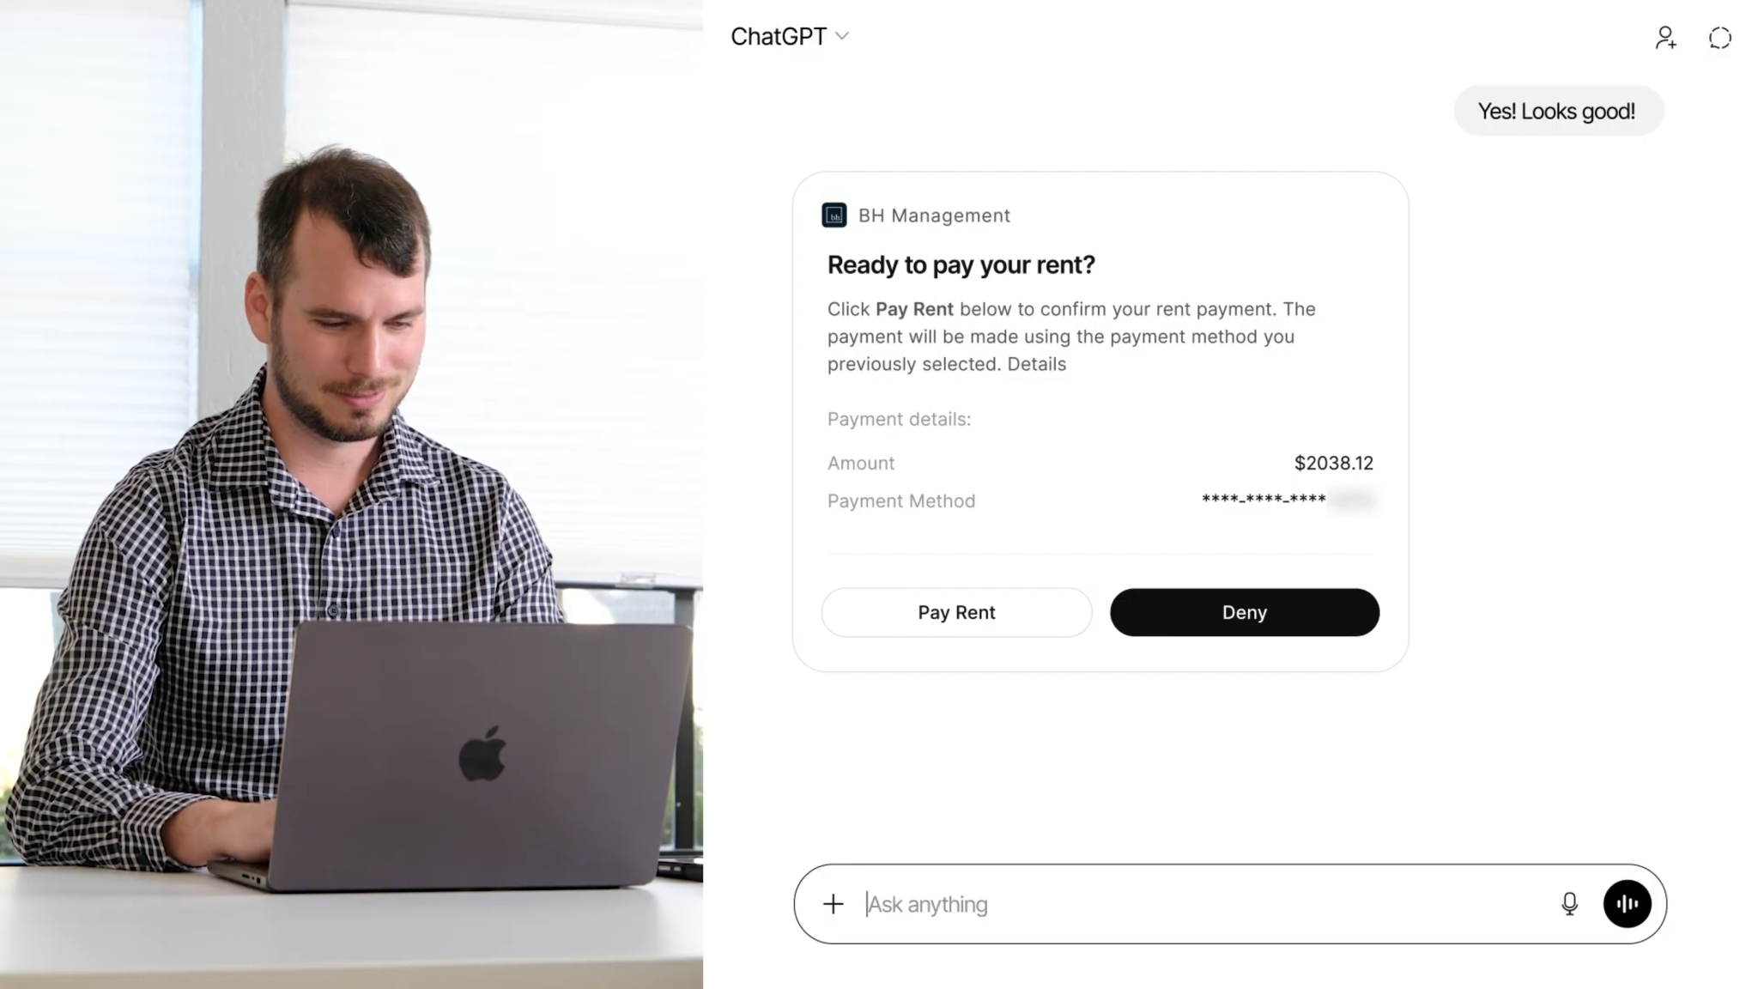
LLM AS THE NEW OS
World’s 1st rent payment in
WELCOME TO AIM
Into Our Future
#aimconf
Notes:
This slide: Christi Weinstein, COO, BH
Christi, BH, completed the world’s first ChatGPT rent payment. What does this first signal mean for how we are going to rethink and rebuild what the customer journey looks like to include LLMs and AI assistants deeply in property management operations?
Slide: GPT rent payment
Up next: Michelle Moriello, VP, Marketing, Windsor Communities
Michelle, marketers have historically been asked to focus on acquisition. As technology makes it easier to remove friction across the customer journey, where do you see the biggest opportunity to create more value through retention and loyalty, not just lead generation?
Slide - no data

Slide 6
Tyler Christiansen
Christi Weinstein
Michelle Moriello
CEO, Funnel
COO, BH
VP, Marketing
Windsor Communities
#aimconf
Notes:
This slide: Michelle Moriello, VP, Marketing, Windsor Communities
Michelle, marketers have historically been asked to focus on acquisition. As technology makes it easier to remove friction across the customer journey, where do you see the biggest opportunity to create more value through retention and loyalty, not just lead generation?
Slide - no data
Up next: Christi Weinstein, COO, BH
Christi, one of the big ideas in this session is that AI is becoming part of the operating system for the customer journey. What feels most important to future-proof now, even for organizations that feel pretty good about their resident experience today?
Slide: ~40% On average, Funnel Voice AI saved ~41 hrs / day. That’s 492 calls / day avoided or handled by the Voice AI instead of an employee.
Slide: 200% increase in Voice AI containment rate YOY

Slide 7

LLM AS THE NEW OS
AI that scales service not strain
Time saved (per day)
~40%
On average, Funnel Voice AI saved ~41 hrs / day. That’s 492 calls / day avoided or handled by the Voice AI instead of an employee.
#aimconf
Notes:
This slide: Christi Weinstein, COO, BH Slide 1 of 2
Christi, one of the big ideas in this session is that AI is becoming part of the operating system for the customer journey. What feels most important to future-proof now, even for organizations that feel pretty good about their resident experience today?
Slide: ~40% On average, Funnel Voice AI saved ~41 hrs / day. That’s 492 calls / day avoided or handled by the Voice AI instead of an employee.
Slide: 200% increase in Voice AI containment rate YOY
Up next:Christi Weinstein, COO, BH Slide 2 of 2
Slide: 200% increase in Voice AI containment rate YOY

Slide 8
LLM AS THE NEW OS
Leaning into AI advancement
+200%
WELCOME TO AIM
Voice AI containment rate YOY
Into Our Future
#aimconf
Notes:
This slide: Christi Weinstein, COO, BH Slide 2 of 2
Slide: 200% increase in Voice AI containment rate YOY
Up next: Michelle Moriello, VP, Marketing, Windsor Communities
As leasing has become more regulated and more complex, how has that changed the role marketing plays, and the partnership with ops, in designing a digital experience that feels clearer, simpler, and more trustworthy for renters?
Slide: 50% faster application processing (apply to approve)

Slide 9
LLM AS THE NEW OS
Trust is part of the digital journey
-50%
faster application processing (apply to approve)
WELCOME TO AIM
Into Our Future
#aimconf
Notes:
This slide: Michelle Moriello, VP, Marketing, Windsor Communities
As leasing has become more regulated and more complex, how has that changed the role marketing plays, and the partnership with ops, in designing a digital experience that feels clearer, simpler, and more trustworthy for renters?
Slide: 50% faster application processing (apply to approve)
Up next: Christi Weinstein, COO, BH
Christi, AI can make renter and resident-facing workflows faster, easier, and more helpful, but it also raises the stakes around compliance, trust, and fraud, especially during the application process. How do you think about bringing AI deeper into those workflows responsibly, while still protecting the business and making sure the experience feels good for real renters?
Slide: 70% faster application decisions
96% positive user ratings about their online leasing experience

Slide 10
LLM AS THE NEW OS
Protects the business and experience
Application decisions speed
Online leasing experience
+70%
96%
Positive user ratings
with Funnel Online Leasing
#aimconf
Notes:
This slide: Christi Weinstein, COO, BH
Christi, AI can make renter and resident-facing workflows faster, easier, and more helpful, but it also raises the stakes around compliance, trust, and fraud, especially during the application process. How do you think about bringing AI deeper into those workflows responsibly, while still protecting the business and making sure the experience feels good for real renters?
Slide: 70% faster application decisions
96% positive user ratings about their online leasing experience
Up next: Michelle Moriello, VP, Marketing, Windsor Communities
What’s the balance between optionality and control? How do you meet renters where they want to engage without giving up brand voice, accuracy, or consistency?
Slide: no data

Slide 11
Tyler Christiansen
Christi Weinstein
Michelle Moriello
CEO, Funnel
COO, BH
VP, Marketing
Windsor Communities
#aimconf
Notes:
This slide: Michelle Moriello, VP, Marketing, Windsor Communities
What’s the balance between optionality and control? How do you meet renters where they want to engage without giving up brand voice, accuracy, or consistency?
Slide: no data
Up next: Christi Weinstein, COO, BH
Christi, the resident journey is still fragmented in a lot of organizations, with too many logins, tools, and handoffs. Knowing that we’ve made these advancements in tour bookings, what kind of work do we need to prepare for resident workflows so that those are prepared for agentic experiences?
Slide: 1,150% increase in AI tour bookings, 109% increase in share of tours booked through a link sent via an automated message

Slide 12
LLM AS THE NEW OS
Giving teams a hand
AI tour bookings
Share of tours booked through a link sent via an automated message
+1,150%
+109%
#aimconf
Notes:
This slide: Christi Weinstein, COO, BH
Christi, the resident journey is still fragmented in a lot of organizations, with too many logins, tools, and handoffs. Knowing that we’ve made these advancements in tour bookings, what kind of work do we need to prepare for resident workflows so that those are prepared for agentic experiences?
Slide: 1,150% increase in AI tour bookings, 109% increase in share of tours booked through a link sent via an automated message
Up next: Michelle Moriello, VP, Marketing, Windsor Communities
Michelle, can you talk about what it would look like to create an experience where a resident feels known across the full journey, not just during leasing, but later when their needs change, their renewal comes up, or they may want to stay within the brand in a different community?
Slide: no data

Slide 13
Tyler Christiansen
Christi Weinstein
Michelle Moriello
CEO, Funnel
COO, BH
VP, Marketing
Windsor Communities
#aimconf
Notes:
This slide: Michelle Moriello, VP, Marketing, Windsor Communities
Michelle, can you talk about what it would look like to create an experience where a resident feels known across the full journey, not just during leasing, but later when their needs change, their renewal comes up, or they may want to stay within the brand in a different community?
Slide: no data
Up next: Christi Weinstein, COO, BH
Christi, once a resident has moved in, where do you see the greatest opportunity for AI to reduce friction in everyday operations, whether that is payments, communication, or ongoing engagement?
Slide: no data

Slide 14
Tyler Christiansen
Christi Weinstein
Michelle Moriello
CEO, Funnel
COO, BH
VP, Marketing
Windsor Communities
#aimconf
Notes:
This slide: Christi Weinstein, COO, BH
Christi, once a resident has moved in, where do you see the greatest opportunity for AI to reduce friction in everyday operations, whether that is payments, communication, or ongoing engagement?
Slide: no data
Up next: Michelle Moriello, VP, Marketing, Windsor Communities
Let’s move further down the resident journey. One of the real risks with centralized teams is that relevant context gets dropped during handoffs, which damages the brand experience. Tools like AI call summaries are helping close that gap. Can you talk about how your team is thinking about knowledge transfer and the resident experience with your brand?
Slide: no data

Slide 15
Tyler Christiansen
Christi Weinstein
Michelle Moriello
CEO, Funnel
COO, BH
VP, Marketing
Windsor Communities
#aimconf
Notes:
This slide: Michelle Moriello, VP, Marketing, Windsor Communities
Let’s move further down the resident journey. One of the real risks with centralized teams is that relevant context gets dropped during handoffs, which damages the brand experience. Tools like AI call summaries are helping close that gap. Can you talk about how your team is thinking about knowledge transfer and the resident experience with your brand?
Slide: no data
Up next: Questions for everyone
If we need more toward the end:
You’ve both navigated big change under real pressure — from regulation to new tech. What’s one piece of advice you’d give to operators in this room about embracing change instead of resisting it?
What is one move operators should make now to better prepare for a future where AI plays a much bigger role in the customer and resident experience?
As you look ahead, what are you most optimistic about if the industry gets this right?
Slide: no data
Closing slide

Slide 16
Tyler Christiansen
Christi Weinstein
Michelle Moriello
CEO, Funnel
COO, BH
VP, Marketing
Windsor Communities
#aimconf
Notes:
This slide: Questions for everyone if we need more.
You’ve both navigated big change under real pressure — from regulation to new tech. What’s one piece of advice you’d give to operators in this room about embracing change instead of resisting it?
What is one move operators should make now to better prepare for a future where AI plays a much bigger role in the customer and resident experience?
As you look ahead, what are you most optimistic about if the industry gets this right?
Slide: no data
Up next: Closing slide

Slide 17
Multifamily is at the cutting edge of AI
WELCOME TO AIM
Into Our Future
The people in this room are the ones leading the revolution
#aimconf
#aimconf
Notes:
This slide: This is the end!

Slide 18
Thank you!
WELCOME TO AIM
Into Our Future
APARTMENT INNOVATION &
MARKETING CONFERENCE
#aimconf

