Slide 1

Bringing Multifamily’s Blind Spots Into Focus:
Understanding the Full Journey Behind Every Lease
AIM Conference · MAY 5, 2026

Slide 2
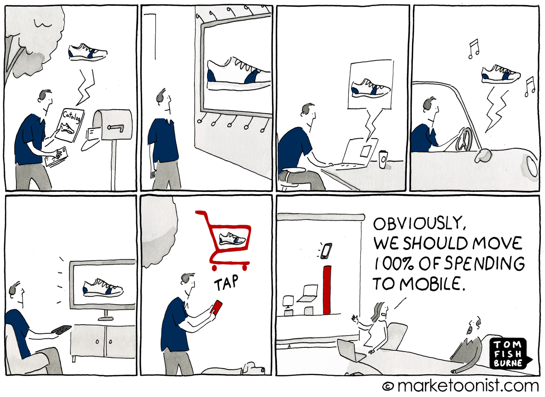
Does This Look Familiar?

Slide 3





Full-Funnel Digital Marketing
+
MarTech Platform
9,700+ Properties
2M+
Leads Generated
7X
Inc. 5000 List

Slide 4



Same Budget, Different Outcomes
Market: Los Angeles, CA
Size: 300 Units
$10,000/mo Advertising
84% Occupancy
96% Occupancy
Property A
Property B

Slide 5


The Reality of Today’s Market
Rising Costs &
Tighter Budgets
Longer, More Complex Renter Journeys
Navigating Marketing
in the AI Era
Fierce Competition
from New Supply
High Pressure to
Prove ROI

Slide 6

What’s the Difference That Makes the Difference?

Slide 7
The Gap Between Reality & Your Reporting
BLIND SPOT #1
BLIND SPOT #2
BLIND SPOT #3
The Invisible Journey
Tracking online renter behavior is a challenge.
Performance Measurement is Outdated
Last-touch models credit the final click and ignore
the full journey.
Every Platform
Serves Itself
Ad platforms focus on
their vanity metrics and optimize for their results
not yours.

Slide 8
We traded conventional performance tracking for a more holistic reporting model.

Slide 9
And Realized Just How Many Leads Were Being Credited to the Wrong Channels
CLX Paid Search
UA Model
Organic Search
Last-Touch
CLX Social
Over Credited
Under Credited
Referral
Direct
CLX Display
CLX YouTube
CLX PMax
CLX GBP Accel.
0
5
10
15
20
25
30
35

Slide 10

Marketing doesn't happen in a vacuum.
What’s shaping campaign performance:
Starting Rent (1BR & 2BR)
Comp Avg. Occupancy
Rent Premium (1BR & 2BR)
Occupancy
Comp Exposure (30 day)
Comp Concession %

Slide 11
We closed the gaps in our reporting….
and completely changed the way we approached budget allocations.

Slide 12
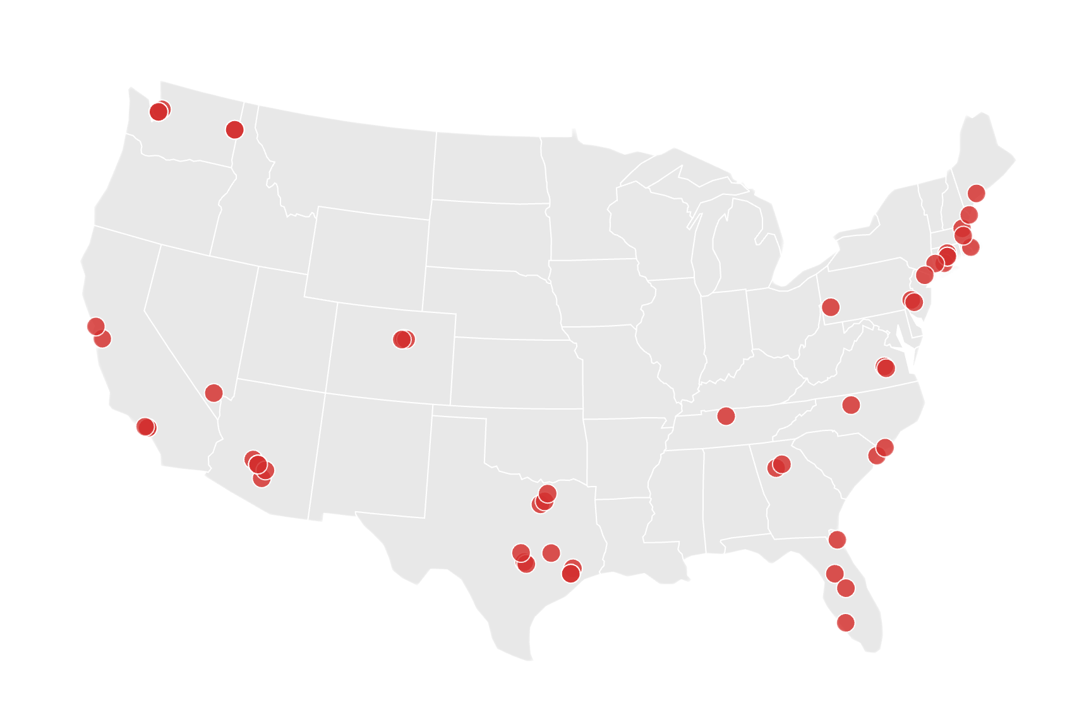
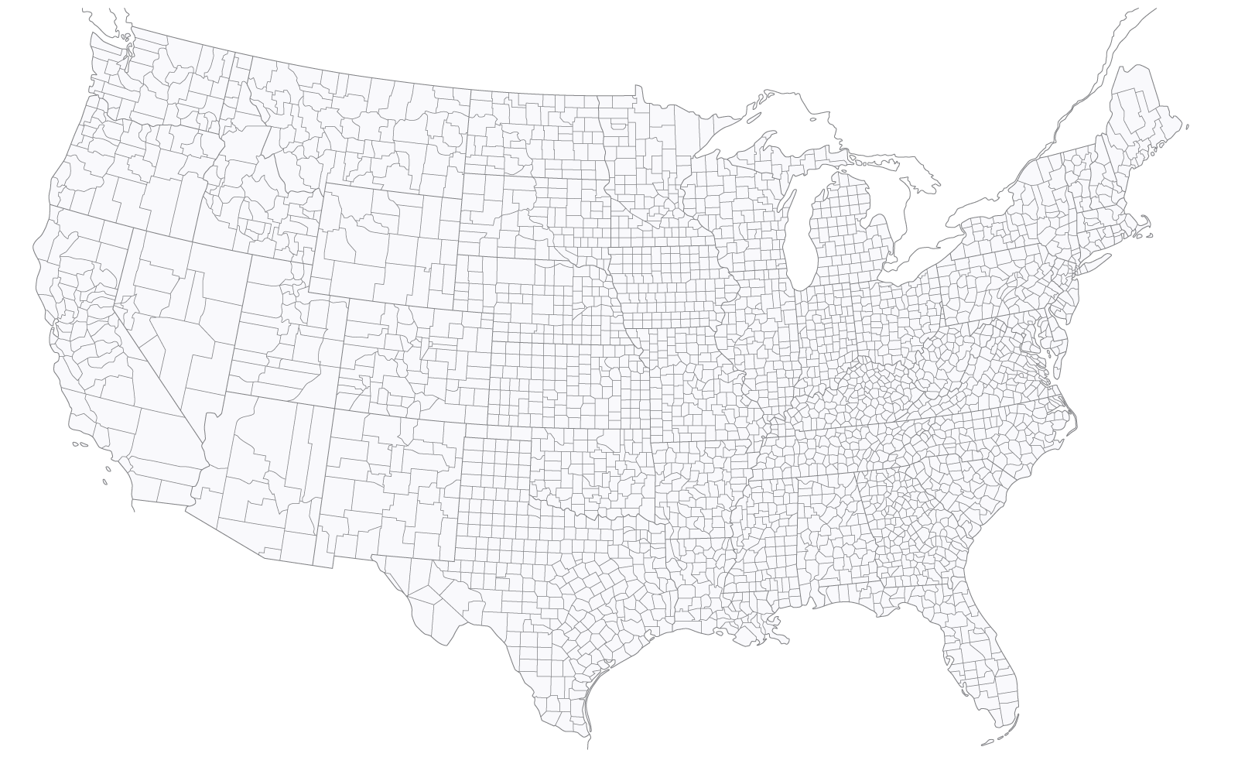
We Tested a Smarter Way to Spend
3-month pilot
53 properties
Daily cross-channel spend optimizations
The KPI: Conversions Per Dollar

Slide 13
What We Uncovered
Three insights that made the difference.

Slide 14

INSIGHT #1
Last-click is rewarding the wrong channels.
Upper-funnel channels have an even bigger influence on overall conversions than we realized.
Top Conversion Paths
Top Conversion Paths
Top Conversion Paths
Top Conversion Paths
CLX Display Organic Search
CLX Display Organic Search
CLX Display Organic Search
CLX Display Organic Search
629
629
629
629
CLX YouTube CLX Pmax
CLX YouTube CLX Pmax
CLX YouTube CLX Pmax
CLX YouTube CLX Pmax
338
338
338
338
281
281
281
CLX Display CLX Paid Search Organic Search
281
CLX Display CLX Paid Search Organic Search
CLX Display CLX Paid Search Organic Search
CLX Display CLX Paid Search Organic Search
203
203
203
Referral CLX Paid Search
203
Referral CLX Paid Search
Referral CLX Paid Search
Referral CLX Paid Search
CLX Social Direct
CLX Social Direct
CLX Social Direct
CLX Social Direct
177
177
177
177
CLX YouTube CLX Paid Search
CLX YouTube CLX Paid Search
CLX YouTube CLX Paid Search
CLX YouTube CLX Paid Search
166
166
166
166
CLX Paid Search CLX Pmax Direct
CLX Paid Search CLX Pmax Direct
CLX Paid Search CLX Pmax Direct
CLX Paid Search CLX Pmax Direct
95
95
95
95
82
82
82
CLX YouTube Referral
82
CLX YouTube Referral
CLX YouTube Referral
CLX YouTube Referral
CLX Social CLX Paid Search Direct
CLX Social CLX Paid Search Direct
CLX Social CLX Paid Search Direct
CLX Social CLX Paid Search Direct
71
71
71
71

Slide 15

INSIGHT #2
There is no right channel mix. Every property wins its own way.
53
5,883
111
unique daily
formulas
optimized budget decisions
across the pilot
budget decisions on average per property
We saw a 26% increase in conversions per dollar when we implemented daily micro movements across channels.

Slide 16
INSIGHT #3
What looks like a marketing problem is often a market problem.
Above-market rents. Heavy competitor concessions. Oversupplied submarket.
Smart budget optimization couldn’t overcome a pricing or positioning problem on its own.
Marketing alone = Diminished returns

Slide 17


Properties with affordable rents, healthy occupancy, and soft competitor exposure realized a lift in CPD.
Marketing + Market = Multiplied

Slide 18

Properties with above-market rents facing heavy competitor concessions were less likely to see a lift in CPD.
Marketing alone = Diminished returns

Slide 19

CASE STUDY:
Same Spend, But Smarter
THE
RESULTS
36%
Website
conversions
THE SITUATION
A lease-up at 13% occupancy in Phoenix.
THE BLIND SPOT
Social and Display strategies were undercredited by Google Analytics.
THE MOVE
No new budget. Just reallocation.
Display Awareness
Display Retargeting
Instagram Stories
Meta Retargeting
300%
Post-view
website visits
323%
Returning visitor
conversions

Slide 20
The Takeaway
Every marketer in this room has blind spots right now.
With everything that’s changed in the past 18 months, you can’t trust old assumptions.
And the market isn’t slowing down.

Slide 21



Over to the operators.
I've shown you our blind spots. Now let's hear from operators who found their own.
Kristin Dixon
Nicole Caiazza
Martin Stein
Paralign Marketing
Jones Street Residential
Conversion Logix
Founder and CEO
Senior Vice President, Marketing
Chief Data Officer

Slide 22
Three Questions to Uncover Your Blind Spots
#1
What's a metric you’ve relied on that you haven't audited in 18 months?
#2
Where in your portfolio is the market doing the work you're crediting to marketing or vice versa?
#3
What changes would you make if you could see the full journey, not just the last click?

Slide 23

Want the full case study?
The downloadable case study includes:
The 53-property pilot methodology in full
Channel-by-channel attribution findings
How market factors shaped results
The budget-threshold finding we didn't show on stage
Plus, a checklist to take action now to uncover your blind spots.
SCAN TO DOWNLOAD

