Slide 1
The “Last Impression” Paradox:
Turning Move-Out Friction
Into a Hospitality Superpower

Slide 2


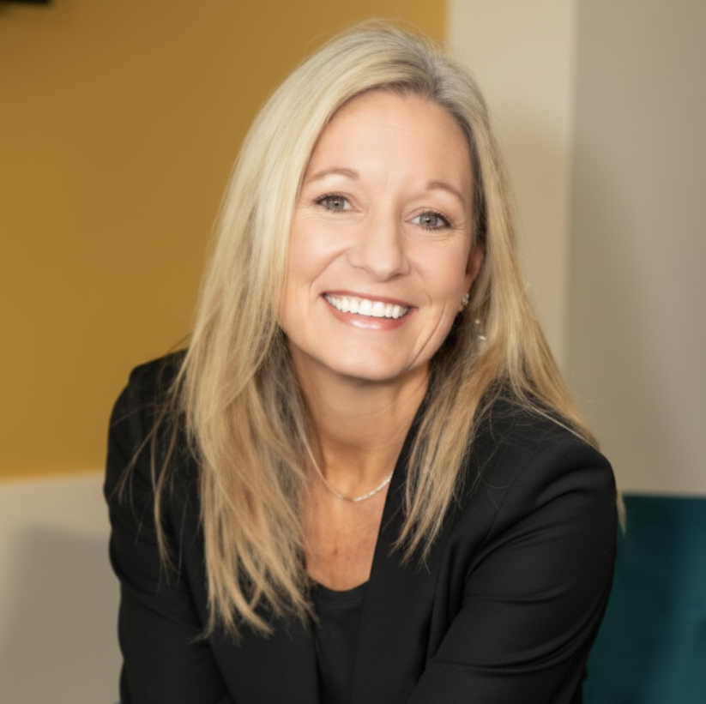
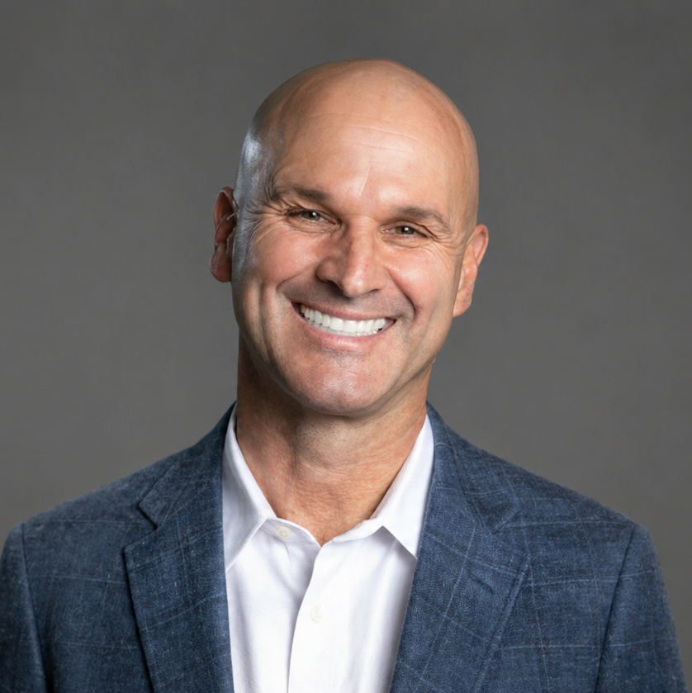

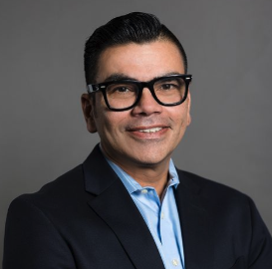
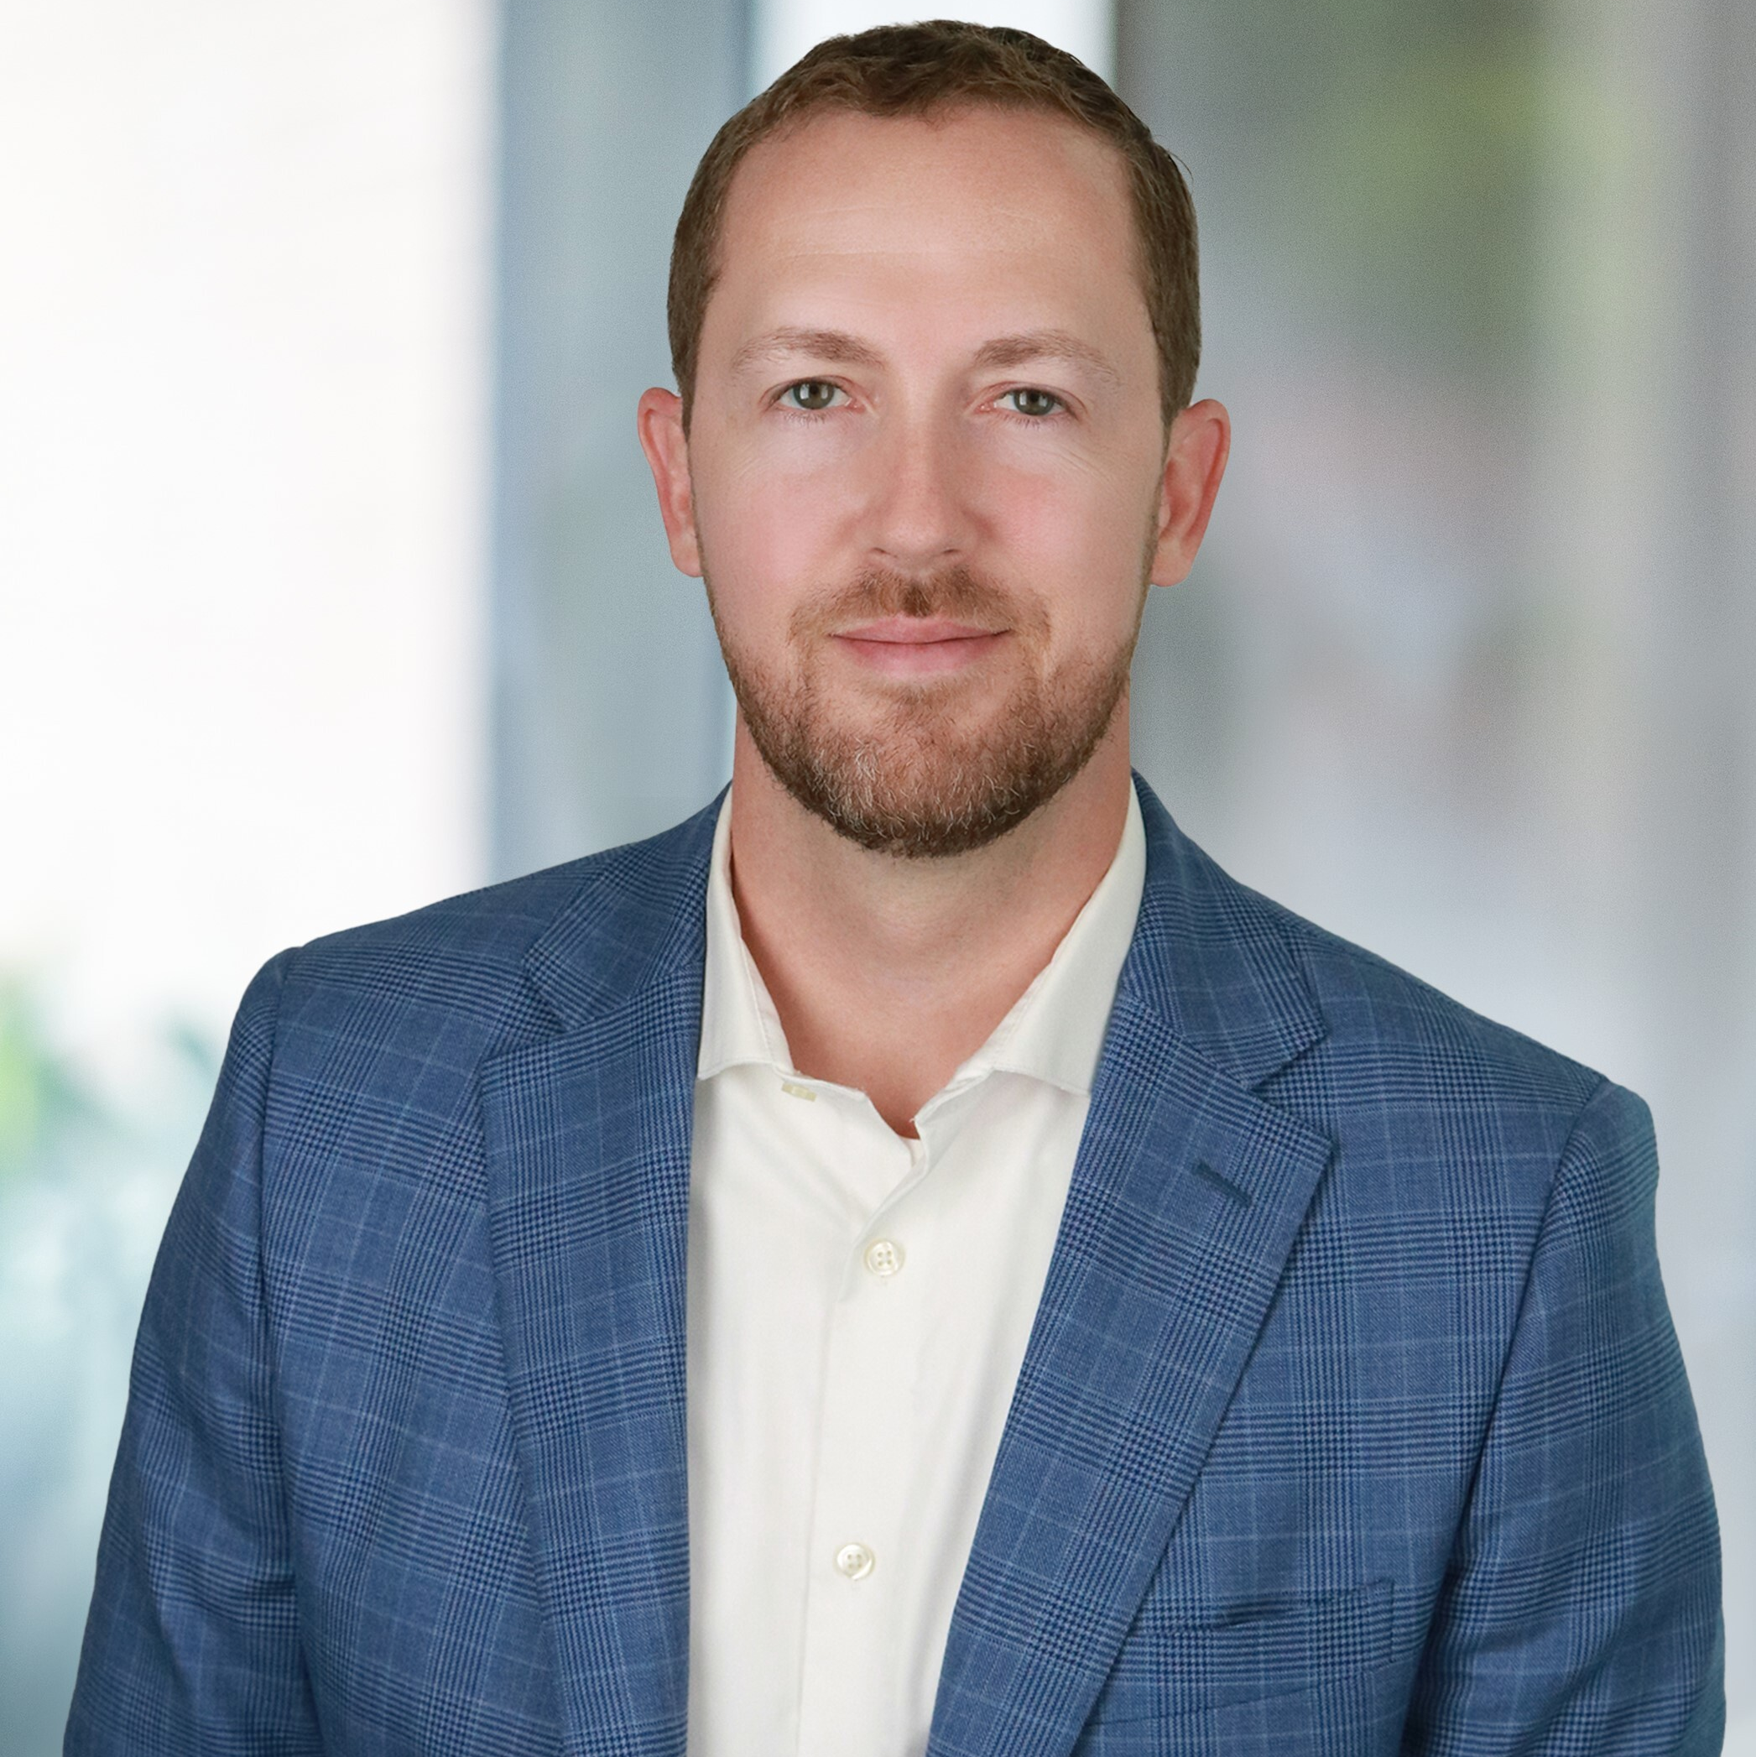
Kelly McCunniff
Senior Director, Real Estate
Greystar
Christie Bennett
Vice President, Systems Operations & Performance
Willow Bridge
Jason Gheradini
Senior Vice President, Information Technology
SRG Residential
David Walther
Chief Revenue Officer
Asset Living
Moderator
Stacy Stemen
Senior Vice President, Strategic Relations
PASSCO
Meet Your Experts

Slide 3
The "Last Impression" Paradox: Turning Move-Out Friction into a Hospitality Superpower

Slide 4



The last 5% of the resident journey drives 100% of the perception.
The "Last Impression" Paradox: Turning Move-Out Friction into a Hospitality Superpower
Why does hospitality break down at move out?
Increasing new regulation risks
Non-refundable deposits pros & cons
Driving a great move-out experience

Slide 5


Proudly Sponsored By

