Slide 1
🧠 🎣
*Your* Losing Attention: How to Use 'Safe Bait™' Marketing on Social Media to Get Attention & Leases
A science-backed playbook for multifamily teams to turn social attention into property tours
Notes:
Ashley
I have to admit.
It feels wrong and icky.
I’m embarrassed talking about principles that ignite rage bait. Use it to manipulate.
Today we’re going to offer a different approach.
Entirely new concept that’s never had the language attributed to it until today but has been seen on social media for years.
We don’t have all the answers but we’ve done extensive research that we want to present you with here today.
The goal today is to make you aware of safe bait, spot it and potentially use it at your properties to capture attention.
Studied it hard and led us to believe that with right intentions, creativity, and execution, this new type of bait isn’t icky. It’s tasteful and strategic.
Because here’s the thing: As executives and marketers in this room…
Tasked to think outside the box.
Skepticism. Stacey Feeney.
Now who am I?

Slide 2

# Who Are We?
👩‍💼
👨‍💼
👩‍🎨
Ashley McGovern
Gunnar Blakeway-Walen
Stacey Feeney
Director of Marketing
Marketing Manager
Founder & Chief
Creative Director
Company: Nurture Boss
Role: Content Creator & Behaviorial Psychologist Enthusiast
Company: FLATS
Role: Operator, Social Media Brand Manager, Content Creator
Company: Zipcode Creative
Role: Brand Strategist
& Brand Police
Notes:
Ashley:
My name is Ashley with Nurture Boss.
Not familiar with NB, we’re an AI property management company specifically for multifamily.
We provide true conversation AI that facilitates…
One of the reasons I love working at Nurture Boss is because of our philosophy…
We are human-led first and AI powered second.
That’s fitting for today’s presentation because humans are at the center of this strategy. Your creativity, judgement and consistency are needed…
Now throughout my career, I’ve build a small business in being a TikTok content creator where I’ve tested…
I’m joined by another TikTok creator…
Im Gunnar:
- Also Chronically online
- At FLATS, I am a marketing team of one
- manage Brnd & STRGY 4 EVRY single property in our portfolio.
-My Focus Old Social strategy of Vase on marble counter Is dead
-If ur not grabbing attention in 3 secs ur posting 4 bots
-Which is ok if thats ur strategy, but
-If your looking for a new strgy to breath life into your social
-Were here to show you how to bring that CREATOR energy to your posts to INCREASE YOUR FOLLOWING and DRIVE LEADS
-While staying on Brand, Speaking of brand heres brand expert Stacy Feeny
Stacey Speaker Notes:
As someone who builds brands,I know how important…to define who you are as co/apts
Right now, matters more than ever - MF brands struggling to stand out in their markets = every property looks and sounds the same
Identical amenity packages (resort-style pool)
Same in-unit features (wood-look flooring)
Overused term: Luxury = “if everything…” (stacey quote)
Sea of sameness > brand may be your only differentiation
I’m Stacey Feeney - Founder at ZC
Creative agency exclusive to multifamily + brand dev is our focus

Slide 3

# What We Aren’t Talking About Today
Reminders that social media matters
The importance of video content (we assume you're in)
The importance of AI (this strategy requires humans)
Notes:
Ashley:
You’re here for a reason.
We’re going to assume you know about the importance of organic and paid social media strategies and video content.
In addition, like I said earlier, this is not an AI session, this is a human session.
Quick plug: Jacob Carter and Grady Newman

Slide 4
# What We Will Be Talking About Today
How to spot rage bait vs. Safe Bait™
The Safe Bait™ framework and how to capture attention with these tactics for multifamily (and why it works, scientifically)
Brand discernment (do's and don'ts)
Leadership enablement: How to empower and protect your teams
Notes:
Gunnar:
-How to spot attention grabbing technies on social media
-Including Rage bait and safe bait
-The safe bate framework, and the scientif reons on how it can capture attention
-Brand Discernment checklist to help you decide if a posts works for your brand
-leadership enablement step to help empower teams and protect them form risks
Ashley:
We’re going to teach you how to grab attention tastefully, intentionally and strategically and use our concept for the greater good of your properties.
You all have great intentions. You work for your PMC because you believe in the product you’re marketing and selling.
But the creativity and execution is the hard part. Luckily we got you.

Slide 5

⏸
🤔
Pause: Did You Notice?
Did we do something odd at the beginning of
this presentation?
💡
🔍
Call it out! That mild surprise is by design.
Notes:
Ashley:
Did we do something odd?
We wanted to demonstrate the core concept of capturing your attention using safe bait.
Before I discuss the pschology behind it, let’s align on terminology we’ll use throughout the presentation.

Slide 6





# Vocabulary
📱
UGC
⚔️
Engagement/Friction Farming
User-generated content authentically created by residents or local creators, not the corporate brand.
Engineering engaging content Artificially stimulate comments and algorithmic lift.
Levels of Engagement
🪤
Click Bait
🤬
Rage Bait
Overpromising or misleading hooks that leave viewers annoyed and disappointed after clicking.
The Opportunity
Zone
Intentionally provocative content designed to trigger outrage, anger, and algorithmic pile-ons.
Notes:
Gunnar:-We need to align on vocabulary—shifting focus from 'impressions' and 'reach' to creator terms.
User Generated Content (UGC):
Content created by consumersvs brands, prioritizing authentic over polished.
Multifamily must move from 'perfect hero content' to raw, real-feeling videos.
Engagement/Friction Farming:
Intentional posting of stimulating content.
Goal: Lure interaction to create algorithmic lifts.
Largest Engagement Farming Tactics:
Click Bait: Over-promising hooks leading to a hollow payoff. YOu wont believe whats next! (a 'bridge to nowhere'). Online renters are too savvy for this.
Rage Bait: The 'evil twin' of clickbait.

Slide 7
🔥
2025 Oxford Word of the Year
Rage Bait
Rage bait: Online content deliberately designed to elicit anger or outrage by being frustrating, provocative, or offensive, typically posted in order to increase traffic to or engagement with a particular web page or social media content
Source: Oxford dictionary
Notes:
Gunnar: Lets take a short dive into rage bait. to show you just how much the landscape has shifted,
We dont need to look in marketing journal or social media blog.
Rage Bait was the Oxford Word of the Year in 2025.
It is a global phenomenon, no longer niche.
Defined as Online content deliberately designed to elicit anger or outrage by being frustrating, provocative, or offensive, typically posted in order to increase traffic to or engagement with a particular web page or social media content
Purpose: increase traffic and engagement.
Who knew pissing people off could sound so offical

Slide 8

# Rage Bait Examples | Do Not Do!
Unrealistic Lifestyle Content
Wasteful Content
Deliberate Misinformation
Displaying impossibly perfect, antiquated, or privileged lifestyles designed to spark resentment or debate about authenticity.
Purposely inefficient, chaotic, or wasteful cooking and DIY videos intended to frustrate viewers
Presenting false information, creating strawmen, particularly regarding politics or social issues.
⚠️
These drive views at the cost of trust and brand integrity.
Notes:
Gunnar:- Three Common Rage Bait Tactics (Do not suggest using):
Unrealistic Lifestyles: Performative perfection that sparks resentment and debates, leading to comments from annoyance.
Wasteful Content: Purposely inefficient videos that trigger the audience's "need to correct" (digital hate-watching).
Deliberate Misinformation: False claims used to ignite outrage, forcing division and comment engagement to correct the record.
Bottom Line: These tactics drive massive views but ultimately cost customer trust and respect.
The Multifamily Challenge: As a solo marketing team, we cannot afford hollow clicks or a PR disaster.
The Opportunity Zone: We need a solution that harnesses the raw energy of UGC and the psychological engine of Friction Farming to capture attention without destroying the brand.
Our Hypothesis: Is there a way to use these attention tactics while keeping customer respect and trust in the forefront?

Slide 9

# The Opportunity: Safe Bait™
Safe Bait™ is a proprietary engagement framework (sitting in between click bait and rage bait) using controlled, low-stakes tension and behavioral psychology to drive interaction while protecting brand trust.
“
Spark engagement with curiosity, humor, and interest, not real conflict.
Notes:
Gunnar:
Safe Bait™ is found in the Opportunity Zone.
It's a proprietary engagement framework between clickbait and ragebait.
Uses controlled, low-stakes tension and behavioral psychology.
Goal: Drive interaction while protecting brand trust.
Sparks engagement using curiosity, humor, and interest—avoiding real conflict.
It's the brand-safe sibling of the viral troll and is already being used by some brands.

Slide 10
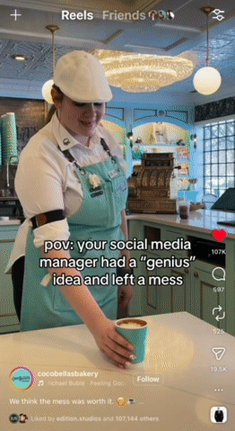
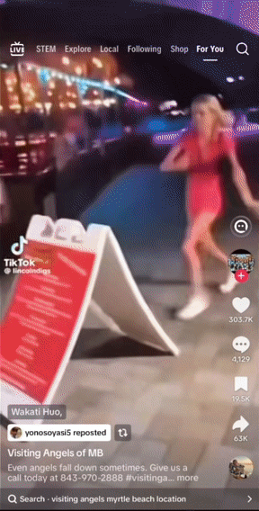
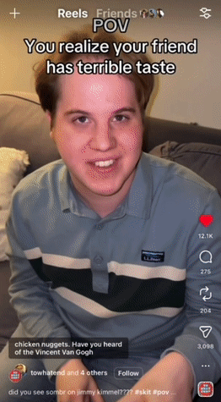
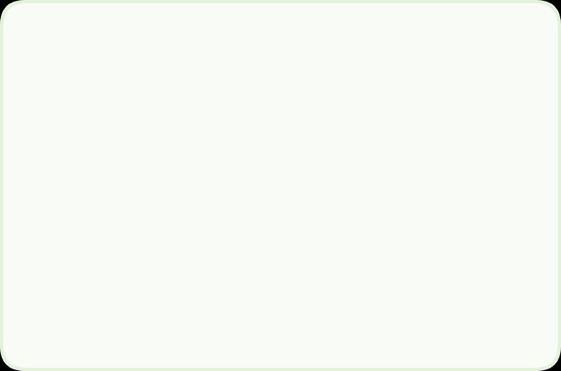

# Safe Bait™ Examples
-Messy but not overly wasteful.
-States a safe opinion about own content
-Starts with someone falling
-Was posted by senior care saying they prevent falls
-Video posts multiple opinions
-The text says one of them is bad without clarifying
Notes:
Gunnar: Lets take these three examples show exactly how we use friction farming tactics without crossing the line into a brand crisis.
Coffee Shop Video: Explain VIDEO “When your marketing MAnager has a genius idea and leaves a mess” Triggers a "Why is that happening?" response with a messy spiral
Ashley Chime In with Q: Wait isn’t that kinda rage bait because earlier you said wasteful content?
clarifies if this was rage bait it would be 5 gal buck of lates also humanizing because it mentions and recognizes the “Mess”
Senior Care Home Jump-cut: Uses a high-energy, humorous hook (a faked fall) to transition into a professional topic on fall prevention, earning attention through irony rather than mockery.
'Worst Opinion' Group Video: Employs Friction Farming by leaving the "worst opinion" unidentified, forcing the audience to debate in the comments and drive algorithmic lift without brand damage.

Slide 11
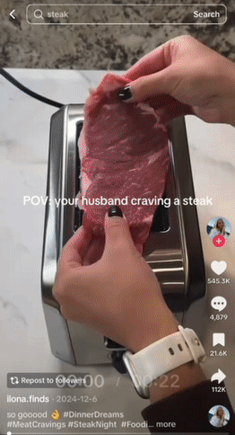
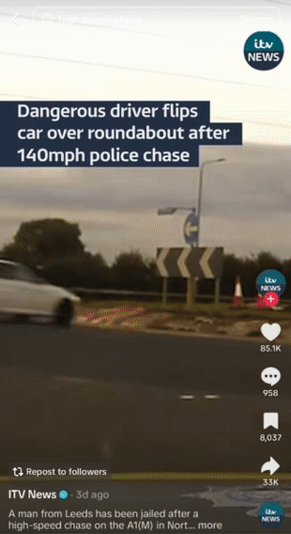
# Raise Your Hand If…
1) You’d think it would be wrong if you saw someone cooking a steak in a toaster.
2) You’ve watched a video of a high-speed police chase or bar fight
3) You’ve watched a video of someone doing their makeup or cooking while talking about an unrelated topic.
Notes:
Ashley:
Let’s talk about a key part of safe bait which uses behaviorial psychology.
Raise your hand if…(read)
If you raise your hand, there’s a psychology behind these types of videos that spark engagement and hold our attention.

Slide 12
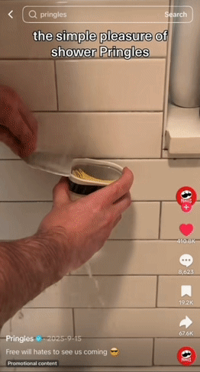
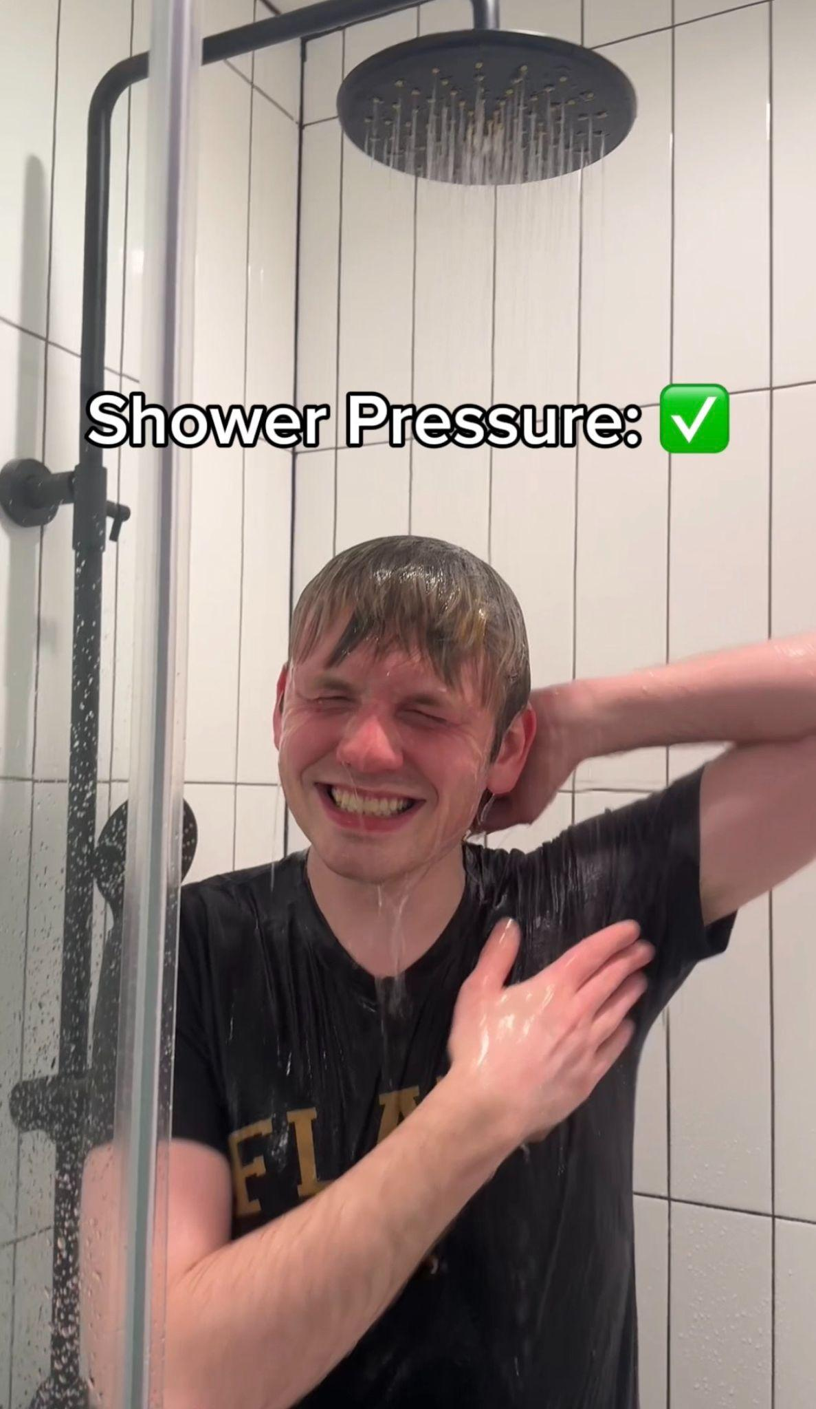



# Prediction Error
What It Is:
The brain is a prediction machine. It’s constantly guessing what should happen next.
When reality deviates slightly from expectation, attention spikes. That mismatch creates a brief moment:
"Wait… what?"
Behavioral Psychology Concept #1
“What the! Those two things don’t go together.”
Source: Schultz (1997) — dopamine & prediction error
Notes:
Ashley:
The first one being Prediction error.
To some extent, most of us carry certain expectations for people in certain scenarios.
When I put earrings on, I broke that expectation and it caught your attention and caused you to maybe wonder what is she doing.
This is prediction error. So when people deviate from what we consider normal, attention spikes.
Let’s talk about a brand example.
Pringles ran a campaign with their pringles being shown in the shower.
This seems odd because it’s not a usual thing you’d see but to some people, it’s funny. This is known as Prediction Error.
Let’s talk about a multifamily-specific example: The Sally.
This matters because you have to get the hook right in your videos to increase the likelihood someone engages with your content and becomes aware of your property.

Slide 13
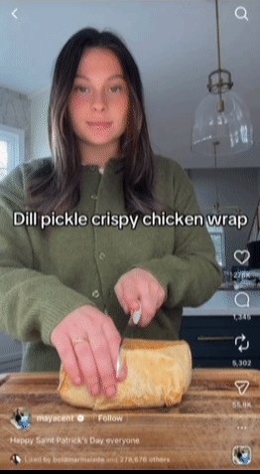
# Cunningham’s Law
What It Is:
The principle states that the fastest way to get the right answer online is not to ask a question. It’s to post something incorrect. People feel compelled to fix it.
“People correct things on the internet.”
Behavioral Psychology Concept #2
“Ahhh stop you’re going to cut your finger!”
Source: Predictive Processing frameworks (Clark, 2013)
Notes:
Ashley:
The second concept is Cunningham’s Law.
I’ve mispronounced countless things on social media.
This happens on social media every day to other creators and brands.
Every viewer has a correction reflex. Whether they say outloud, internally or via a comment, everyone has it.
It’s known as Cunningham’s Law. People correct things on the internet. The principle states…
Gunnar - Bring in the example of the title - did anyone catch that? We were trying to trigger your correction reflex.
Another type of wrong behavior we’ve observed on social media is cutting food incorrectly. Think Kendal Jenner.
Example: Creator on screen. She capitlized on what people were calling out.
That’s she’s going to cut her finger. She’s cutting the wrap wrong.
Her posts consistently get thousands of views because as humans we’re curious to see how it ends.
Example: Ashley Stran / Burgundy
Again this concept can help you create better hooks.
Now I’m not saying to go grab a knife and copy this creator.
What I am saying it to think creatively how to get people to correct you in a nice way.

Slide 14
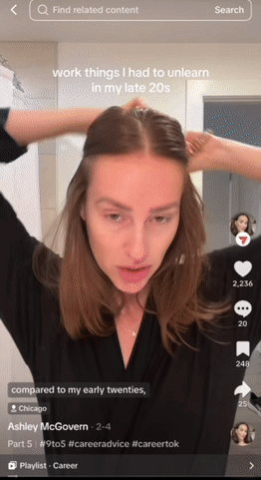
# Bottom-Up Attention
What It Is:
Information is processed as it enters the sensory organs (eyes, ears, etc.) without conscious effort, often driven by low-level features like color, movement, or contrast.
👋
🔄
⚡
Loud Noises
Hands Moving
Objects Changing
Behavioral Psychology Concept #3
“Why is she doing her makeup but talking about work?!”
Sources: Corbetta & Shulman (2002); Itti & Koch (2001)
Notes:
Ashley:
Lastly, there’s one more concept I want to talk about.
The brain is attracted to noise, sound and movement which triggers attention.
So not only did we do something your brains deemed bizarre at the beginning…
This is know as bottom up attention.
Our brain detects motion and triggers attention before the brain consciously evaluates the topic.
This is why a lot of GRWM videos work or ASMR videos or sirens. If I would have thrown my earrings…
Our brains are protecting us.
They’re also filtering out whether we should stay or whether we go unconsciously.
And with Bottom Up Attention, we're triggering the part of the brain that notices motion automatically to make it pause and potentially stay during conscious thought.
Think about this when creating your hooks.

Slide 15
# How to Do This in Multifamily (On Brand)
Know Your Audience — who's looking
Know Your Brand — who you are
Know Your Reputation — where you stand
Know Your Platform — where it lands
Notes:
Stacey Speaker Notes:
Now that you know what Safe Bait is + psychology
Real question: how do we actually do this in MF w/o blowing up brand
'yeah, this is a cute idea, but it won’t work for us.’
Fair, that was me too at first - but stick with me, it can work…
1: KNOW YOUR AUDIENCE– get specific
Student housing residents - go to war in comments over dirty dishes
55+ community - strong feelings about pickleball court hours
Point = understand residents (persona building research)
Will know how to match SB content to audience (to resonate)
2: KNOW YOUR BRAND - brand not just your logo
Name, verbal, logo, visual - all working together to define who you are
Safe Bait = verbal lane (voice, vocab, personality)
All important to ensure SB stays on brand
3: KNOW YOUR REPUTATION
Your rep = version of brand living rent-free in other’s heads
Every Google Review, neighborhood FB comment, TikTok posted by a frustrated resident
All build a brand impression whether you like it or not
If last 5 reviews are complaints about maintenance and you post a cutesy hot take about maintenance requests…
Not being playful, being tone deaf
Brand is a combo of what you say and what people say back
Know what’s being said before you speak next (or audience already annoyed)
4: KNOW YOUR PLATFORM
Every platform has its own personality…
TikTok = chaos, IG = polish, LI = corporate hat on, FB = your mother
Exact post crushes on one and tanks on another
Great brands don’t just match audience, but also the room audience scrolls in
Before you post, ask: “does this tone fit the room I’m walking into?”
Nail these four brand insights, Safe Bait stops being scary and starts being fun.

Slide 16

# Safe Bait™ Do’s
🧠
Understand Your Audience’s Consumption Habits
🤝
Consider Your Brand When Creating Content
Follow your audience’s consumption and production habits
(Match the frequency of your audience’s behaviors)
Invite community engagement driven by curiosity or humor.
(The goal is healthy community debate, or a simple double-take, not toxic conflict.)
3-5:1 Ratio
Safe-bait posting
Tap into relatable
apartment-life moments instantly.
Notes:
Stacey Speaker Notes:
Do’s of Safe Bait = where staying on brand really matters
1st - understand audience’s content consumption habits…
what they're already watching, how often they're watching it, and what format they prefer
= set a brand-safe guideline for your posting frequency
Rule of Thumb: 1 Safe Bait to every 3-5 value-driven posts
2nd - consider your brand when you create SB content…
Point of SB is curiosity and healthy debate
Get there by building content thru lens of who YOU are as a brand
Example: imagine a brand new class A dev in heart of busy urban market
= refine architecture, rooftop amenities, chef-curated events
= brand’s whole identity built on sophistication (tone, visuals, language = elevated)
Chaotic, confrontational style of SB that works beautifully for some brands is going to clash in this instance.
Realize > Safe Bait isn't a tone — it's a tactic. And every brand has its own version of playful.
Same Class A property could post something like: 'Unpopular opinion — the rooftop pool is for reading, not TikTok content.'
Same curiosity hook, same debate. but in your brand’s personality and tone.
Also important to know what your audience is creating and consuming….
28-year-old is deep in matcha discourse, pop culture, and dating app chaos.
38-year-old is in home renovation content, career pivots, and trying to figure out what their 401k actually does.
Your Safe Bait should feel like it belongs in their feed.
Just like your brand as a whole, this content should aim to resonate with its audience.
Set your ratio = blend of their content diet + your brand voice. That's the formula.

Slide 17

# Safe Bait™ Don’ts (This is Rage Bait)
⚠️
The Rage Bait Danger Zone
❌
DON'T: Tie your property to cultural wars or politics
❌
DON'T: Joke about rent, late fees, maintenance, safety, or policy enforcement
❌
DON'T: Mock residents or create real-world harm
Notes:
Gunnar:
Avoid cultural or political issues to prevent alienating the audience.
Do not joke about building quality or financial aspects like rent and fees, as these are pillars of trust. Calling your product a scam is a red flag
Never mock residents or cause real-world harm, as Safe Bait should never punch down.

Slide 18
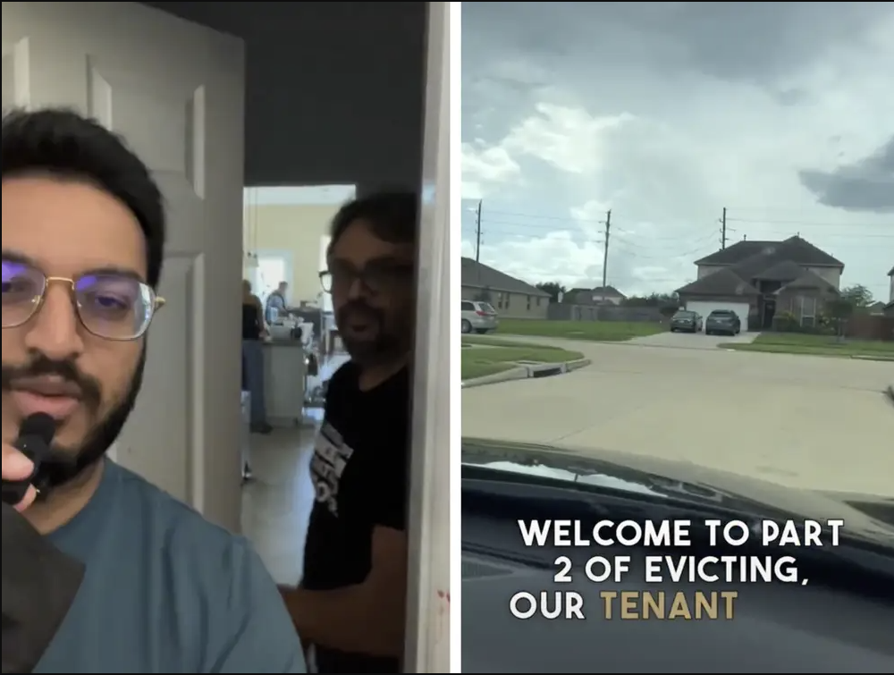


# Case To Avoid: 'Landlord Eviction'
TikTok Series
A landlord chronicled an eviction as content, it backfired and damaged trust.
Lesson: Never create content from sensitive resident situations.
Notes:
Gunnar: This is the importance of knowing the "danger zone" of ugc marketing. This is what happens when you take the "professional troll" energy and apply it to high-stakes, human situations.
The landlord filmed an actual eviction for TikTok, which was pure Rage Bait.
While the video went viral, it triggered a massive national PR disaster.
The tactic resulted in a total collapse of brand trust.

Slide 19
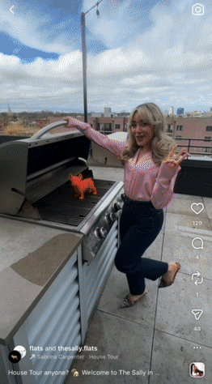
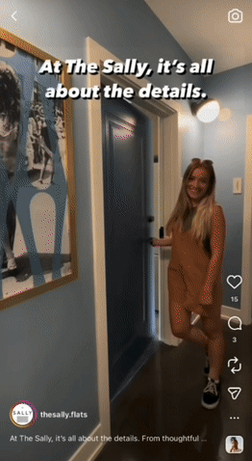
# Safe Bait™ Case Study: The Sally
Safe Bait™ Post
Regular Post
Sabrina Carpenter lookalike
Bizarre dog statue in every shot
Open Cabinets and fridge
-Informational video
-Captions that add value
7.5k Views
529 Views
49 Shares
0 Shares
140 Likes
15 Likes
Notes:
Gunnar:
The Contrast: Traditional "value-add" posts vs. Safe Bait™ strategy.
The Baseline: Right side is a 2-year-old "perfect" post. Informational, clean, high-value captions—but only 529 views and 0 shares. It provided value but failed to capture attention.
The "Bait" Elements:
Lookalike: Sabrina Carpenter double for an immediate "scroll-stop."
Gamification: A hidden orange bulldog in every shot to drive rewatches.
The Faux Pas: Open cabinets/fridge. Intentionally "wrong" visuals that trigger comments and shares.
The Data Gap: Left side is only 2 weeks old.
7.5k views and 49 shares.
In a crowded feed, "perfect" is invisible. Safe Bait™ wins the battle for attention by being contagious, not just informative.
Ashley: Talk about finding your competitive advantage. E.g. Having a friend that looks like Sabrina Carpenter
Last: And we referenced our brand discernment checklist, which we will be sharing next.

Slide 20

# Safe Bait™ Brand Discernment Checklist
Before you post, answer three questions honestly.
Is Safe Bait ™ actually a safe strategy for us?
Know Your Audience + Know Your Brand
✓ 1
✓
How often should we post Safe Bait ™?
Your audience's content diet
✓ 2
✓
What tone should our Safe Bait ™ take?
Your version of playful
✓ 3
✓
Notes:
Stacey Speaker Notes:
Here's where I get to be the useful kind of brand police.
We created = The Safe Bait Brand Discernment Checklist to help guide you in deploying a Safe Bait content strategy.
You will be able to download this checklist at the end of our session.
Before creating any Safe Bait content, answer the Qs on screen (checklist = more detail to get there)
1: Is Safe Bait actually a safe strategy for you?
This comes down to honest self-assessment.
How can you craft Safe Bait content to align with your brand personality?
Is your online reputation in a strong enough place to take a creative swing….
or are there unresolved issues that could surface the second you invite people into your comments?
And do you have internal alignment across corporate, regional, and onsite teams on what's acceptable?
If any of those answers give you pause, that's your answer. At least for right now.
2: How often should you post it?
Said earlier, frequency = know your audience + their content appetite + know the platform = ratio
Remember: Safe Bait only works when it's balanced with community-building, educational, and value-driven content.
It's the spice, not the whole meal.
3: What tone should your Safe Bait take?
Start with your brand personality – what does your version of playful actually sounds like…
dry? Warm? Witty? Chaotic?
Then get clear on what's permanently off-limits for your brand specifically.
Before you hit post, play out the top five comments in your head….
If what you're imagining is healthy debate, you're good.
If what you're imagining is real complaints surfacing…
= that's not a Safe Bait problem, that's a reputation problem.

Slide 21






# Leadership Enablement: 3-Step Process
1
2
3
Define the Guardrails
Standardize the Strategy
Build a Test-and-
Learn Culture
Set clear success metrics with proper tracking tools. (comments, saves, conversions)
Establish a Brand Discernment Checklist
Encourage Bad Ideas
Empower teams to create, test, and iterate quickly
Encourage a fail forward mindset by sharing wins and failures equally
Continuously refine based on current universal trends and culture
Commit to a 3–6 month testing window
Define posting cadence and the 3:1 Safety Ratio
Hold a weekly creative review to evaluate ideas, trends, and early performance
Notes:
Ashley:
I recognize as executives you want control over your brand
You have certain rules in place from a compliance standpoint
This is where the brand discernment checklist + our leadership enablement framework can help ease your worries. [Read slide]
Gunnar: Define The Guardrails
Benchmarks First: We define success before we experiment. Setting benchmarks ensures every experimental campaign has a measurable target.
Link-in-Bio 2.0: Leverage advanced link in bio tools that mirror your feed. This isn't just about links; it can be a tool to improve attribution, knowing exactly which post captured the viewer's attention.
The Guardrails: Every team needs a compass. Use the Brand Discernment Checklist (downloadable at the end) to maintain consistency while pushing boundaries.
Encourage "Bad Ideas" in your brainstorming sessions. The worse, the better.
Analyzing why an idea is bad exposes hidden friction. Flip that logic to find your most brilliant, non-obvious breakthroughs.
Ashley:
Big piece to the safe bait puzzle is consistent and commitment.
TALK ABOUT STEPS 2 & 3

Slide 22
# Your Takeaways
Safe Bait™ sparks curiosity and humor.
Safe Bait™ leverages universal trends, low-stakes tension and behavioral psychology.
Protect your brand with discernment checklist + 3:1 Safety Ratio.
Enable teams with clear goals, templates, and coaching.
Notes:
Ashley: Now as we’re coming to a close, let’s recap what we discussed here today. [Read slide]
Lastly, at the beginning of this presentation, I told you I felt embarrassed talking about this.
Because these principles are often used the wrong way. They’re used to manipulate and to divide.
But here’s what I’ve realized. The principles themselves aren’t the problem. The intention behind them is. People intentionally want to mislead their audience.
And in multifamily, you have a very different intention. You care about your properties and PMC.
You’re trying to help someone find their next home. You’re not intentionally trying to mislead people.
The hard part is you’re trying to stand out in a crowded market. Safe Bait allows you to do that if you use it responsibly, creatively, and intentionally.
So if you felt a little uncomfortable at the beginning of this session, that’s a good thing. You should.
But hopefully now, you also see the opportunity.

Slide 23

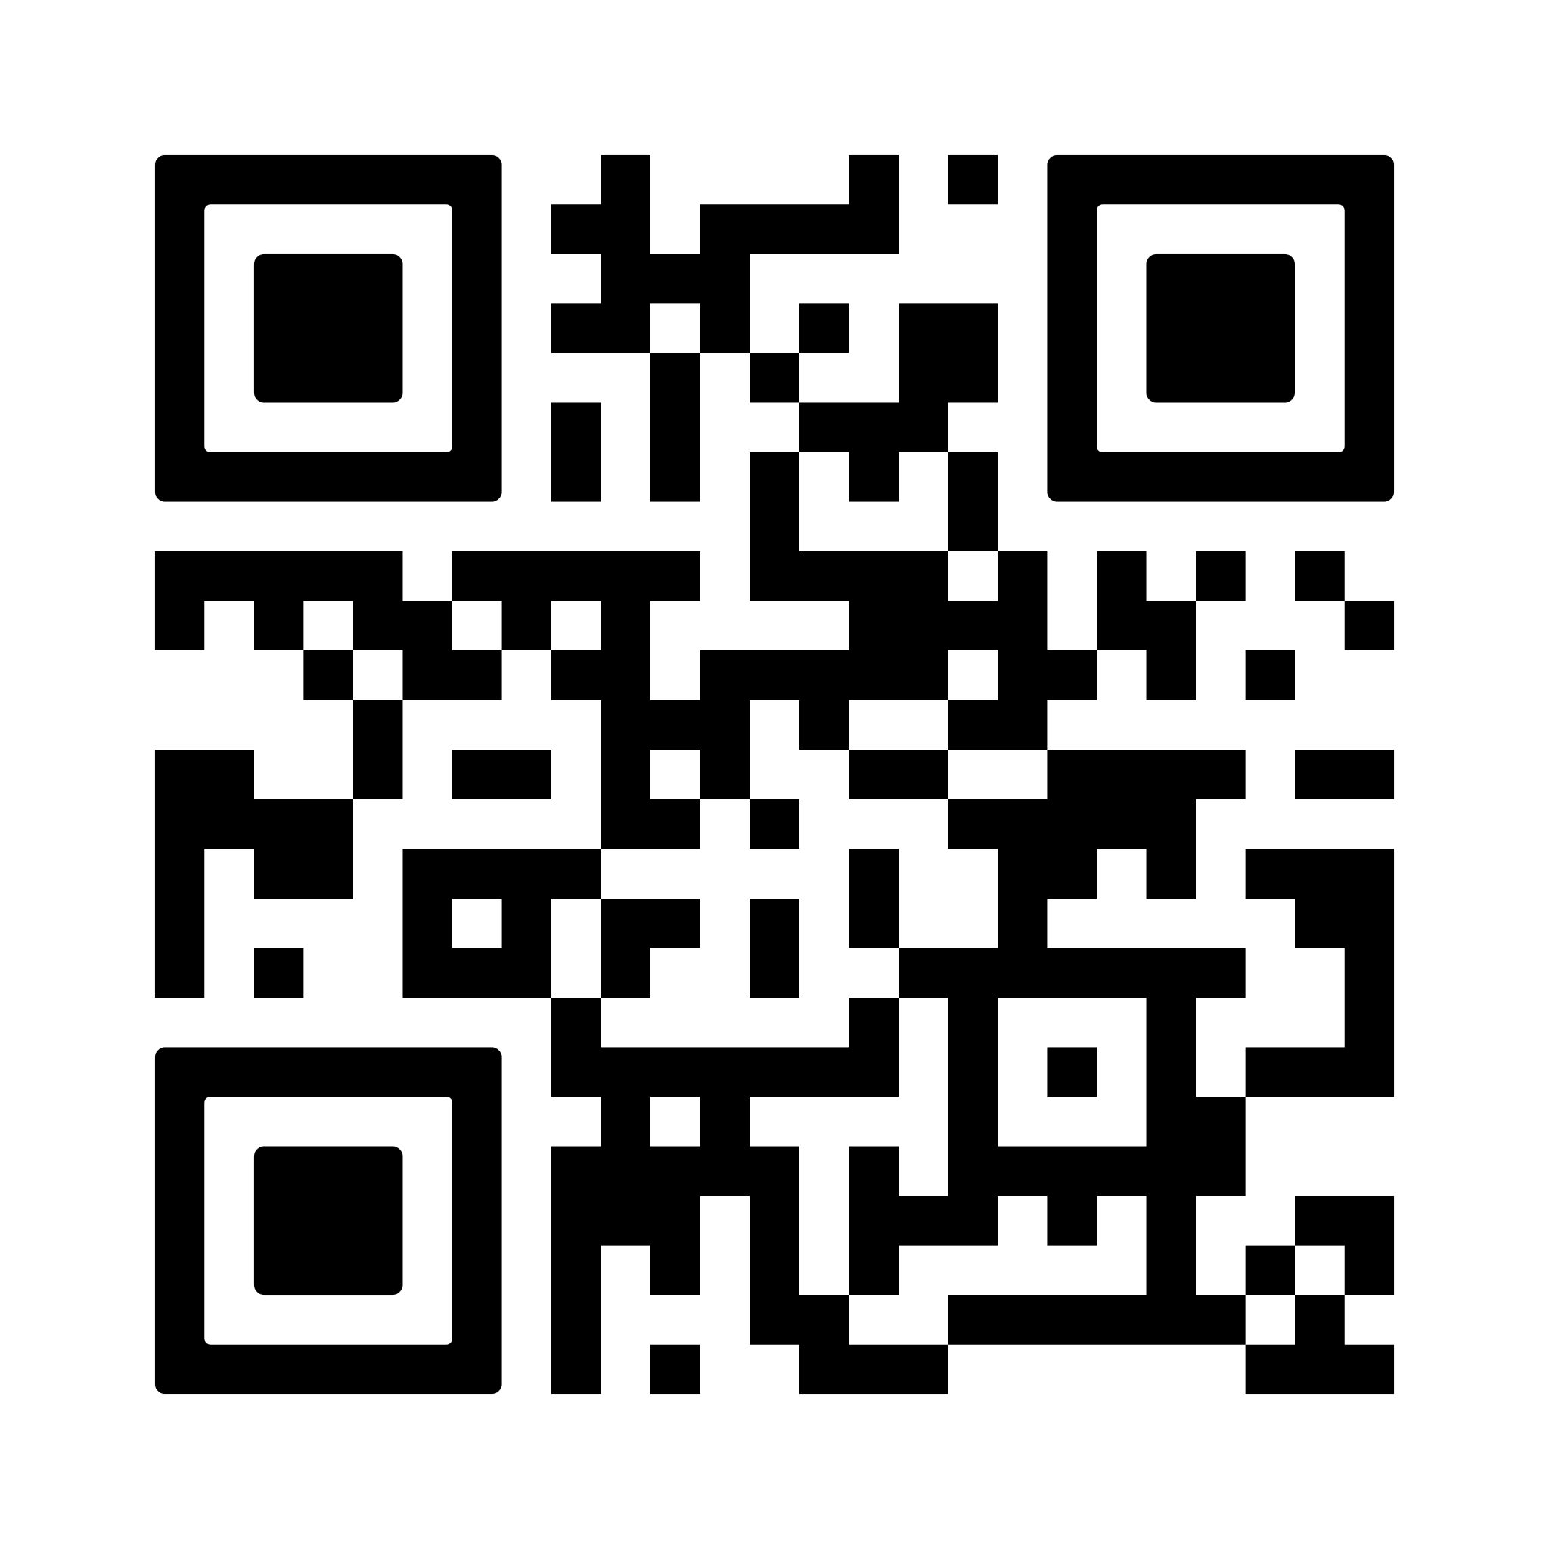

Thank You!
PLACE
QR CODE
HERE
Scan the QR code to venmo us for our time
*Example of rage bait but SER4IOUSLY venmo us
Just kidding, it’s the brand discernment checklist.
Notes:
Gunnar: Scan this QR code to Venmo us for our time….. JK this is our brand discernment checklist.

