Slide 1



PRESENTED BY
THE BELONGING BLUEPRINT
DATA-DRIVEN EXPERIENCES TO SUPPORT MENTAL WELLNESS
FOR THE NEXT GENERATION OF RENTERS
www.reallygreatsite.com

Slide 2

THE WAKE UP CALL
We own the living room.
Our residents aren’t just customers.
They’re people navigating real life - in the homes we manage.
Raise your hand if someone you know has stuggled with loneliness, isolation, or mental health.
AIM 2026 | Slide 2
aimconf.com

Slide 3



ANDREW BOWEN
SVP, Strategic Partnerships | LeaseLock
KADI MANCUSO RICE
VP, Leasing & Marketing | Tailwind Group
PETER LYNCH
Chief People Officer | Cardinal Group
PRESENTED BY
www.reallygreatsite.com

Slide 4
TODAY’S JOURNEY
01
THE WAKE UP CALL
Why this is a human problem – not just a student one.
02
THE EVIDENCE
2025 Thriving College Student Index – what the data reveals.
03
THE PLAYBOOK
How operators are building belonging at scale – and the good news.
AIM 2026 | Slide 4
aimconf.com

Slide 5
THE GAP WE CAN’T IGNORE
Student housing is learning. Conventional multifamily hasn’t caught up – yet!
STUDENT HOUSING
  Mental health training for onsite teams
  Crisis response protocols in place
  Coalition-back wellness programming
  Proactive community-building culture
  Data-driven resident sentiment tracking
  NPO partnerships across the country
AIM 2026 | Slide 5
aimconf.com

Slide 6
THIS ISN’T JUST A STUDENT PROBLEM
It’s a human problem – and it’s already in your buildings.
1 in 4
64%
75%
65%
Young adults 18 - 24 have a diagnosable mental health issue
of college dropouts leave due to mental health related reason
of lifetime mental health cases begin before age 24
of college students report feeling stressed “all the time” or “often”
2023 U.S. Surgeon General’s Advisory: Loneliness has become on epidemic –
with health risks comparable to smoking 15 cigarettes a day.
AIM 2026 | Slide 6
aimconf.com

Slide 7
THE EVIDENCE
2025 THRIVING COLLEGE STUDENT SURVEY
11,204 students • Ipsos • Commissioned by the College Student Mental Wellness Advocacy Coalition & Hi, How Are You Project
93%
71%
see mental health as an important component of their overall health
know where to find free mental health information
42%
44%
say fear or judgement discourages them from opening up or reach out
do not feel comfortable talking about mental health
AIM 2026 | Slide 7
aimconf.com
Notes:
45%

Slide 8
THE EVIDENCE
2025 THRIVING COLLEGE STUDENT SURVEY
The gap shows up clearly in campus communities, where students say social connection is common, but support is less visible.
77%
41%
are unsure whether mental health support exists where they live
say social opprotunities exist in their community
33%
28%
believe their community supports mental well-being
feel strongly connected to their community
Yet 39% say they feel little to no connection at all. That lack of clarity may help explain why fewer students use on-campus counseling.
AIM 2026 | Slide 8
aimconf.com
Notes:
93% see mental health as an important component of their overall health and wellbeing

Slide 9

WHAT THRIVING ACTUALLY LOOKS LIKE
Thriving students twice as likely to socialize, prioritize sleep, exercise regularly, spend time outdoors, and eat healthy compared to struggling peers
AIM 2026 | Slide 9
aimconf.com

Slide 10

WHAT THRIVING ACTUALLY LOOKS LIKE
The data reveals a 47-point gap in social connection between thriving and struggling students.
AIM 2026 | Slide 10
aimconf.com

Slide 11

THE PLAYBOOK
College Student Mental Wellness Advocacy Coalition​
  30+ student housing companies across the U.S.
  200+ communities
  850,000+ college students
We envision a world where all young adults thrive with the support of the residential communities, whose teams are dedicated to promoting and advocating for mental wellness to facilitate personal fulfillment and academic success.
AIM 2026 | Slide 11
aimconf.com
Notes:
mission
Together as a Coalition, we are committed to better understanding our residents, encouraging open dialogues and raising public awareness about the importance of mental wellness and its impact on students as they work to realize their full potential along their college journey and beyond.
Testing, measuring, and refining how wellness and belonging show up in everyday residential experiences.​

Slide 12

PEER-TO-PEER VIDEO SERIES
AIM 2026 | Slide 12
aimconf.com

Slide 13


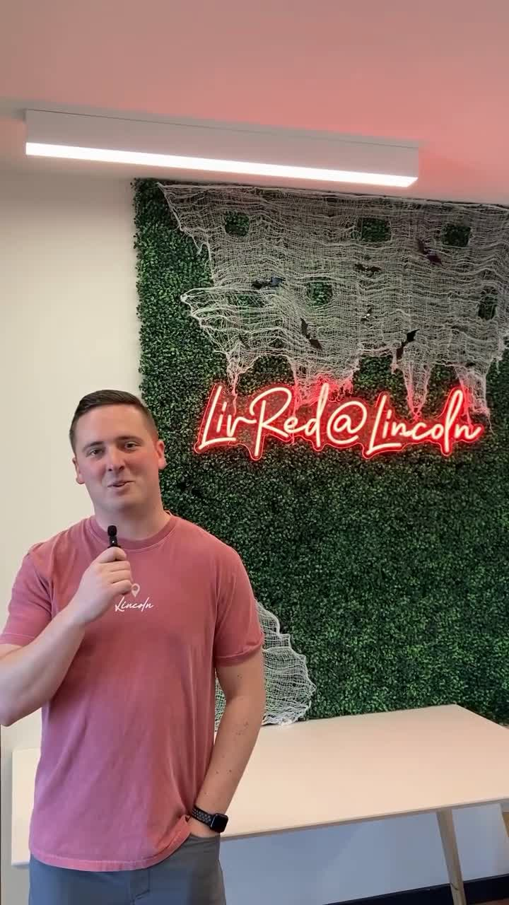
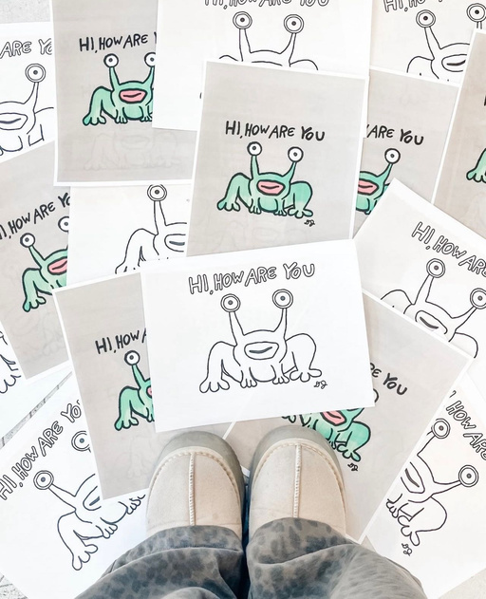
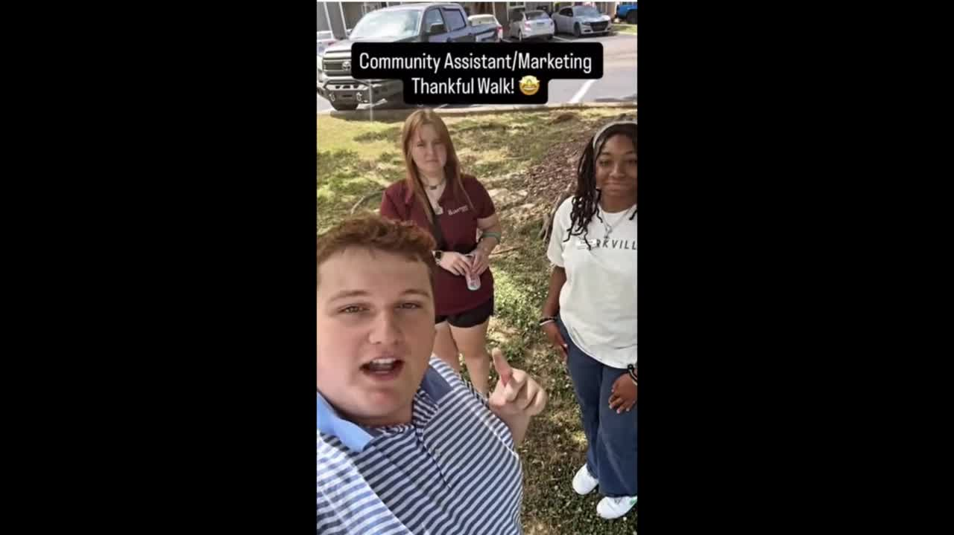
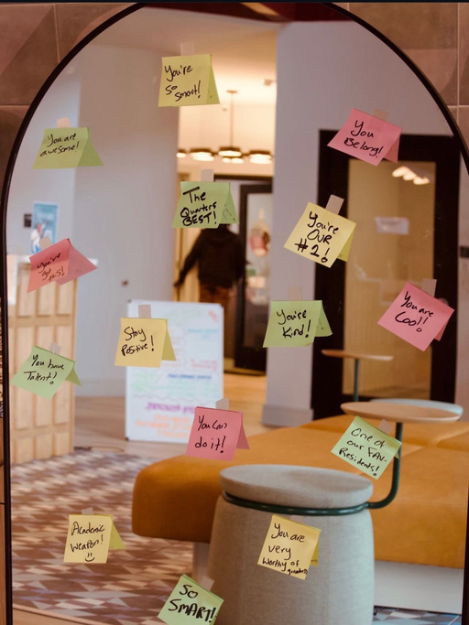
Success stories in student housing → applying to conventional
  Creative outlets for residents to express themselves
  Wellness walks to promote movement
  Give or take what you need
  Open mental health conversations​
AIM 2026 | Slide 13
aimconf.com

Slide 14

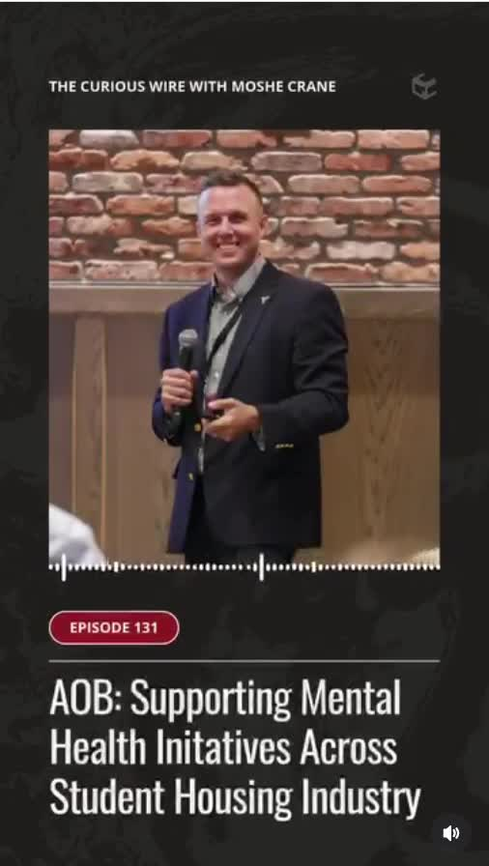
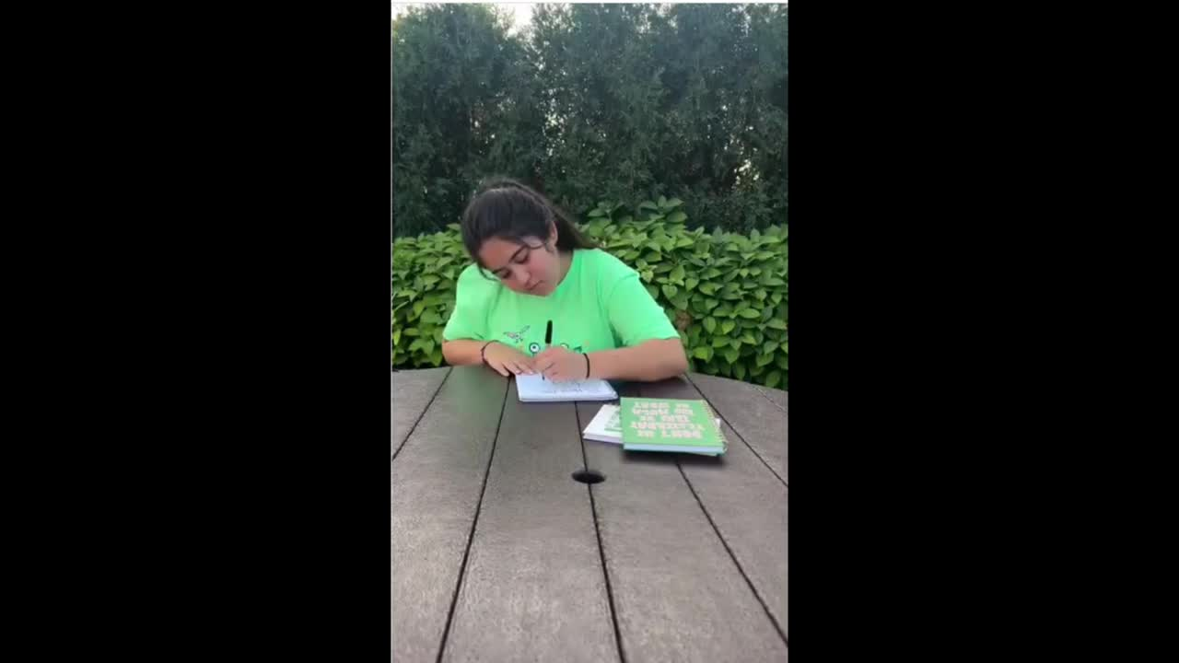

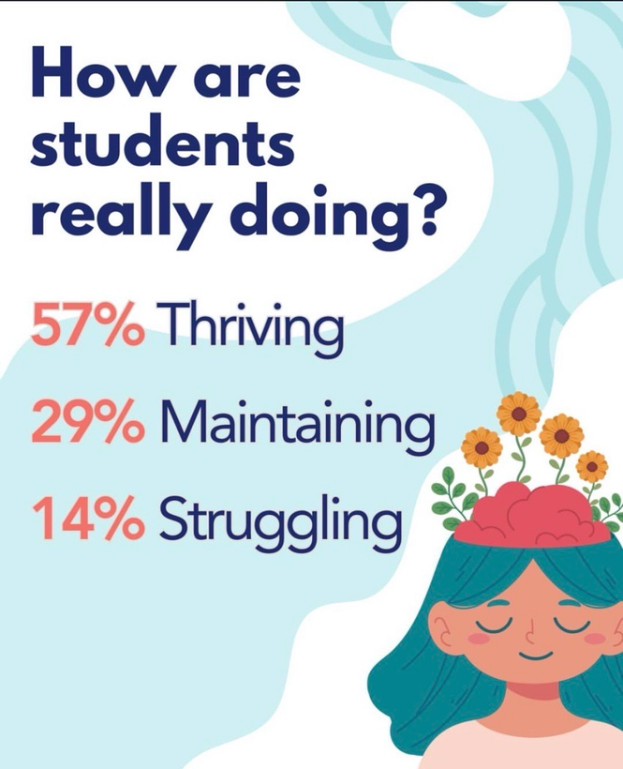
Scaling across small AND large management companies
  Team enablement frameworks
  Hi, How Are You? education
  Thriving College Student Index key learnings
  AI-assisted resident communication tools
AIM 2026 | Slide 14
aimconf.com

Slide 15








THE SIMPLEST TOOL IN THE PLAYBOOK​
HHAY Happy Habits
START THE CONVERSATION
GET MOVING
Ask “Hi, How Are You?" Check in with someone. Be Present. Listen.
Physical activity releases endorphins, lowers anxiety, improves sleep.​
GET CREATIVE
PRACTICE MINDFULNESS
Music, art, expression. Residents' #1 stress outlet is listening to music.​
Gratitude, meditation, presence. Simple habits with powerful returns.​
FEED YOUR MIND
STAY CONNECTED
Read, learn, discover, eat good food, and get good sleep.
Spend time with people you care about. Get out and build a community.
AIM 2026 | Slide 13
aimconf.com
Notes:
5 meaningful connections → 20% higher renewal. Connection is retention.​

Slide 16
STAFF FIRST. ALWAYS.
Meaningful cultural change doesn't happen through data or policy alone — it starts with supporting your teams.​
🛡️​​
Clear Guardrails
🎓
Training Before Programs
Staff are NOT expected to act as mental health professionals. Define where their role ends and professional support begins.​
Teams must be equipped and confident before being asked to deliver resident-facing wellness initiatives.​
❤️​
Permission to Care
📊
Measure What Matters
Give onsite teams explicit permission to prioritize relationship-building — not just task completion.​
Track team sentiment and readiness alongside resident satisfaction. Culture change requires both lenses.​
🔄
Flexibility Built In
🤝​
Coalition Resources
Provide structure while allowing communities toreflect their own identity and resident profile.​
You are not starting from zero. The Coalition offers training frameworks, tools, and shared learning.​
AIM 2026 | Slide 14
aimconf.com

Slide 17
YOUR BELONGING BLUEPRINT​
Five things to take back to your organization starting Monday.​
01
TRANSLATE DATA INTO ACTION
The research is there. What's one insight you can act on in the next 90 days?​
02
SUPPORT TEAMS FIRST​
Before you roll out any resident program, ensure your onsite team feels equipped and supported.​
03
MEASURE WITH TRENDS, NOT SNAPSHOTS​
Track sentiment longitudinally. Point-in-time data doesn't capture cultural change.​
04
STRENGTHEN SOCIAL INFRASTRUCTURE​
Belonging is built through music, movement, connection, and conversation — not just amenities.​
05
START THE CONVERSATION​
Ask your residents, your team, your peers: Hi, How are you? And mean it.​
AIM 2026 | Slide 15
aimconf.com

Slide 18
QUESTIONS?
AIM 2026 | Slide 16
aimconf.com

Slide 19


HI, HOW ARE YOU?
We live in a better world now.
Let’s go out and be the solution.
RESOURCES TO GET STARTED
  hihowareyou.org
  thrivingcollegestudents.org
AIM 2026 | Slide 17
aimconf.com

Slide 20

THRIVING COLLEGE STUDENTS
2025 COLLEGE STUDENT FALL MENTAL WELLNESS FULL SURVEY
AIM 2026 | Slide 18
aimconf.com

Slide 21



CONTACT US
ANDREW BOWEN
SVP, Strategic Partnerships | LeaseLock
KADI MANCUSO RICE
VP, Leasing & Marketing | Tailwind Group
PETER LYNCH
Chief People Officer | Cardinal Group

Slide 22
THANK YOU!
PRESENTED BY
www.reallygreatsite.com

