Slide 1
How AI Ruins Multifamily Operations
And how to stop it from ruining yours…
Notes:
Speaker: Kendrick

Slide 2

Kendrick Bradley,
Co-Founder & CPO
Zuma
Notes:
Speaker: Kendrick

Slide 3
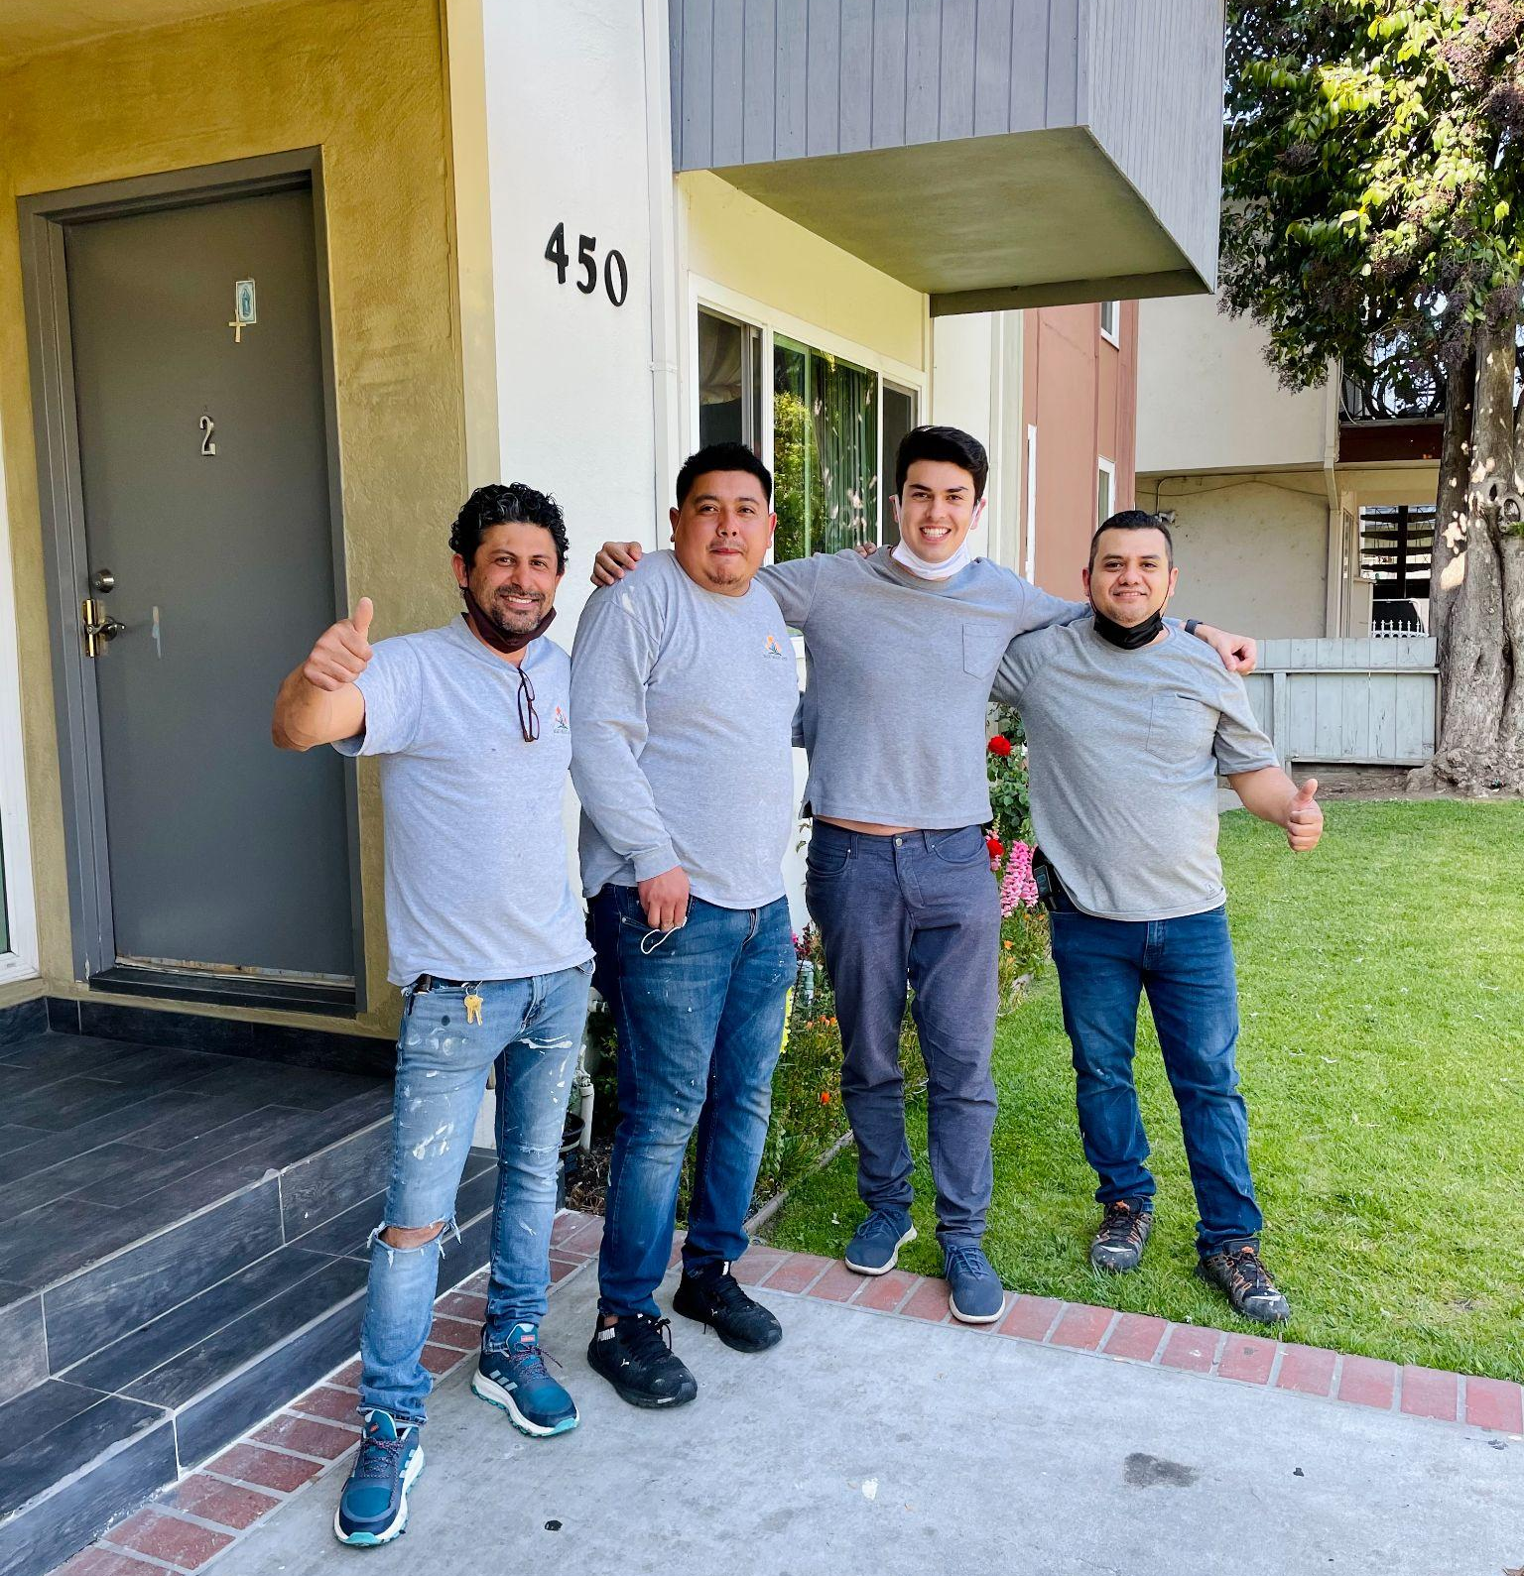
I started out as an Onsite Leasing Assistant in a Class C Building.
Notes:
Speaker: Kendrick
Five years ago, I left my engineering job at SpaceX to become a Leasing Agent. I went full throttle, living at a Class C building in Silicon Valley and supporting our resident onsites while also education our leasing team on technology tools.

Slide 4
AI Has Failed Multifamily…
Notes:
Speaker Notes:
When we started Zuma 5 years ago, no one was talking about AI… Today, AI is everywhere I’m here not just to tell but show you how AI has failed multifamily…

Slide 5
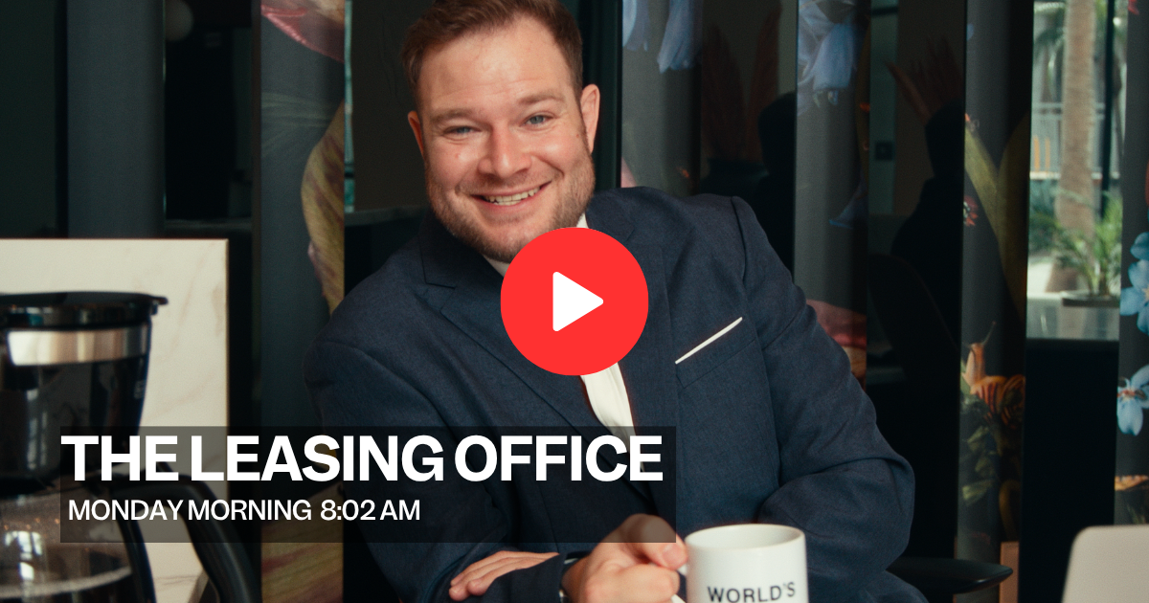

Slide 6


Slide 7
Releasing AI into the wild without clean data, proper guardrails, and handoff training, creates an operational liability.
Notes:
Speaker: Kendrick

Slide 8
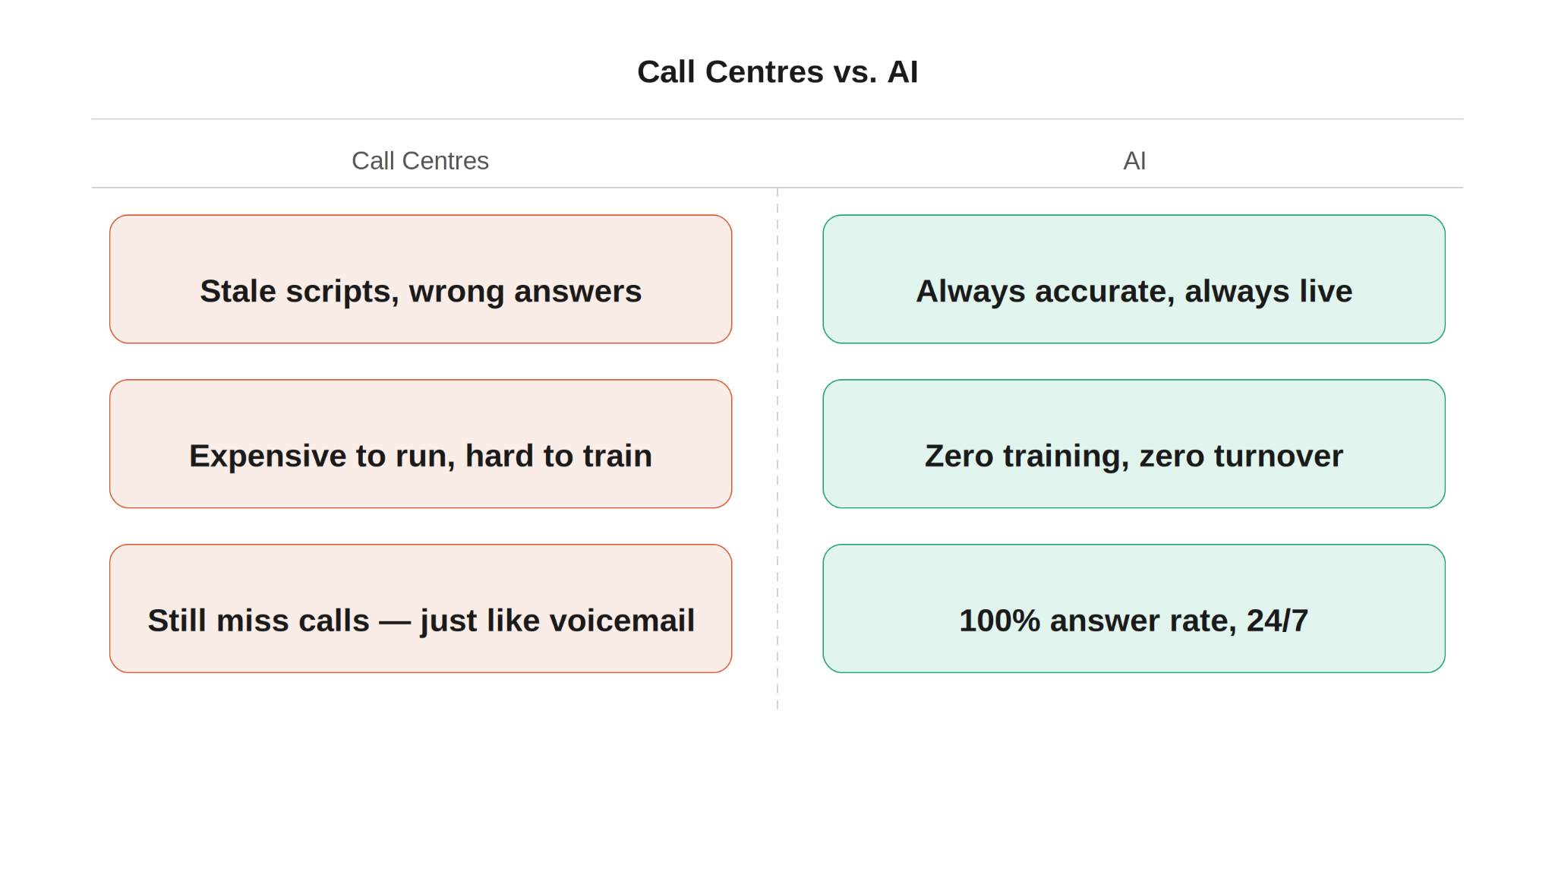
So why the chaos
Bad Data = Bad AI
Human-in-the-Loop
PROMISE
RISK
PROMISE
RISK
Forces data cleanup
Data hygiene work is underestimated
AI absorbs the rejections
Over-automating sales processes
Consistent and always-on
Fails visibly, not silently
Elevates the human element
Requires hospitality mindset
Handles routine comms at scale
Stale data → wrong info sent
Scales revenue, not overhead
Change management process is eseential
Notes:
Speaker: Kendrick

Slide 9


Join me in welcoming my co-hosts:
Dalia Kalgreen,
VP of Stuff
Unified Residential
Ryan Funt,
VP of Marketing
Fitzrovia
Notes:
Speaker: Kendrick

Slide 10
Your Renters Expectations Have Evolved…
Notes:
Speaker: Dalia

Slide 11
Renter Expectations Have Evolved
Instant Gratification
Renters want to book tours NOW, not tomorrow
24/7 Availability
Not being able to procure information or complete a task = instant frustration
Meet your Renters Where the are
If you don’t you’ll lose the lead to a competitor
Notes:
Speaker: Dalia

Slide 12
Renter Expectations
Dalia - What are you seeing in renter expectations? How do you think about an operational infrastructure that facilitates a seamless renter journey?
Notes:
Speaker: Dalia, Kendrick to ask her this question
AI FAIL STORY– Too many platforms + logins

Slide 13
The Human
Psychology Shift
Notes:
Speaker: Ryan

Slide 14
When do renters want AI vs a Human?
AI = Information
Humans = Sales
Renters trust AI to give them factual, unbiased information without sales pressure
Humans handle the ‘big feelings’ issues and are more valuable further down the funnel
Uncertainty Reduction Theory in action:
AI helps renters de-risk their decision before talking to a human
Notes:
Speaker: Ryan
What about renaming this slide:When do renters want AI vs. a human?
Maybe add a note under human = sales
Humans handle the ‘big feelings’ issues and are more valuable further down the funnel

Slide 15
Renter Behavior
Ryan – What's the data telling us about how renter behavior is changing?
Notes:
Speaker: Ryan
AI FAIL STORY– AI justed to get names wrong, data wrong
Would delete the 2nd question - “when do renters want AI vs. a human” as we talk about this on the last slide… We can just launch into the renter stats page after the question is asked. Stats provided on next page in comments.
Would change slide from “Operator Story” to “Renter Behavior” and question to:
Ryan - What’s the data telling us about how renter behavior is changing?

Slide 16
Renter Stats
Speed & Responsiveness
Properties responding in under 15 minutes see 2x the conversion rates
60% of prospect engagement happens after leasing office hours
Source: Zuma
Pricing Transparency
The #1 renter expectation is all-in-pricing, shown upfront online
Source: SatisFacts
Channel Preference
SMS open rates exceed 90% vs 20-30% for email
Source: Power in AI
Notes:
Speaker: Ryan
Behavior stats from Ryan
Speed & responsiveness
Properties responding in under 15 minutes see 2x conversion rates ¹
60% of prospect engagement happens after leasing office hours ¹
Pricing transparency
#1 renter expectation is all-in pricing shown upfront online ²
Channel preference
SMS open rates exceed 90% vs. 20–30% for email ³
¹ Zuma, analysis of 100,000+ multifamily units
² SatisFacts Biennial Online Renter Study, 2025
³ Power in AI

Slide 17
The Operational
Reality
Notes:
Speaker: Kendrick to introduce this idea and pass off to. Renters expectations influence your new operational reality.

Slide 18
Change Management Resistance
Multifamily = Laggard to technologies
Renters = Journey becomes overwhelmed
Roughly 35–40% of operators have fully modernized their core tech stack (NMHC, 2024)
Cost remains the #1 barrier, followed by integration complexity (Buildium, 2024)
Properties running legacy systems report operational costs 20–25% higher than peers using modern tech (NAA, 2024)
Maintenance responsiveness is the #1 driver of renter dissatisfaction (Satisfacts, 2024)
65% of renters prefer self-service options for payments, requests, and communications (NMHC, 2024)
72% of renters expect digital leasing workflows, yet fewer than 50% report experiencing one
(J Turner 2024)
Notes:
Speaker: Dalia
- Update to Dalia’s idea of fragmented systems disrupt operations and cause data discrepancies
- Renter journey too convoluted

Slide 19
Change Management Methodology
Implement Staff Training & Enable Tech Adoption
Understanding Renter Expectations
Staff training gaps and change resistance remain top internal obstacles to tech rollout across mid-size operators
Consolidation of proptech vendors is accelerating, yet adoption of AI-specific tools remains below 25% (NAA/NMHC, 2024)
AI-powered chatbots and 24/7 digital support are now considered "expected" by renters under 35
Renters who experience friction during move-in are 3x more likely to leave a negative review (Entrata Renter Survey, 2024)
Notes:
Speaker: Dalia
- Update to Dalia’s idea of fragmented systems disrupt operations and cause data discrepancies
- Renter journey too convoluted

Slide 20
The Call Center Problem
Raise your hand if any of your communities still using call centers?
Notes:
Speaker: Ryan hop in here
Can use this visual on the next slide or just replace the slide body text with this chart: https://we.tl/t-hyQsNPpS1Zn77Yoe
Ryan to share the fail story about implementing voiceAI for the first time

Slide 21
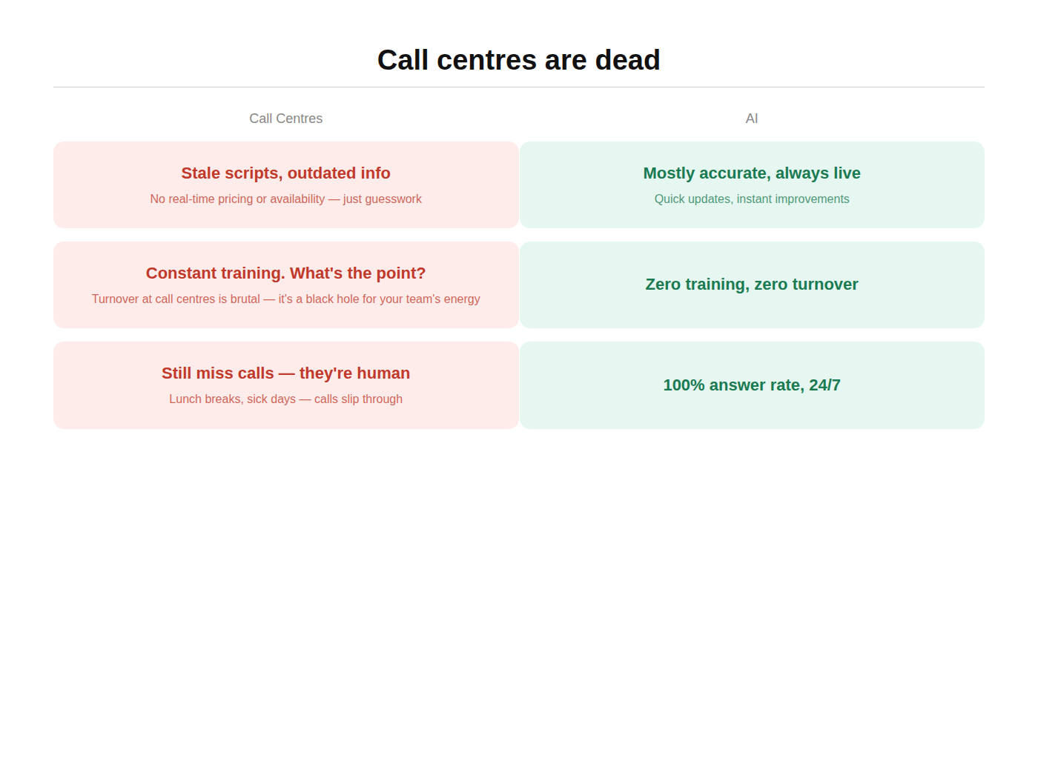
Call Centers Are Dead
Call Centers
AI
Notes:
Speaker: Ryan hop in here
Can use this visual on the next slide or just replace the slide body text with this chart: https://we.tl/t-hyQsNPpS1Zn77Yoe

Slide 22
The Human-Centric
Future of Multifamily
Notes:
Kendrick to introduce - drive home ethos of HitL

Slide 23
Operator Stories
Ryan / Dalia – How has Unified Residential & Fitzrovia implemented AI technologies to become AI-first
Notes:
Kendrick to introduce - drive home ethos of HitL

Slide 24

Every team needs a Kelsey
Kelsey is agentic AI powered by assistant, learning your communities nuances
We obsess over conversation quality and PMS brand, tone & voice
We have our own human team in the loop supporting when Kelsey gets stuck
💡
💬
🧑🏻‍💻
Notes:
Speaker: Kendrick

Slide 25
Operator Story
Dalia / Ryan – What does the future of multifamily operations look like? And what does it mean to ‘meet renters where they are’ while leveraging AI?
Notes:
Speaker: Dalia + Ryan to share stores
– Bring home the “meeting people where they are via AI”

Slide 26
AI will absolutely shape multifamily…but only if we implement it with care, context, and humanity.
Notes:
Speaker: Kendrick

Slide 27

Thank you!
Kendrick Bradley
Co-Founder & CPO
Notes:
Speaker: Kendrick

Slide 28


So why the chaos
01 | Bad data, bad AI
02 | Human-in-the-loop
✓ PROMISE
✕ RISK
✓ PROMISE
✕ RISK
Handles routine comms at scale
60–70% of workload reduced
Consistent, always-on
No energy drop from lead #1
to lead #100
Forces data cleanup
Surfaces years of
accumulated PMS debt
Stale data → wrong info sent
"Bad data is bad robot"
Fails visibly, not silently
LLM can't hallucinate its way
out of bad source data
Pre-work is underestimated
Data hygiene = org change,
not an IT problem
AI absorbs the rejections
"The robot gets the rejections,
you get the wins"
Elevates the human element
Frees staff for hospitality
and relationship-building
Scales revenue, not overhead
Portfolio grows without
headcount scaling in parallel
Over-automating sales
"Sales requires way higher
level than any AGI today"
Elevates the human element
Frees staff for hospitality
and relationship-building
Scales revenue, not overhead
Portfolio grows without
headcount scaling in parallel

Slide 29
Change Management Resistance
Dalia – Prior to 2020, you were an early adopter implementing chatbot technology, what happened after new leadership phased it out?
Notes:
Speaker: Dalia, Kendrick to ask her this question

Slide 30
The State of AI in Multifamily
Notes:
Speaker: Kendrick

Slide 31
Everyone is “AI-First” today…
In multifamily operations, that noise shows up everywhere:
Property Management Software
Your Property Management Software is now "AI-Native"
Horizontal Generative AI
Your CRM suddenly has ChatGPT or Claude "plugged in"
2010 Nurture & Chat Bots
Chat and nurture bots are rebranded as "AI leasing agents"

