Slide 1
Transparency Sells:
Using All-In Pricing to Stand Out in a Crowded Market

Slide 2




Allison Nesbitt
VP, Solutions & National Sales
Zumper
Ryan Perez
Executive Vice President
Capital Square Living
Jessica Romero
Director of Strategic Marketing
RangeWater Real Estate
Jay Harris
Partner
Hudson Cook LLP
Meet your speakers

Slide 3


Audience Poll
Raise your hand if you’ve ever been personally victimized by fee transparency laws

Slide 4
Panelist Question
Share a time when transparency (or lack of it) influenced a major purchase you made

Slide 5
Meet the Operators
The Architect

Slide 6

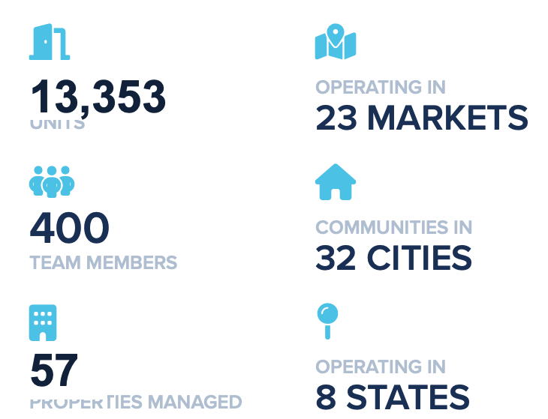
About Capital Square Living
Portfolio Footprint
Fee Transparency markets:
• 22 properties in VA
Other markets include:
• AL, FL, GA, KY, NC, SC, TN
Owner/Operator
Current Stage
• Evaluating approach
Primary Drivers
• Legislation, renter expectations, operational alignment
13,353
UNITS
57
PROPERTIES MANAGED
Notes:
Where are you seeing transparency impact your funnel? Primary driver of evaluation of the fee transparency is a result of an identified intrusion of the cohesive prospect workflow in the sales cycle. Example: incorrect/lack of quoting through shopping experience on website and follow up.
How is ownership reacting to the shift? REIT and owners are committed fee transparency with the intention of strengthening the overall experience and ultimately retention

Slide 7
Meet the Operators
The Connector

Slide 8

About RangeWater Real Estate
Portfolio Footprint
Fee Transparency markets:
• 4 properties in CO
• 2 properties in VA
Other markets include:
• AL, AZ, FL, GA, IN, NC, SC, TN, TX, WV
Fee Manage
Current Stage
• Phased rollout
Primary Drivers
• Legislation, renter expectations, brand positioning
13,353
13,353
13,353
13,353
13,353
60,511
142
UNITS
UNITS
UNITS
UNITS
UNITS
CURRENT UNIT COUNT
CURRENT CITIES
270
12
PROPERTY COUNT
CURRENT STATES
57
57
57
57
57
111
PROPERTIES MANAGED
PROPERTIES MANAGED
PROPERTIES MANAGED
PROPERTIES MANAGED
PROPERTIES MANAGED
CURRENT CLIENTS
Notes:
Where are you seeing transparency impact your funnel? Primary driver of evaluation of the fee transparency is a result of an identified intrusion of the cohesive prospect workflow in the sales cycle. Example: incorrect/lack of quoting through shopping experience on website and follow up.
How is ownership reacting to the shift? REIT and owners are committed fee transparency with the intention of strengthening the overall experience and ultimately retention

Slide 9
The Opportunity:
Transparency as the Next Marketing Frontier
Notes:
Transparency is often introduced as a compliance topic. But what we’re really seeing is a shift in how pricing itself becomes a marketing signal.

Slide 10

When the fee transparency conversation hits

Slide 11

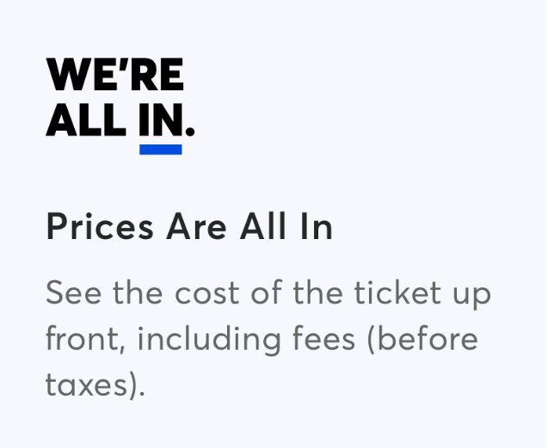






Other industries have already entered their transparent era
Renters have learned to expect upfront pricing when they:
Schedule flights
Buy tickets
Reserve stays
Book hotels

Slide 12

Multifamily is entering the same transition moment
Fee disclosure laws are expanding
Platforms are restructuring listing formats
Renters now expect total cost clarity up front
Operators are adjusting nationwide
83.3%
Of renters believe apartments communities should be more transparent about mandatory fees
56.4%
Of renters say their top reason for leaving negative reviews is when fees are not communicated clearly
Source: Biennial Online Renter Study, 2025 - SatisFacts
Notes:
Although currently CSL portfolio is not showing lack of fee disclosure as a pain point in the top 10 reasons, we respect the changing laws and and landscape and want to be active participants and on the forefront of servicing our prospects and residents proactively.

Slide 13
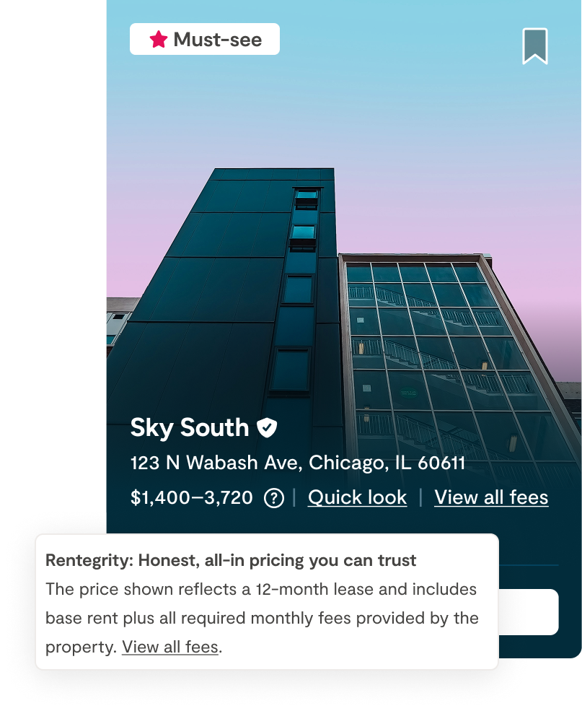
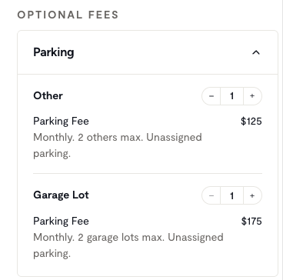
Fee transparency and all-in pricing are not the same
Fee Transparency
Required fees are clearly defined and disclosed where advertised
All-in Pricing
The total monthly price advertised inclusive of those fees

Slide 14
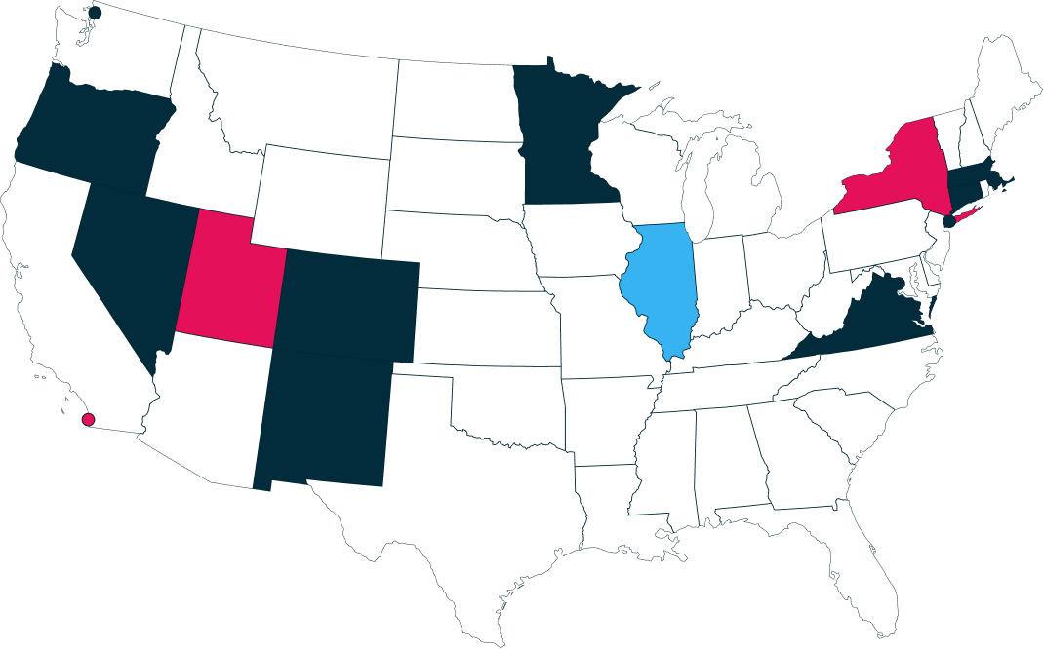
Regulation is accelerating adoption
Transparency is quickly becoming mandatory across markets
Laws in effect
Pending enactment
Proposed legislation

Slide 15
FTC may establish national rule for housing transparency
Federal guidance could establish a consistent nationwide floor
Total monthly cost and fee descriptions will be expected across channels
Local/state rules (and litigation) may continue to apply atop FTC standard
Owners/operators may have a transition window to comply
Open question if FTC chooses to tackle fee permissibility

Slide 16
Making the Business Case for Transparency
Notes:
What happens after transparency is implemented at the funnel level.

Slide 17
The early adopter jump scare
PMCs who implemented all-in pricing in 2025 found:
Lead volume declined
Tours fell
One year later, renters are here for it:
178.87% more leads
253.89% more tours
vs. listings with only base rent
But…
Approved applications grew
Move-ins increased

Slide 18
And it’s become the expectation
86% of properties disclose fees nationally on Zumper’s marketplace¹
47% of renters who used Zumper’s cost calculator submitted a lead¹
95% of renters say upfront fee transparency influences their decision²
Source: 1. Zumper internal data, April 2026 2. Zumper 2025 Annual Renter Survey.

Slide 19
Helping owners get comfortable with transparency
For fee managed operators:
Measurable funnel improvement
Occupancy protection without added spend
Protection of the asset’s reputation
Lower compliance risk
For owner/managers:
Protection of brand equity
Competitive portfolio positioning
Reduced regulatory and reputation risk at the asset level
Strategic differentiation
Notes:
In VA comparing Q1 of last year to Q1 of this year, our move in conversion % grew 163%!
Ryan: from an owner manager perspective, we are committed to ensuring a greater level of service through the sales experience and driving brand equity through strategic differentiation amongst our competitive set.

Slide 20









Suppliers are taking steps towards compliance
Industry-leading PMSs and ILSs are quickly introducing and accepting MITS 5 feeds

Slide 21
Messaging That Converts:
Implementing transparency across the renter journey

Slide 22

All-in pricing impacts every stage of the renter journey
Improves visibility in AI and ILS search results
Reduces pricing surprises during applications
Reduces fee-related complaints and negative reviews
Builds confidence before renters schedule tours
Builds pricing trust and improves loyalty

Slide 23
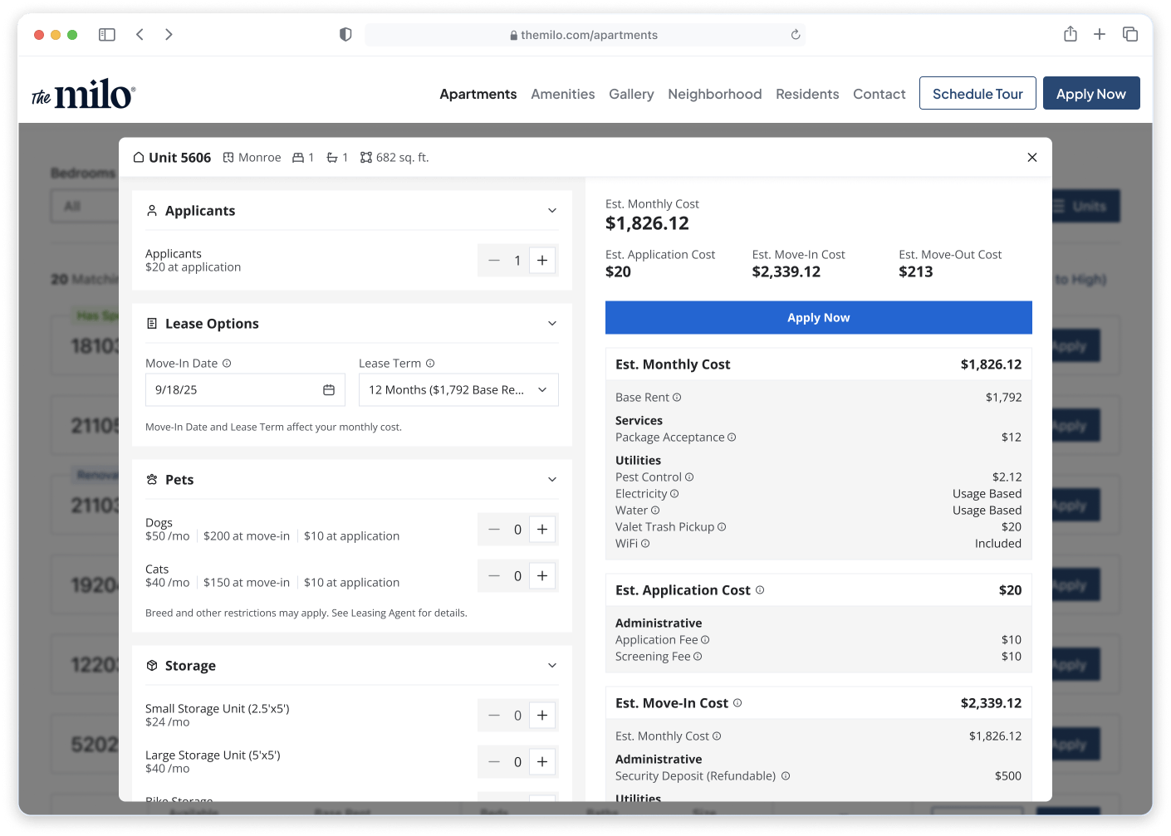
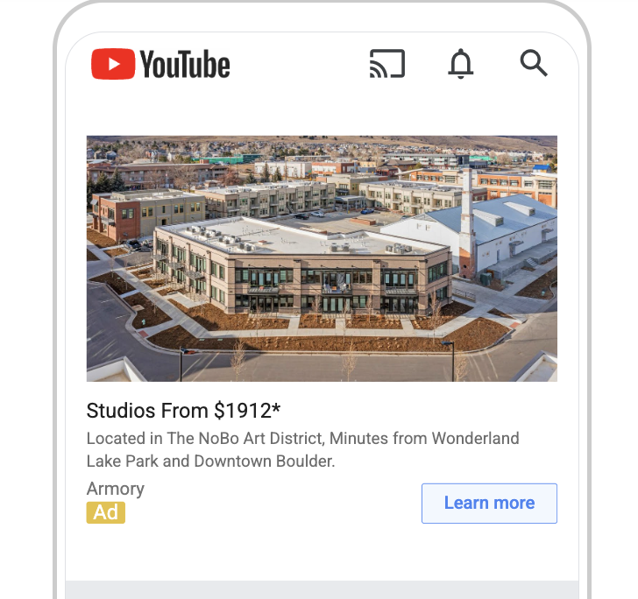
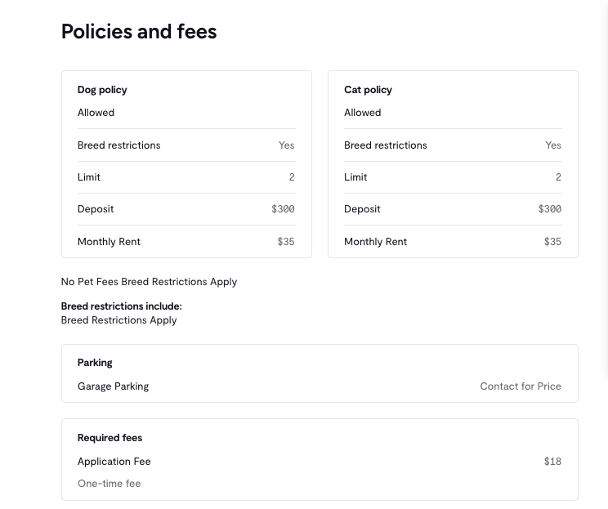
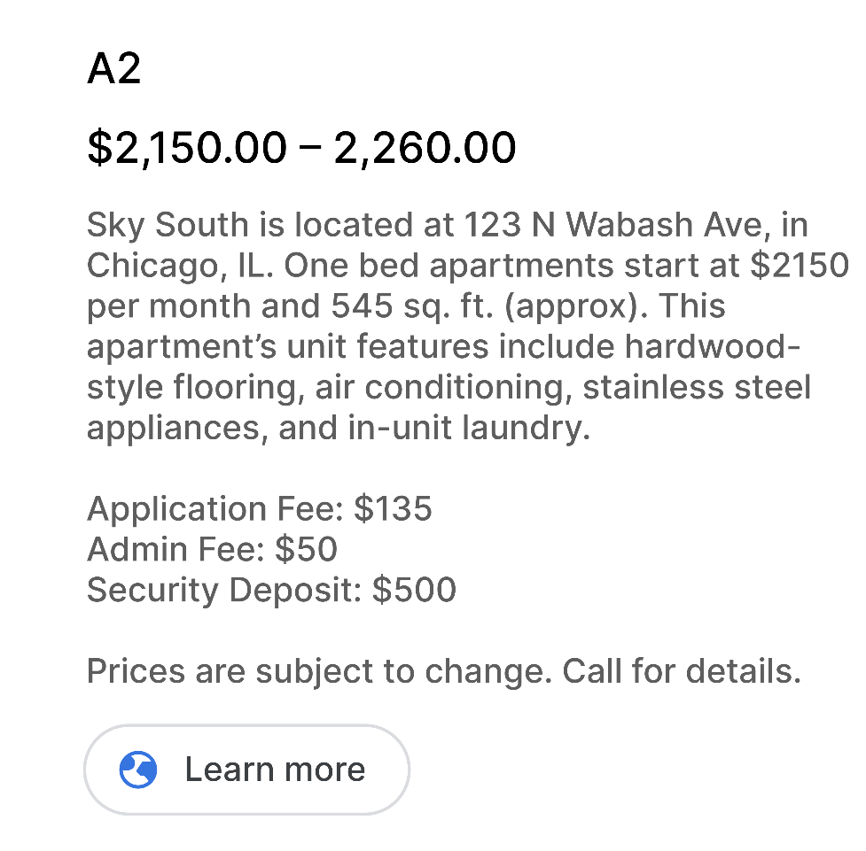
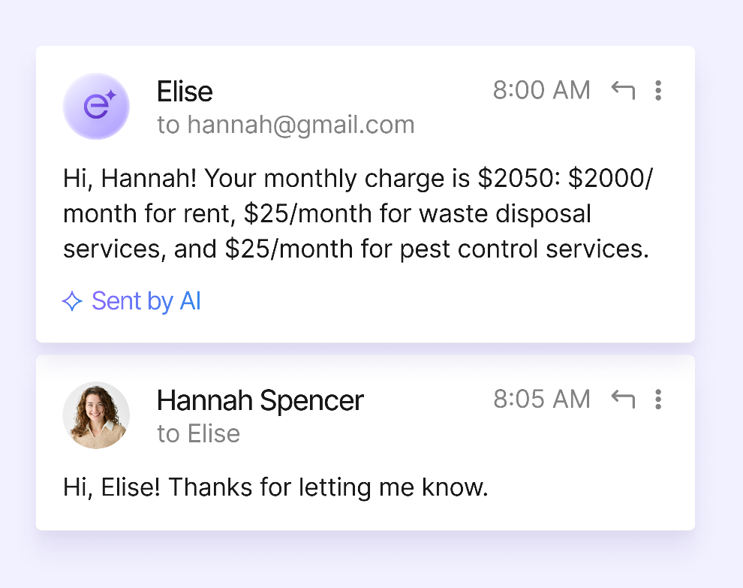
Start at the beginning
Early stage transparency includes:
Website & chat bots
Google & AI
Paid Ads
ILS

Slide 24
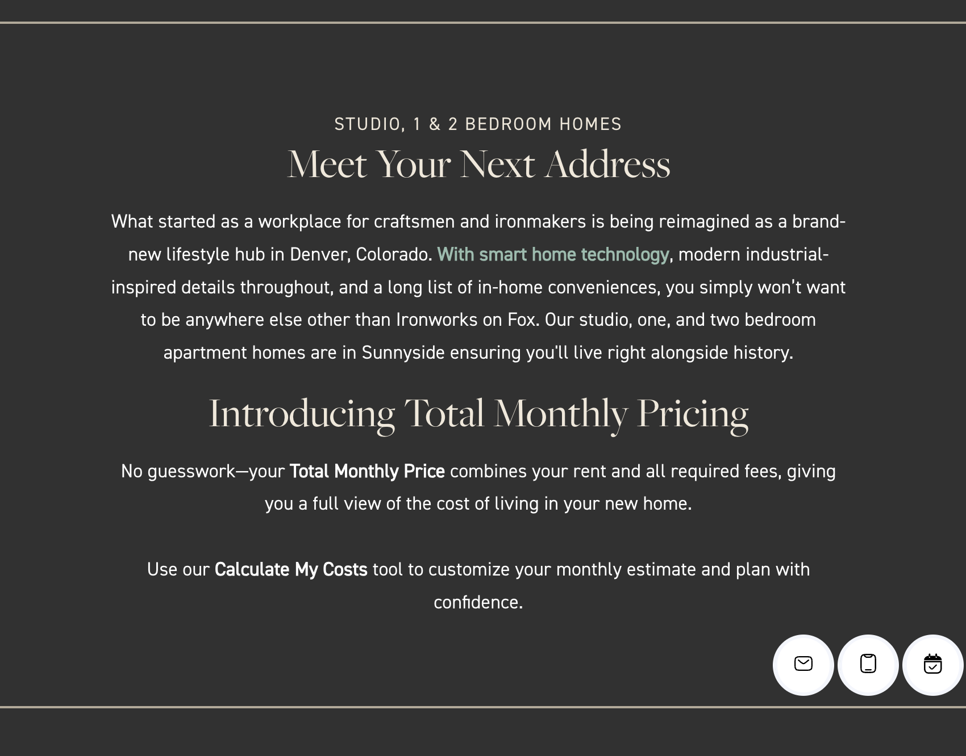
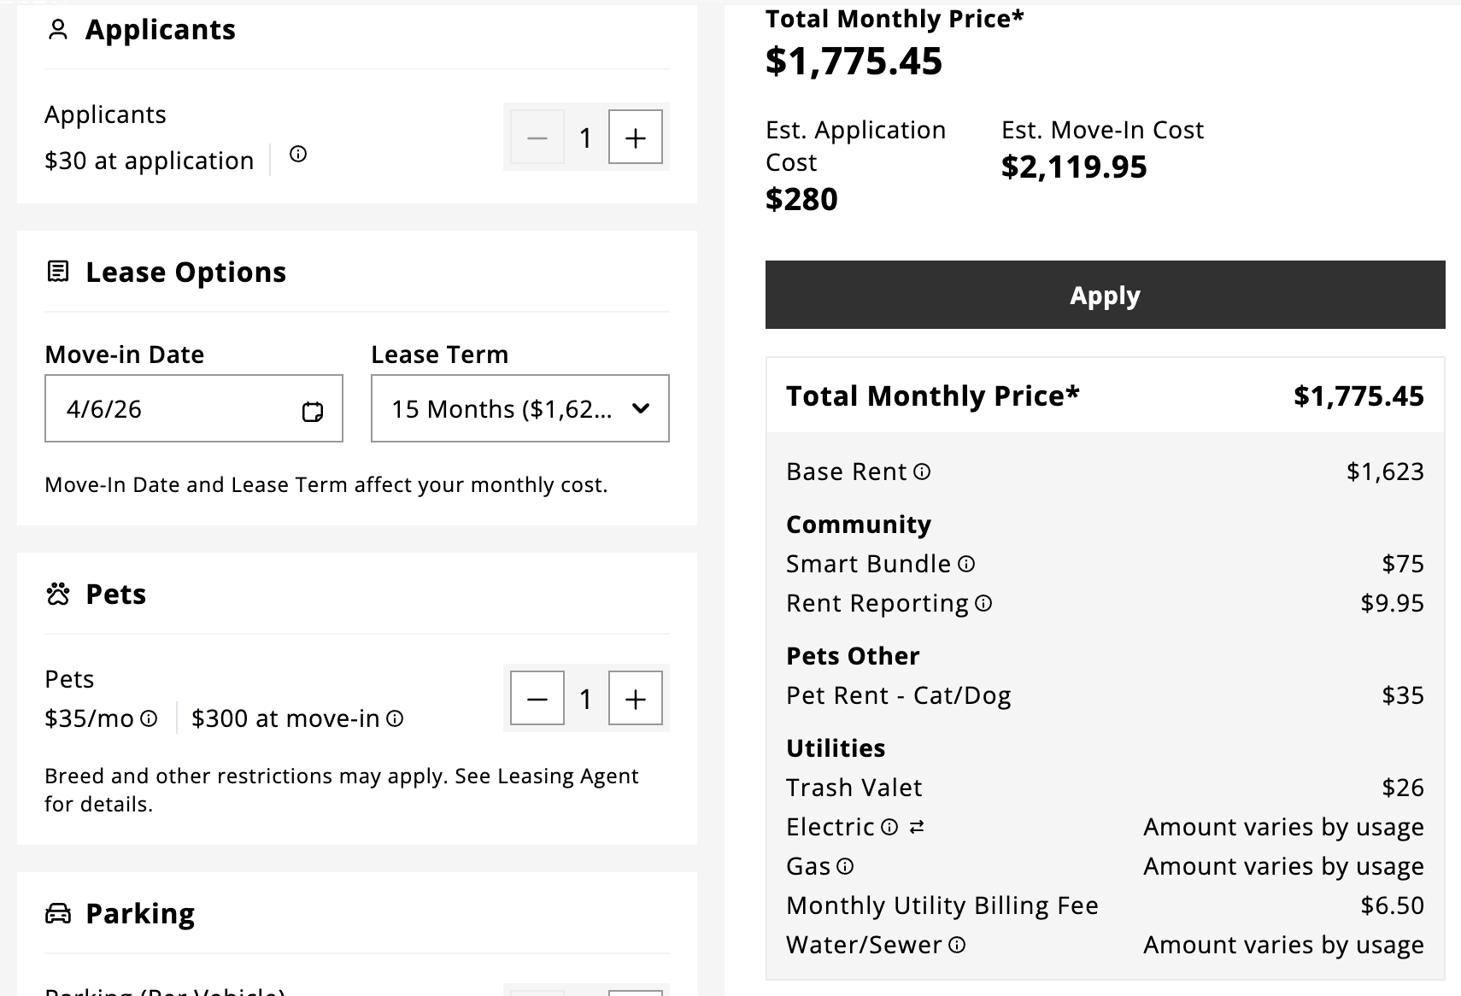
Turn your website into your clearest pricing surface
Make transparency part of your brand voice
Bold and clear descriptions of pricing on floorplans pages
Call outs on home page
Create or embed cost calculators so renters see their true costs
Provide total monthly cost in chatbot
Notes:
This was a long process involving a few different depts but getting here w/ the help of Engrain

Slide 25
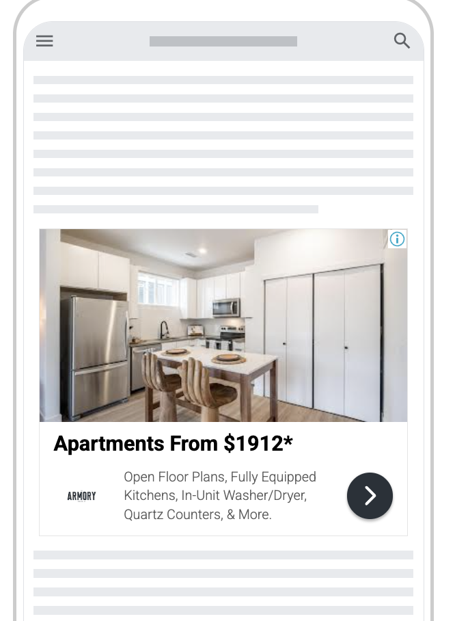

Google is the new front door
Create frequent Posts that highlight floorplans and specials
Reinforce “no surprises” messaging
Include total monthly cost and fee descriptions in Products, if eligible
Test headlines on paid ads that emphasize transparency
Organic
Paid

Slide 26
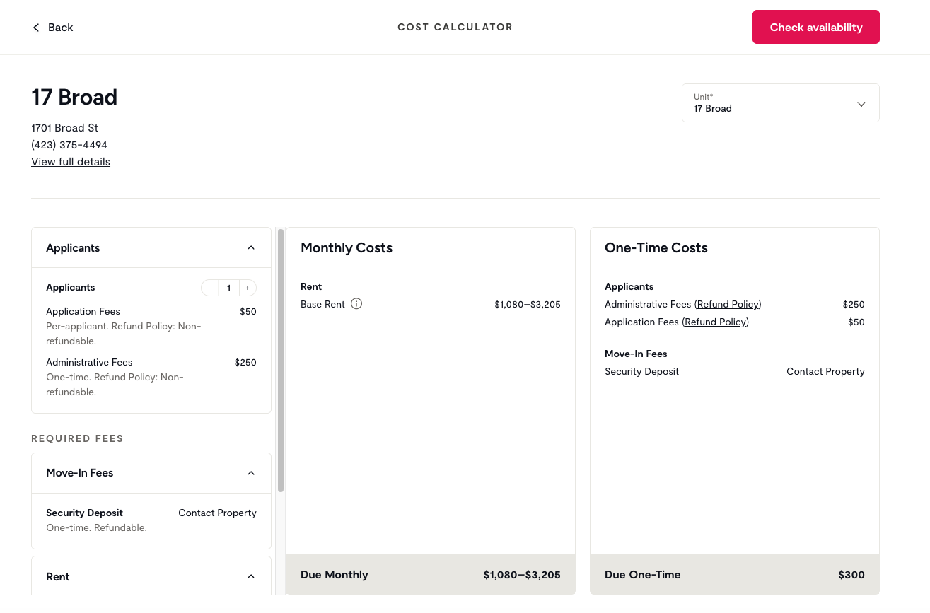
Set pricing expectations on ILS platforms
Send complete fee data through feeds
Explain required fees directly in listing descriptions
Position your community as transparent before renters begin applications
Talk to your ILS partners about badging, priority placement, and cost calculators
Notes:
Ryan: pending Zumper update on status for feeds. TBD

Slide 27
AI reads your pricing the way renters do—literally
AI search summarizes what your content makes explicit
Add plain-language fee explanations to floorplan and pricing pages
State what’s included in the total monthly cost directly in listing copy
Repeat pricing clarity across GBP, listings, and websites so totals match across sources
Example:
Say: 1BR from $1,875 (includes $125 required monthly fees)
Not: 1BR from $1,750
Notes:
Currently 30% MF industry clients have requested fee transparency be incorporated into their PPC ads. Through imagery, pricing, fee structure, and all in packaging, this married with clear websites, social media and GBPs will help support overall fee transparency as the new “must have” from prospects.

Slide 28
Make sure the math is mathing
The quoting process is where pricing consistency was breaking down. Confirm pricing matches from search to sign.
Include required fees in email and SMS follow-ups
List all-in pricing details by unit
Align leasing scripts with advertised pricing structure
Ensure quoted totals match listings and application pricing
Notes:
Ryan: larger conversation involving L&D, Marketing, and all Support Services in order to best support fee transparency. Retraining our approach to sales and closing.

Slide 29

Consistency strengthens credibility, quality, and reputation
Aligned pricing supports trust and compliance
Avoids “bait and switch”
Improves the quality of renter conversations
Reduces fee-related complaints in reviews
70.6%
Of Gen Z renters say they would leave a negative review if fees were not communicated early
Source: Biennial Online Renter Study, 2025 - SatisFacts
Notes:
Ryan: greater transparency leads to higher conversions and avoids athe bait and switch theory.

Slide 30
Q&A
And wrap-up

Slide 31

Transparency is the new curb appeal
Show total cost sooner
Keep pricing consistent everywhere
Use clarity as a competitive signal
Strengthen conversations before tours begin
Prepare for structured, AI-driven discovery

Slide 32
Any questions?

Slide 33
Thank you!

Slide 34
All-in pricing signals confidence
Being upfront about costs builds trust faster
Shows there are no surprises later in the process
Makes pricing easier to evaluate across communities
Builds trust before conversations start
Positions your community as transparent and modern

Slide 35
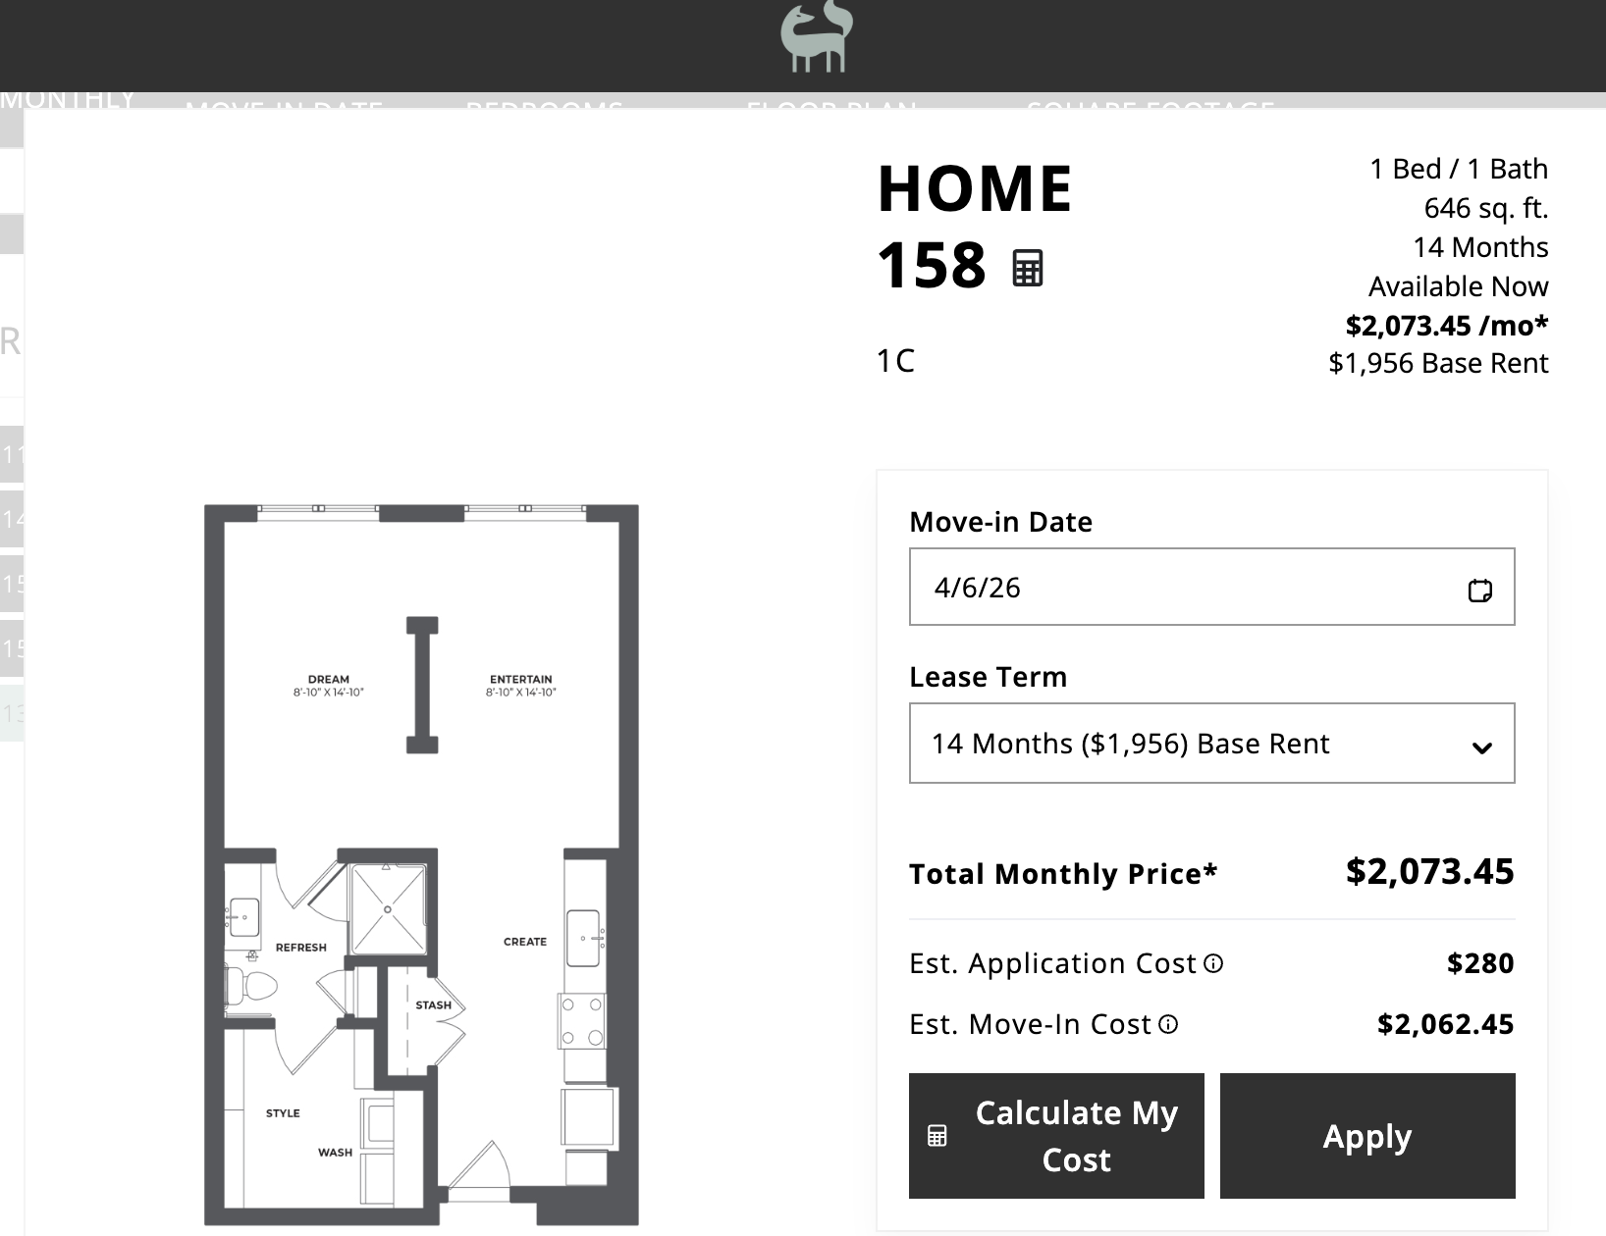
Show what’s included in the total monthly cost
Understanding the structure of pricing increases renter confidence
Breakdowns reduce uncertainty
Clear totals support comparison decisions
Visibility improves perceived fairness
Transparency signals operational confidence

Slide 36
Capital Square Living’s portfolio
Portfolio Footprint
• X properties in [city], [st]
• X properties in [city], [st]
• X properties in [city], [st]
Current Stage
• Pilot markets / phased rollout / portfolio-wide implementation / evaluating approach
Primary Drivers
• Legislation / renter expectations / operational alignment / brand positioning

Slide 37
The Transparency Playbook
What marketers can implement today

Slide 38
Make transparency part of your brand voice
Pricing clarity should feel like a deliberate promise, not just a disclosure
Introduce “all-in pricing” as a positioning statement
Frame transparency as part of the leasing experience
Reinforce “no hidden fees” as a trust signal across channels

Slide 39
Compete on clarity in search and ads
Renters compare communities using total cost, not just base rent
Rewrite ad headlines to emphasize predictability
Update meta titles to reflect total monthly cost
Replace “starting at” copy with defined ranges

Slide 40
Use follow-up messaging to reinforce transparency
The moments after a click or inquiry are where pricing confidence can either grow or erode
Restate total monthly cost in follow-up emails
Reinforce what’s included before tours or applications
Reduce uncertainty before the next step & remain compliant

Slide 41
Turn pricing questions into content
If renters keep asking the same pricing questions, marketing should answer them earlier
Create social posts that explain common fees
Share examples of total monthly cost breakdowns
Use recurring questions to guide new content themes

Slide 42
Build an internal transparency benchmark
You can’t improve what you haven’t mapped across the journey
Audit where total monthly cost appears today
Identify gaps across listings, websites, and ads
Track where pricing becomes visible too late

