Slide 1
Turning Sentiment Into Steps
The Next Frontier of AI

Slide 2

The Big Idea:
AI Chat Is Ubiquitous in multifamily.
The words that chat produces are a great source of insight into resident sentiment.
The same insight is enabling the next wave of automation.

Slide 3



Maria Banks
President & CEO
AMLI Management
Tiffany Walsh
Director of Marketing
Nolan Living
Dom Beveridge
Principal
20for20

Slide 4


AI Chat Improves Sentiment Analysis
White paper presents AI-driven research and sentiment analysis
Study uses resident Wi-Fi as a guinea pig topic
Explores a key blind spot: how residents feel about connectivity

Slide 5

The Power of Open-Ended Questions
AI pursues engagement with the topic of conversation
Questions follow an “anchor” and “follow-up” structure
The conversations produce a lot of words, which form the basis of the sentiment analysis
Start With an “Anchor Question”
Ask Another Anchor Question
Follow-up Exploratory Questions
Follow-up Exploratory Questions
Capture Both Factual Information and Emotional Responses
Analyze Results

Slide 6
The Importance of Reliable Data
Survey Approach
“Does your experience with this community’s Wi-Fi affect your likelihood to renew?
Approach Used in This Research
“How do you feel about the Wi-Fi in this community?” | “How are you feeling about renewal at this point?”
Analyze sentiment, group respondents based on their answers. | Analyze sentiment, compare to renewal outcomes, group by renewal probability
Compare results and look for patterns of correlation

Slide 7
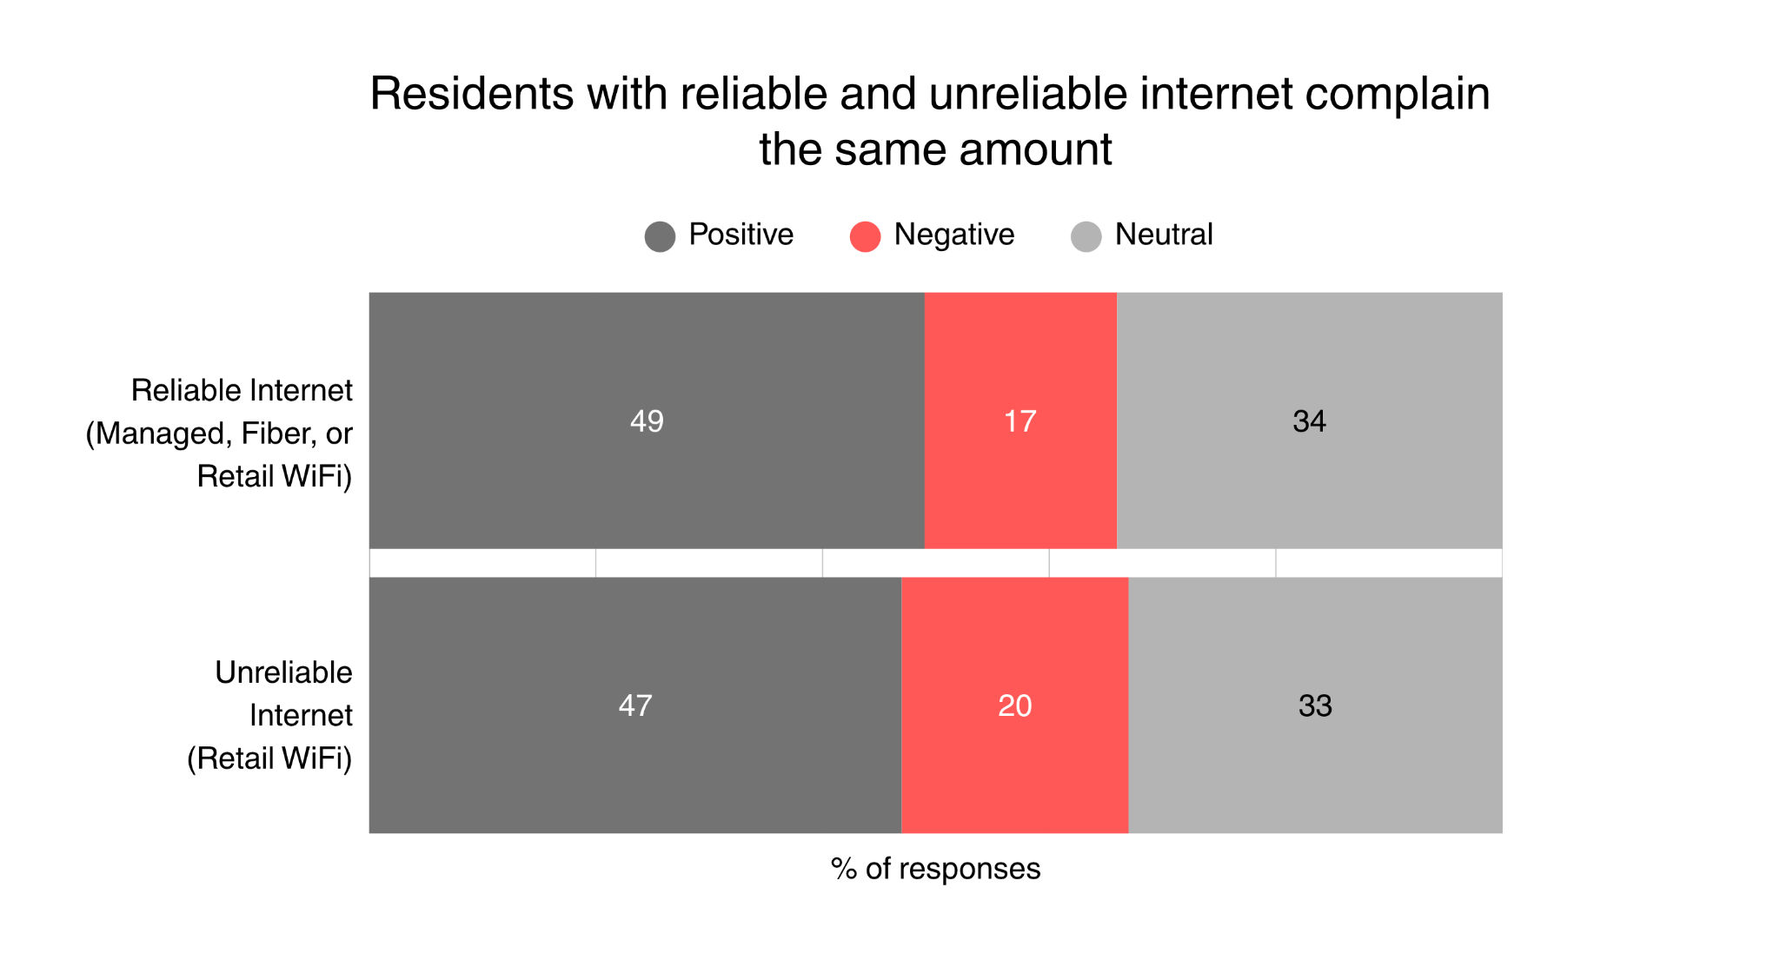
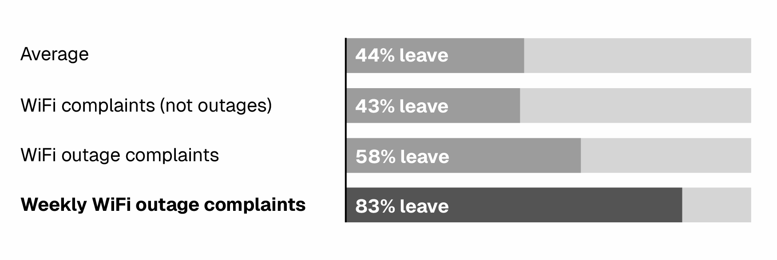
What We Learned…
Residents Complain About Wi-Fi…
…But Only Churn When it Doesn’t Work
Sentiment by Response and Service Types
% Non-Renewing Units By Complaint Type
Internet-related churn comes from outages, not volume of complaints.

Slide 8
Maria Banks
President & CEO
AMLI Management
Tiffany Walsh
Director of Marketing
Nolan Living
Dom Beveridge
Principal
20for20

Slide 9

Resident chat → Real-time sentiment
01 · CAPTURE
Conversations at scale, every day.
02 · MEASURE
26,754 texts
Sentiment data, created over time.
last 30 days
22%
03 · USE
Where sentiment becomes useful.
of residents respond with paragraphs to yes/no questions
Operations
Retention
Marketing
Leasing
Reaching Leads with AI Search

Slide 10
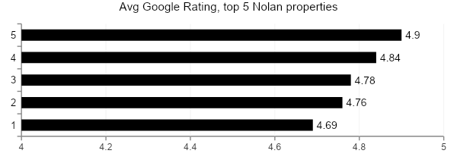
Real-time sentiment → Real detail for AI search
Properties chase star ratings…
…but prospects book tours on relevance
Five averages, all clustered above 4.69. Now what?
26,754 conversations -> 1459 specific reviews for every prospect need.
apartments with good maintenance
Sovereign at Overland Park
PROOF OF SERVICE
“When the trash compactor was down, maintenance came and picked up my garbage from my door until it was replaced.”
best apartments overland park helpful staff
Sovereign at Overland Park
AUTHENTIC STAFF
“I’m so grateful to be living at the very best apartment complex in the KC Metro area. Mike, Edgar, Kim, Chase. All amazing.”
apartment with full gym near me
Sovereign at Overland Park
AMENITY MATCH
“As a personal trainer, I’m able to assist many residents, with a gym that has all the necessary equipment.”
Prospects don’t book tours based on star ratings
They search for specifics surfaced by AI overviews from relevant reviews
Prospects book tours on specifics surfaced by search and AI overviews, not stars.

Slide 11
Maria Banks
President & CEO
AMLI Management
Tiffany Walsh
Director of Marketing
Nolan Living
Dom Beveridge
Principal
20for20

Slide 12
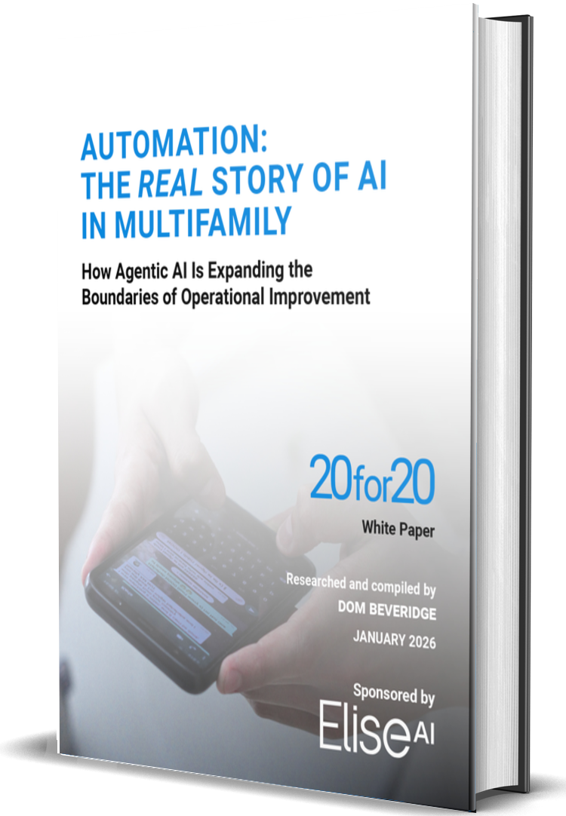

Automation Is the Real Story of AI
It’s more helpful to think about “Automation” rather than “AI”
The scope of what is being automated is growing
Sentiment is at the core of future automation opportunities

Slide 13

Delinquency: The New Gateway Process
Delinquency gets automated and/or centralized
Results improve (faster payments, reduced bad debt, etc.)
Insights gathered about resident preferences can help other processes
The process works, span of control of overseeing team grows
AI learns about resident behavior from each month’s conversations
Organization looks to automate similar processes

Slide 14
Turning Sentiment Into Steps
The Next Frontier of AI

