Slide 2
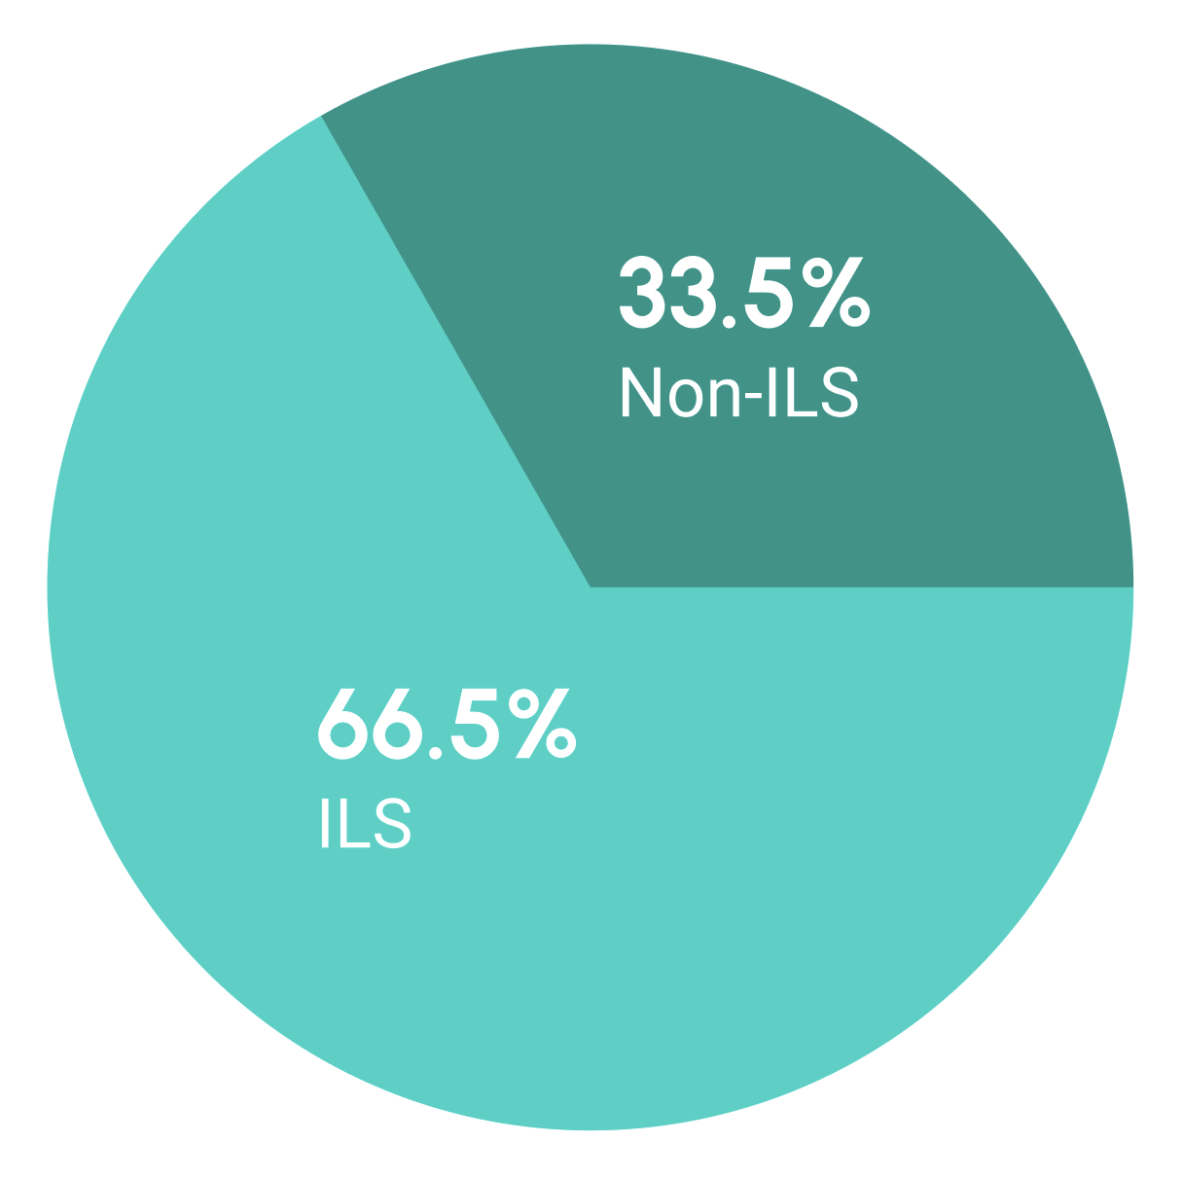

Slide 3
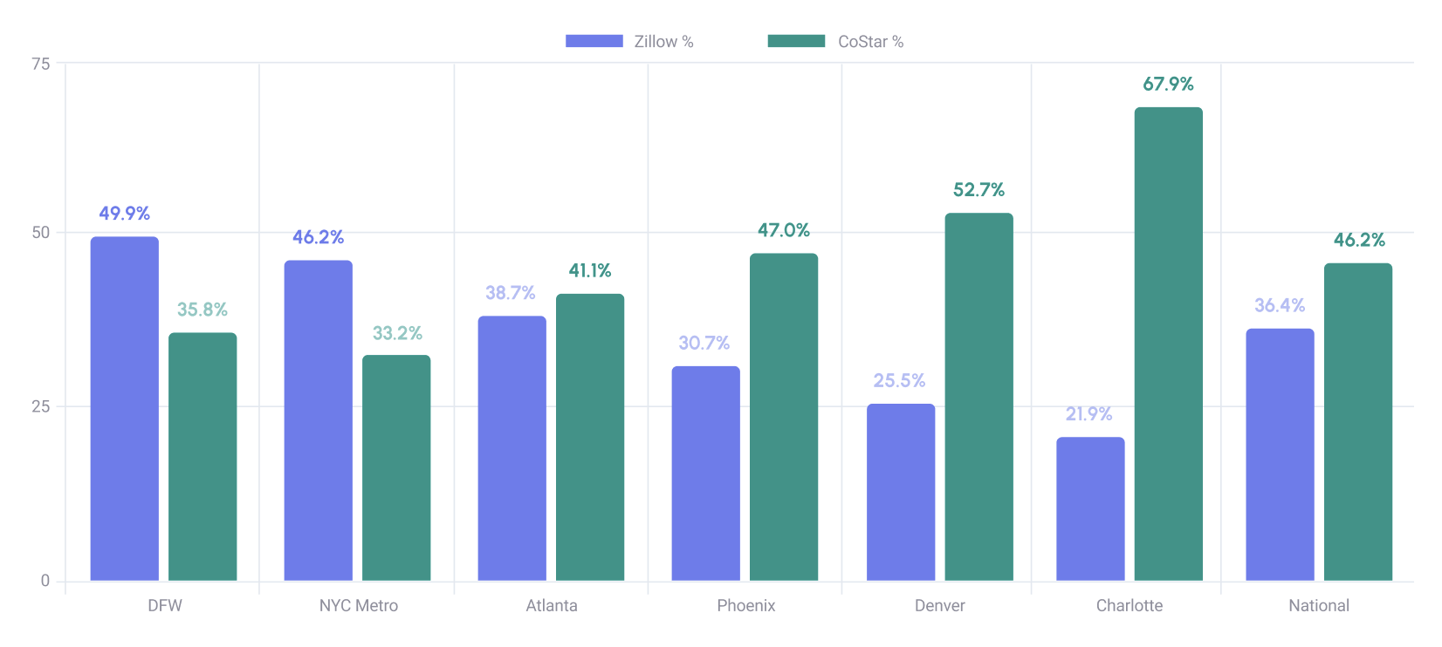

Slide 4
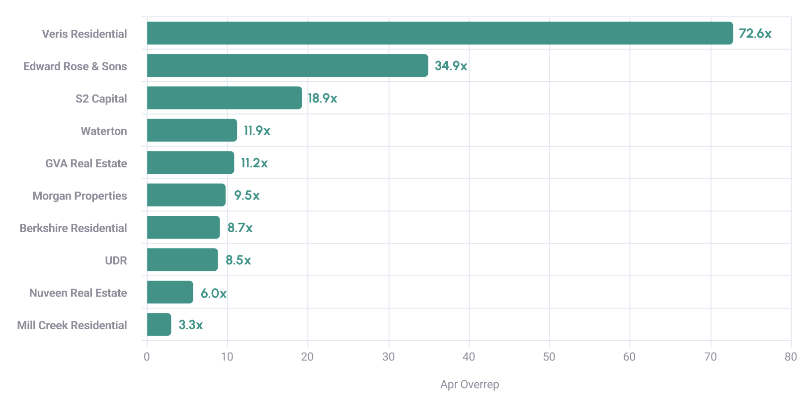

Slide 5
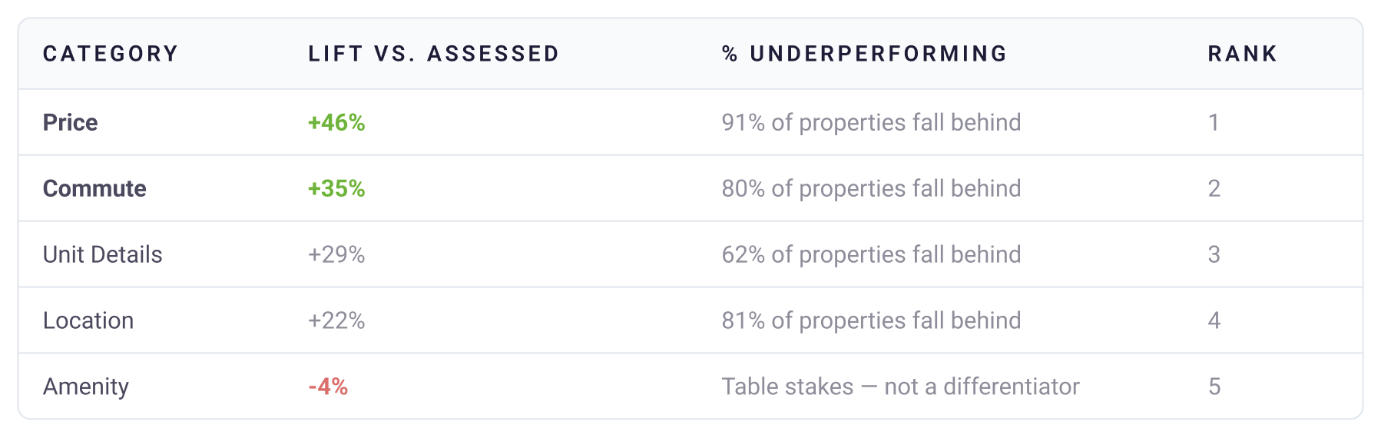

Slide 6
1
Know where you stand.
4
Diversify ILS coverage across data sources.
2
Kill two birds with one stone with SEO.
5
Invest in your property website.
3
Add commute and location content.
6
Continue tracking it over time.

