Slide 1
Interactive poll
How ready is your organization to roll out
Total Monthly Leasing Price?
  Already live
  Ready to launch
  Building our capabilities
  Need to learn more
  Not participating
Insert QR code
Notes:
BRENT - Can use Engrain Slido
Speak to AV Tech on site about how to run the poll (whose computer) and display results

Slide 2
The Price is Right
What We’ve Learned about Fee Transparency
Notes:
5 seats on stage
1 person comes on at a time at transition; finished person takes a seat on stage

Slide 3


Notes:
GREG
In the changing world of fees and price disclosure, what comes to mind when you think about these iconic brands - Southwest and Ticketmaster?
How did you feel when Southwest eliminated bags fly free and introduced fees for seat selection into their business model?
How did you feel about Ticketmaster fees not showing up until the end of the transaction?

Slide 4
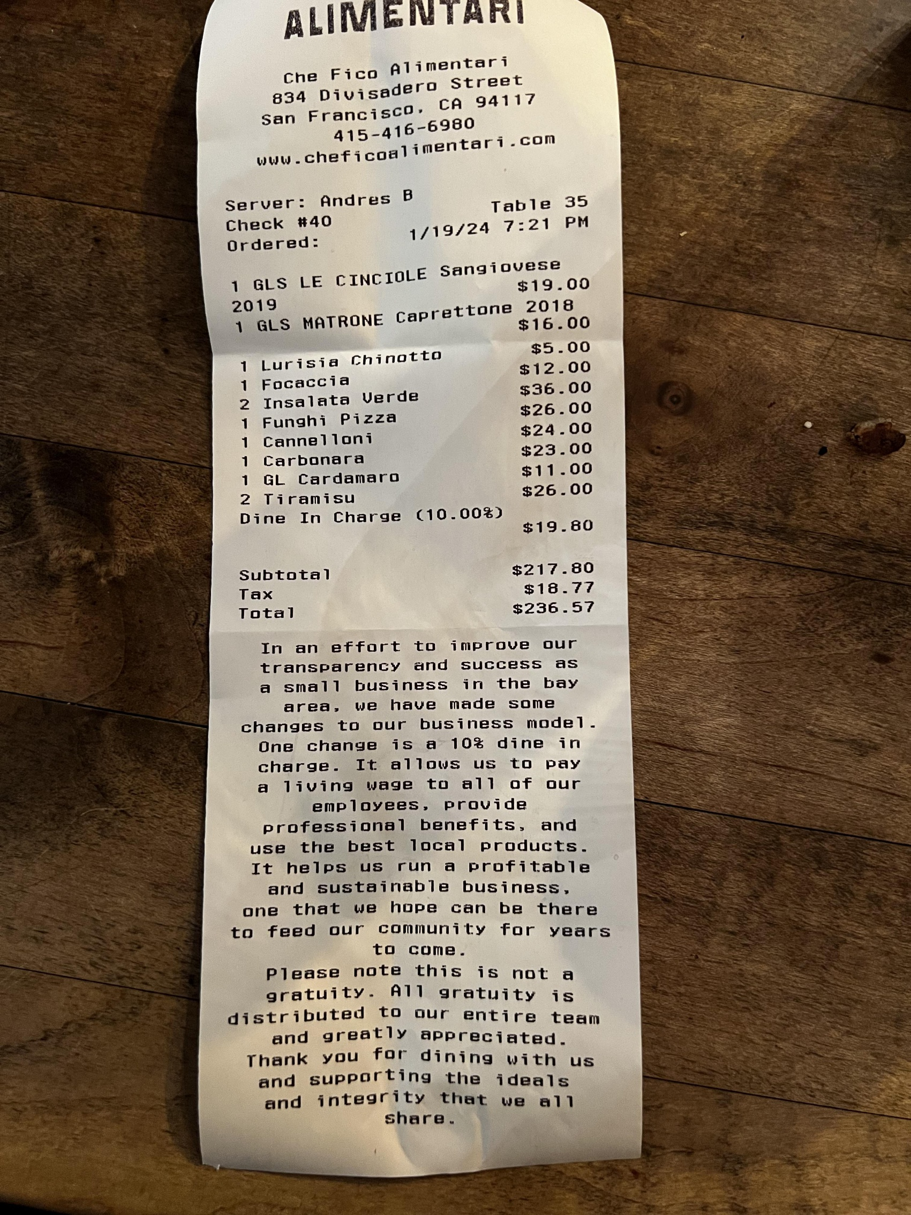
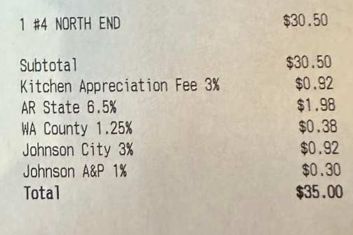
Notes:
GREG
How do you feel when you get a surprise charge at a restaurant when the bill arrives?
Now imagine that you’re a renter… how would you feel if you found a $1500 apartment only to find out at lease signing that the true cost, with all the fees included, is really $1750 per month?
I know how I feel about fees as a consumer.
My name is Greg Benson. I’m the Managing Director – Marketing for Greystar.
Over the last 2.5 years, I’ve co-lead Greystar’s enhanced fee disclosure and price transparency efforts. Understanding how to balance renter-centric experiences with legal requirements and product development cycles allowed me to guide the creation of internal practices and process solutions while also influencing the development of tools and technology across the industry that benefited everyone.
Enough about me. Let’s talk about how we got here.
Renter complaints about fees and pricing energized local, state, and federal governments to scrutinize how the multifamily industry communicates price.
The outcome of that activity is a complex legal environment.

Slide 5
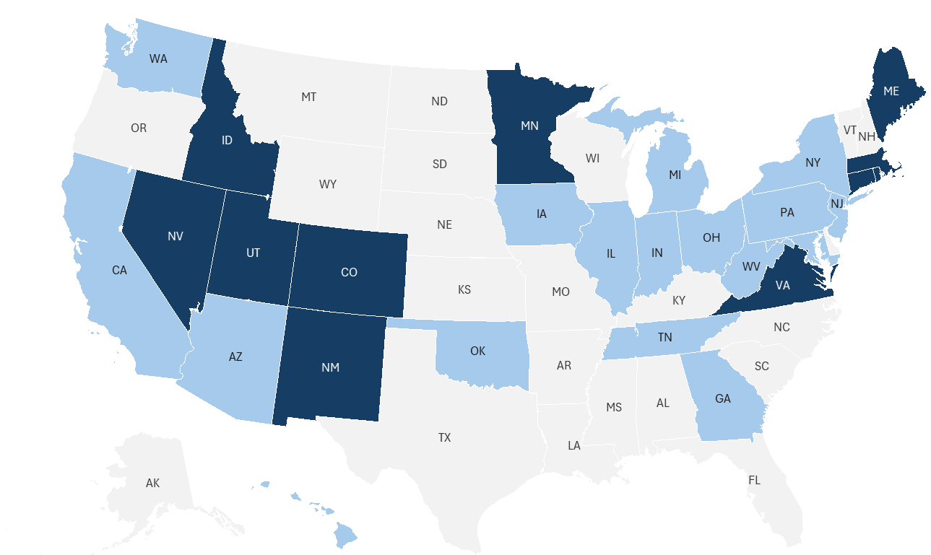
FEE TRANSPARENCY legislation is reshaping the industry
In Effect
Proposed
Federal
H.R.6430 / S.3367
(Introduced)
FTC Advanced
Rulemaking (3/12/26)
Local/City Level Legislation
Fayetteville, AR
New York City, NY
Austin, TX (Proposed)
Bellingham, WA
Olympia, WA
Shoreline, WA
Notes:
GREG
A landscape that is reshaping our industry.
13 states + several local jurisdictions have fee disclosure and price transparency laws in effect
And 16 additional states have proposed legislation in 2026
On top of that, both houses of Congress have proposed legislation, and the FTC has issued a “Advanced Notice of Proposed Rulemaking” for multifamily.
Up until now, the industry
<slide transition>

Slide 6


Notes:
GREG
the industry focused on building technology and tools to meet legal requirements.
Given tight regulatory deadlines and product development cycles, customer experience wasn’t the primary goal for these solutions. Where do we go next?
This session is focused on what we’ve learned in the last year about renters and how they’ve reacted to enhanced disclosure of fees and total monthly leasing price. I’m going to be joined by several experts who will share their learnings across the renter journey from shopping to leasing.

Slide 7
My Property Looks More Expensive
I’m Getting Fewer Leads
My Competitors Aren’t Doing It
We’re Losing Revenue
Notes:
GREG
From the beginning, there were loud voices clamoring about all the reasons enhanced fee disclosure and price transparency is bad.
You may have heard these statements, or ones like them, from co-workers or from clients and investors.
Our goal today is to arm you with data to overcome those stakeholder objections.
And hopefully, leave you with a level of confidence that enhanced price transparency is the right thing to do.
Let’s look at some data…
<slide transition>

Slide 8
95% of prospects found the Community Fee Guide helpful in understanding move-in costs
80% of residents
said the CFG helped in their decision to live at our community
98% of prospects said knowing the Total Price was helpful prior to touring
“It gives a clear picture of my total monthly cost”
- J Bellamy,
Executive Park Apts
“It made it easier for me to understand what I’d really be paying and plan my budget before applying”
- Tyliah, McKinney Terrace Apts
“I was able to see what my total monthly cost was AND a move-in estimate!”
Courtney, Marlowe South Fulton
98% of residents
found the Cost Calculator helpful in their search for a new home
Notes:
GREG
More than 50,000 prospects and residents responded to Greystar surveys since June 2025.
As you can see, Renters are responding in an overwhelming positive way to enhanced fee disclosure and price transparency.
Our efforts have deepened Trust with renters and increased renter confidence levels when selecting their next home.
We’ve eliminated pain points and removed confusion from a complex purchase decision.
And, we’ve found quantifiable financial benefits

Slide 9
Reputation and NOI Lift from TMLP
2,400+ Properties (270-unit avg)
Managed for 24 or more months
Changes since April 2025
69% of properties
saw reputation score increase tied to TMLP
18 point jump
in scores above expected
$76K
estimated NOI lift
Notes:
GREG
We analyzed more than 2,400 properties managed by Greystar for a minimum of 2 years. After the release of Total Monthly Leasing Price in April 2025,
Nearly 70% of the communities saw an increase in their reputation score
The average score increased 18 points more than the expected increase for a property under management for that period of time
In our model, this score increase equates to an incremental lift in NOI of more than $75,000 per property.
Our data shows renters are happy with transparency and there are broad financial benefits for the community.
With me today are 4 multifamily experts who will dig deeper to provide additional data points across the renter shopping journey to demonstrate the value of enhanced transparency.
<slide transition>

Slide 10





Stuart Richens
VP Product | Apartments.com
Catriona Banks-Orosco
Sr Director | REACH by RentCafe
Brent Steiner
Founder & CEO| Engrain
Brandy Daniel
Chief Strategy Officer| BH Mgmt
Greg Benson
Managing Director| Greystar
Notes:
Stuart Richens has worked in multifamily marketing with CoStar Group for the past 15 years. Stuart leads Apts.com’s efforts in price transparency and their approach to nationwide total monthly pricing display, the benefits of displaying an all-in price, and their detailed cost calculator.
Catriona Banks-Orosco has shaped Yardi’s digital marketing capabilities while leading initiatives like Yardi’s evolution of Total Monthly Leasing Price capabilities across the RentCafe® ecosystem. She’s currently leading data-focused research into renter search, shopping, and leasing behaviors to understand the influence that transparent, all-in pricing has on conversions, consumer trust, and leasing efficiency.
Brent Steiner has dedicated his career to understanding what renters want and how they search for apartments. Under his leadership, Engrain has pioneered consumer-focused solutions that make apartment shopping more intuitive and transparent, enabling renters to better understand pricing and self-qualify effectively.
Brandy Daniel leads the Business Performance Systems department, overseeing software development, revenue management, marketing, analytics, reporting, and budgeting. She is the architect of the BH Right Price Promise driving greater transparency, consistency, and performance.
Please join me in welcoming Stuart Richens to the stage. Stuart will take us to the starting point of many renter shopping experiences & share what Apts.com has learned.

Slide 11
Using total monthly price to attract renters as they begin their search

Slide 12
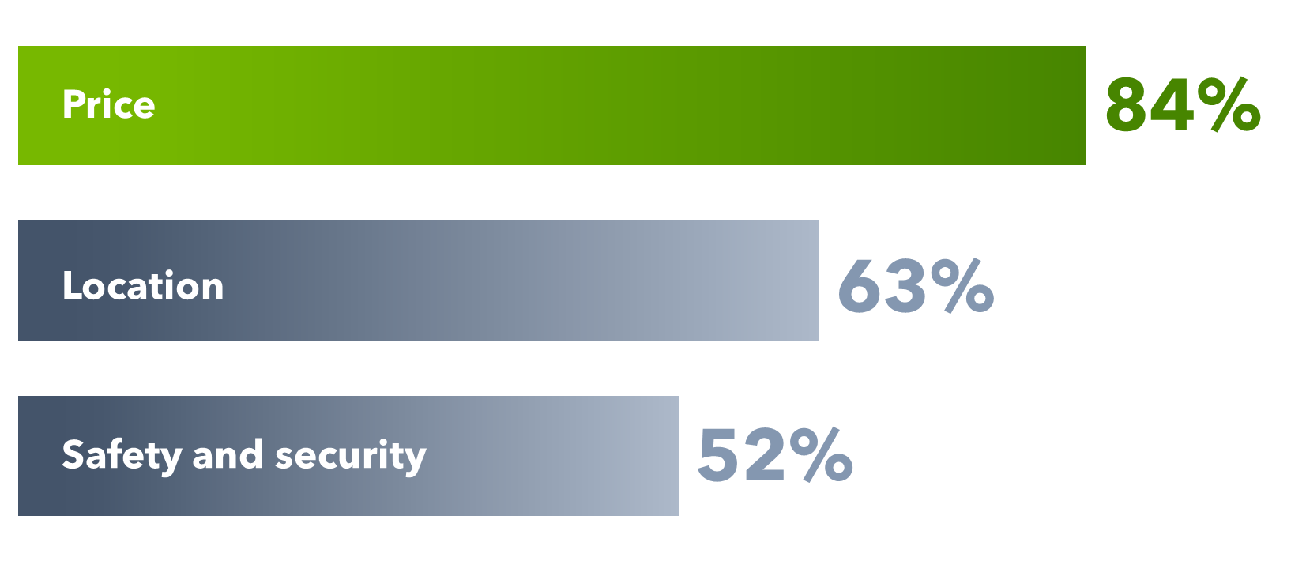
Price is #1 most important factor in renter search
Among top 3 considerations when selecting next rental residence
Source: Apartments.com Renter Survey

Slide 13
We asked ….
Renters want to see the total price with all fees included.
I can’t afford hidden or unexpected charges. I must stay within my budget.
— Renter in Texas
85%

Slide 14
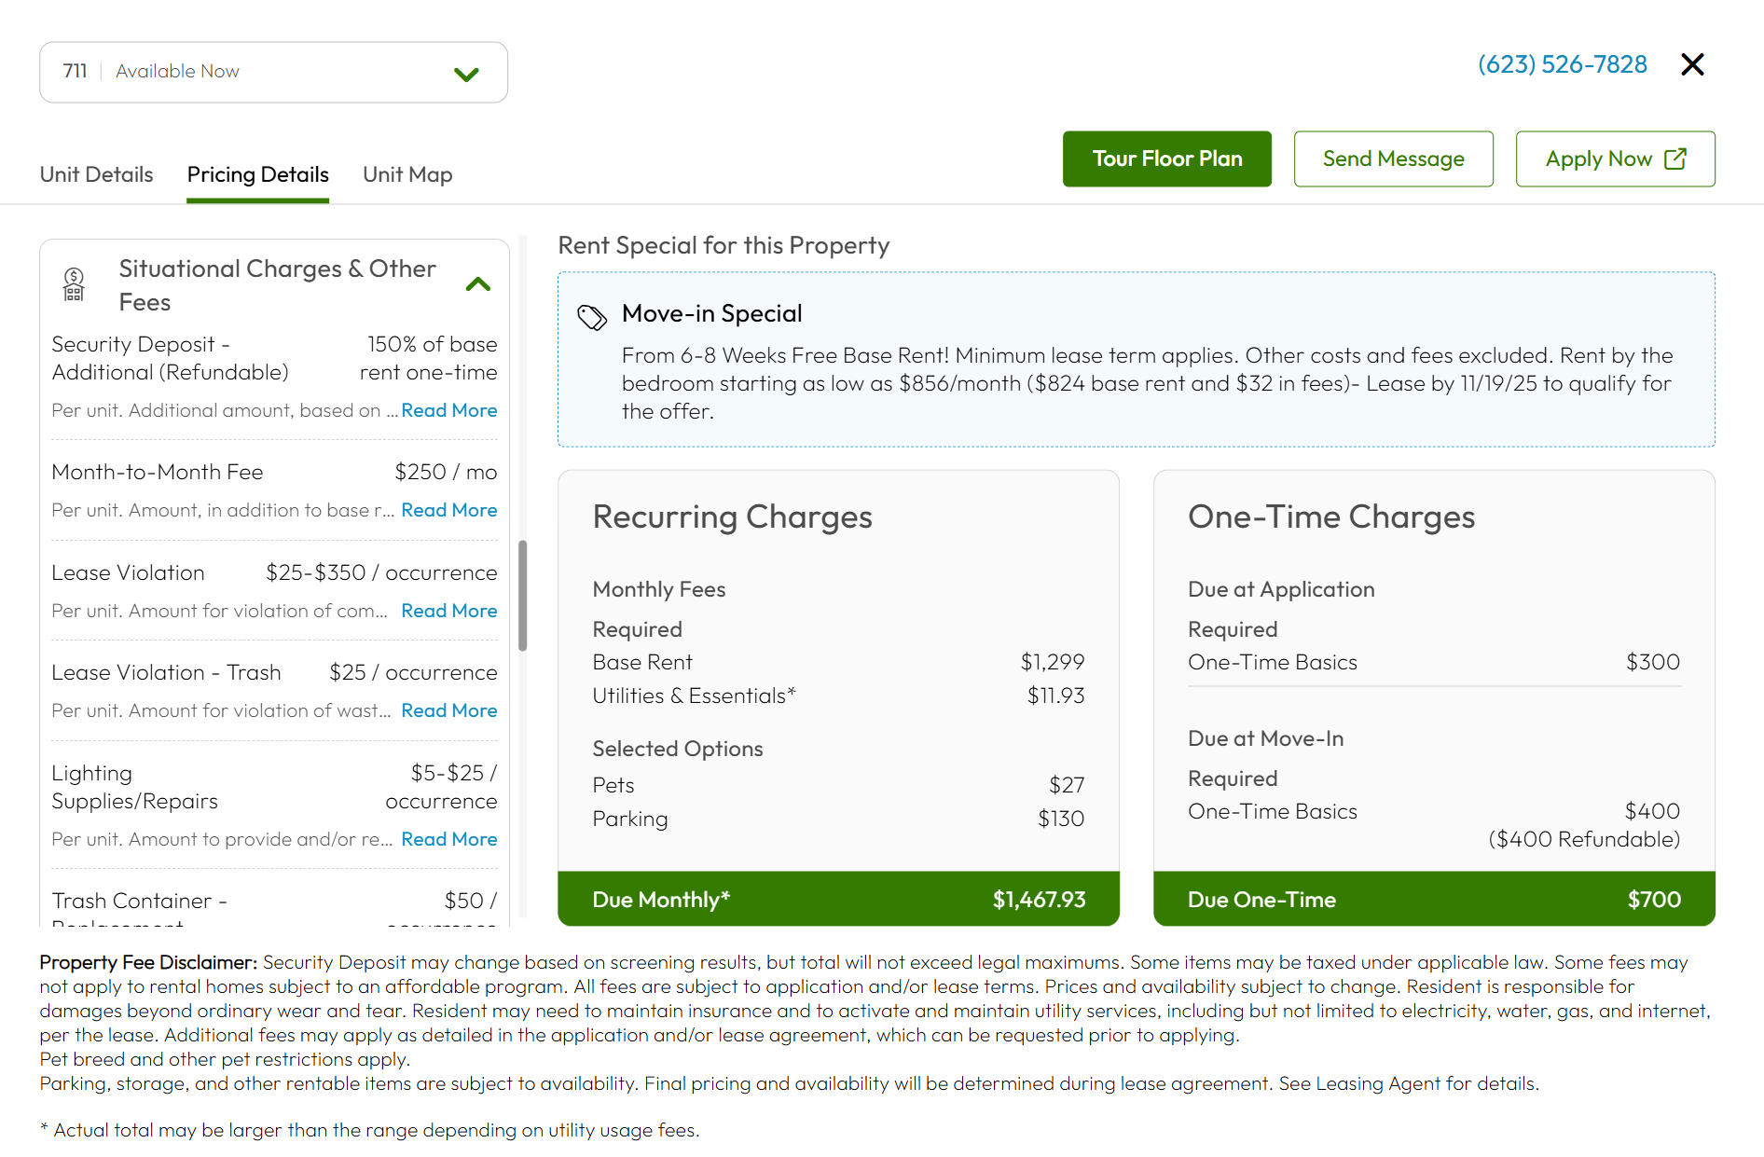
Renters report that hidden fees can be a dealbreaker!
54%
of renters say they would stop considering a property or rental unit if fees made the total cost higher than originally advertised
Source: Apartments.com Renter Survey

Slide 15
48% of renters say they have stopped considering a property when presented with new fees!

Slide 16
Our customers see real benefits when they display a "Total Monthly Price"

Slide 17

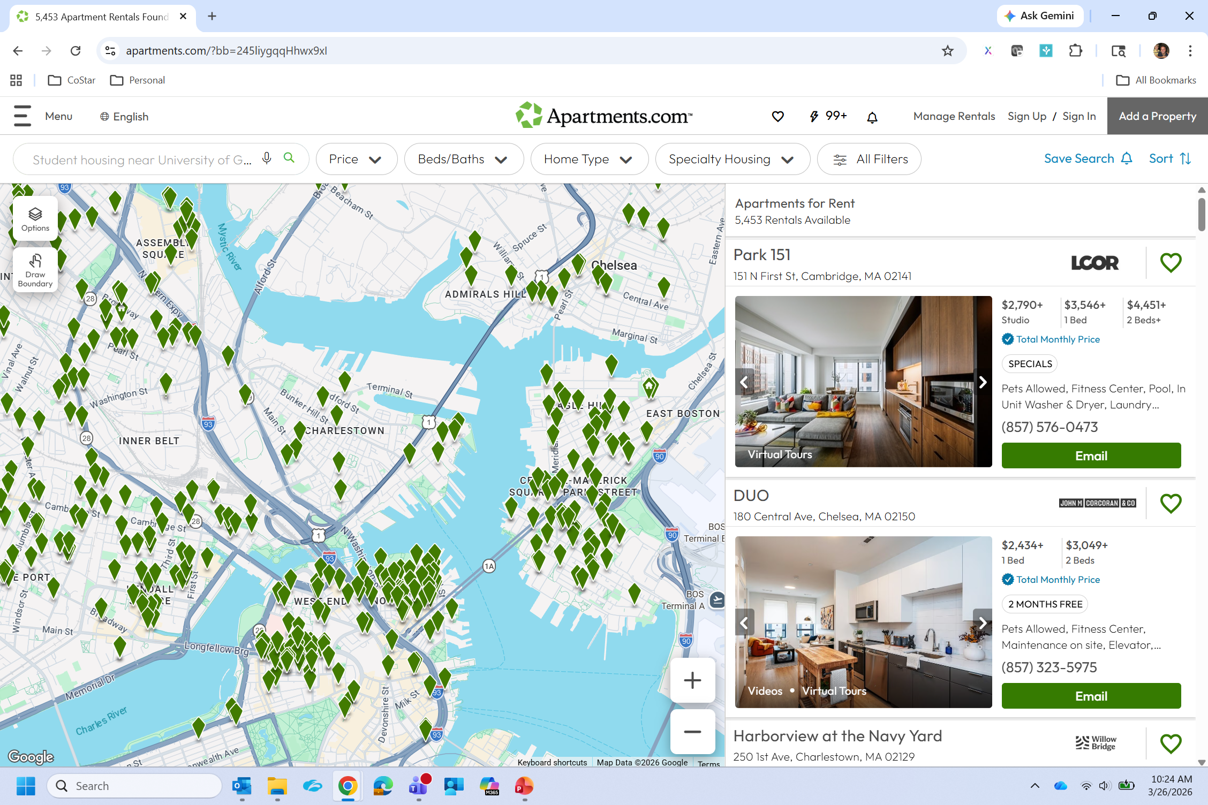
17+% more search results impressions
Source: Apartments.com internal analytics

Slide 18
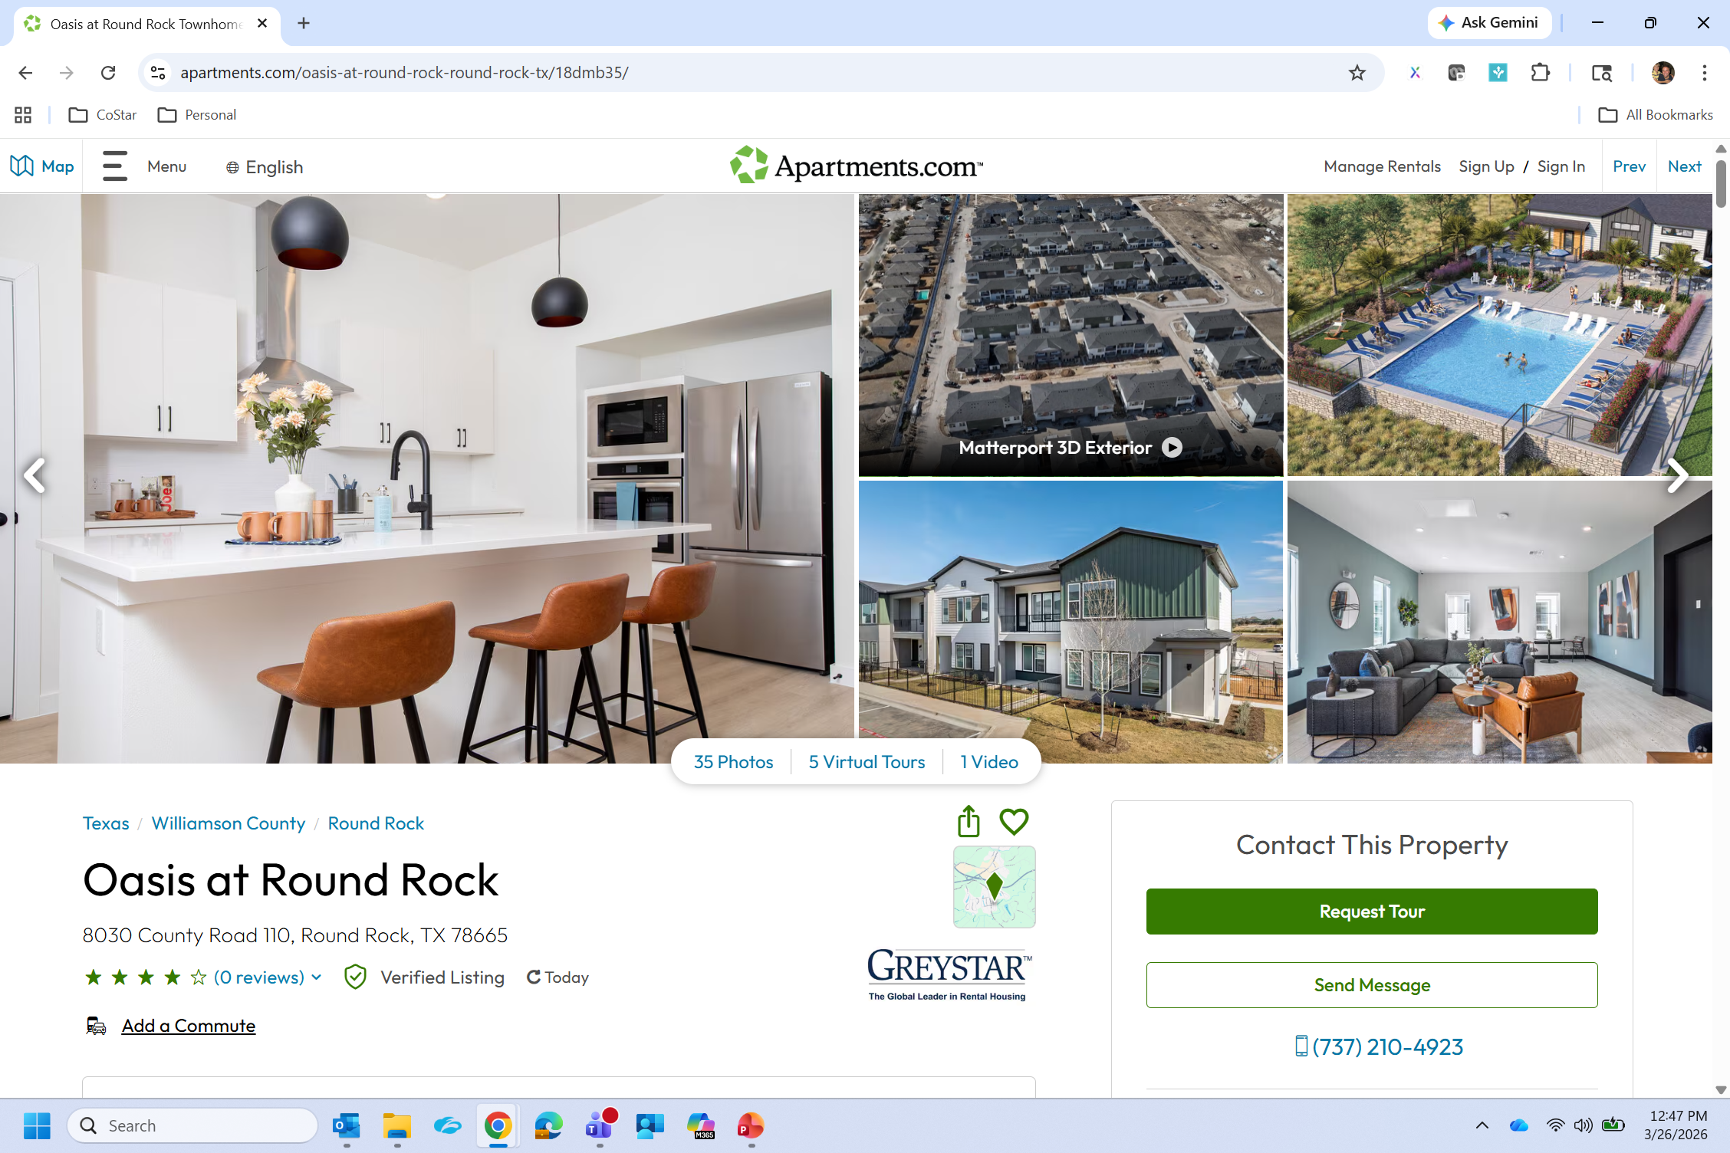
Listing detail page engagement
4% more clickthroughs to listing detail page
4% more time on listing detail page
5% more 3D tour views
Source: Apartments.com internal analytics

Slide 19
15% - 20% more leads
Source: Apartments.com internal analytics

Slide 20
~20% improvement in lead-to-lease conversion
Source: Apartments.com internal analytics

Slide 21
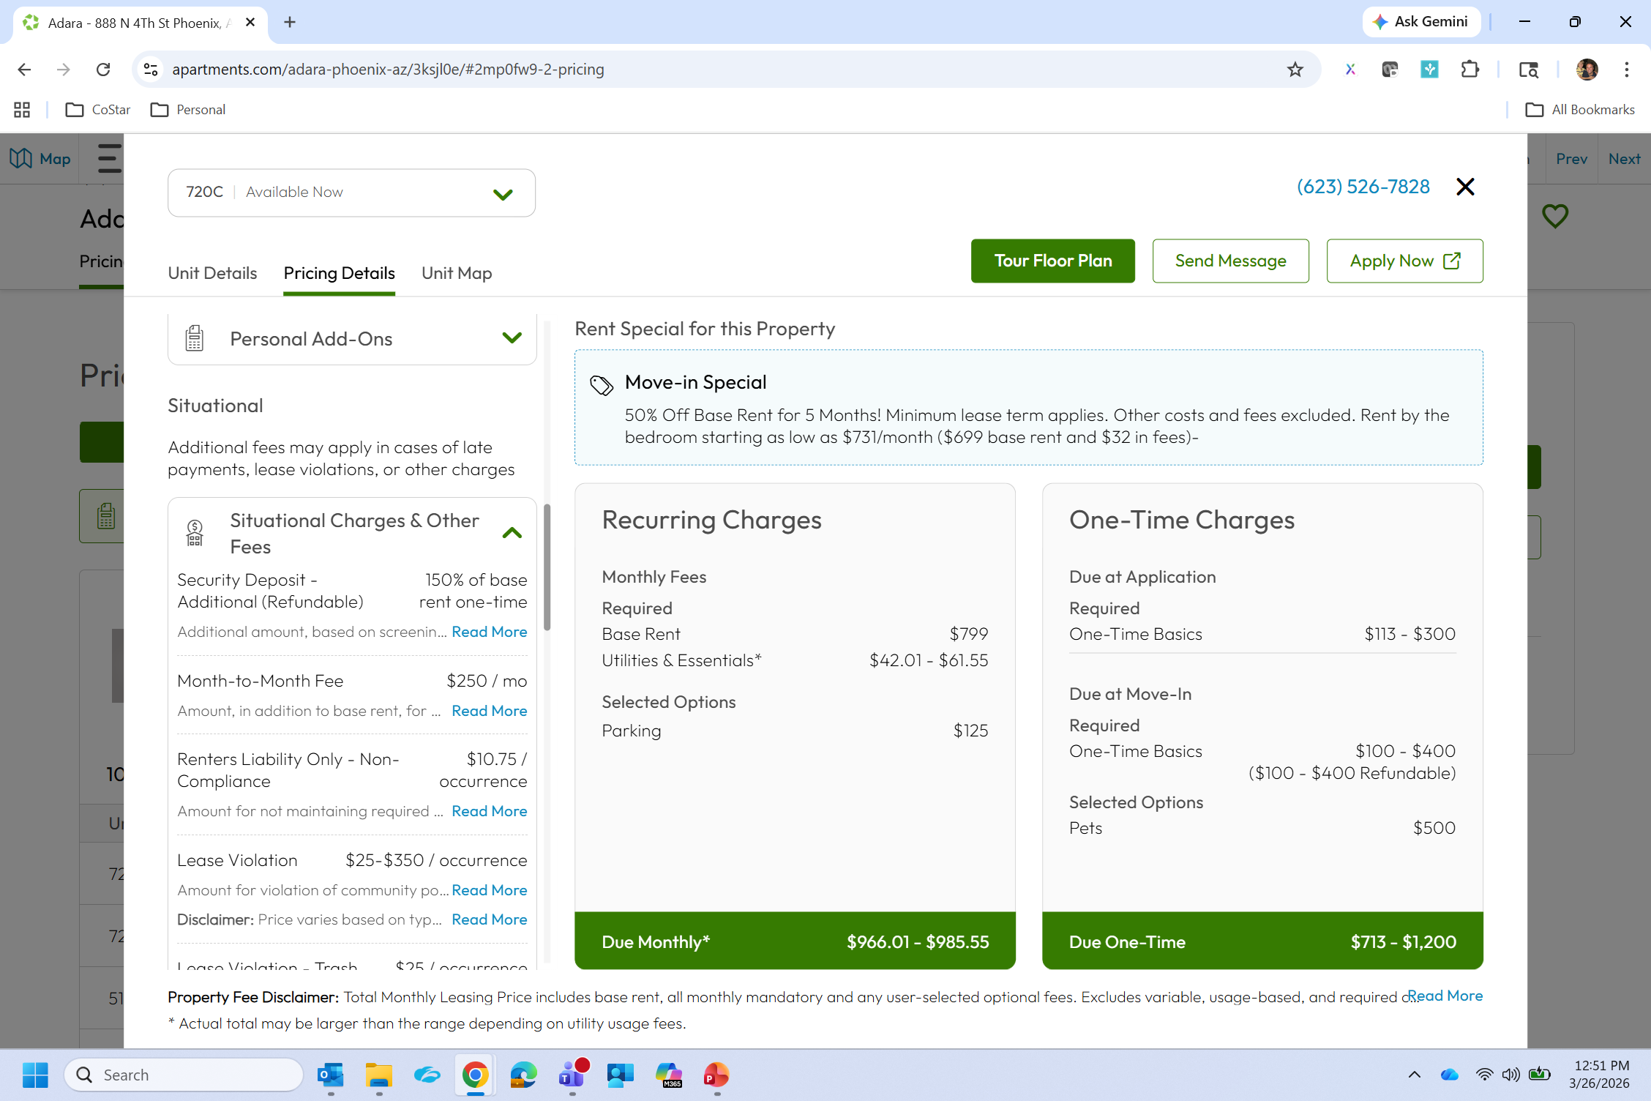
1/3 of Apartments.com customers use our Cost Calculator
Renters that use Cost Calculators are:
  2.4X more likely to submit a lead
  2X more likely to submit a higher intent lead (unit/floor plan level)
Source: Apartments.com internal analytics

Slide 22
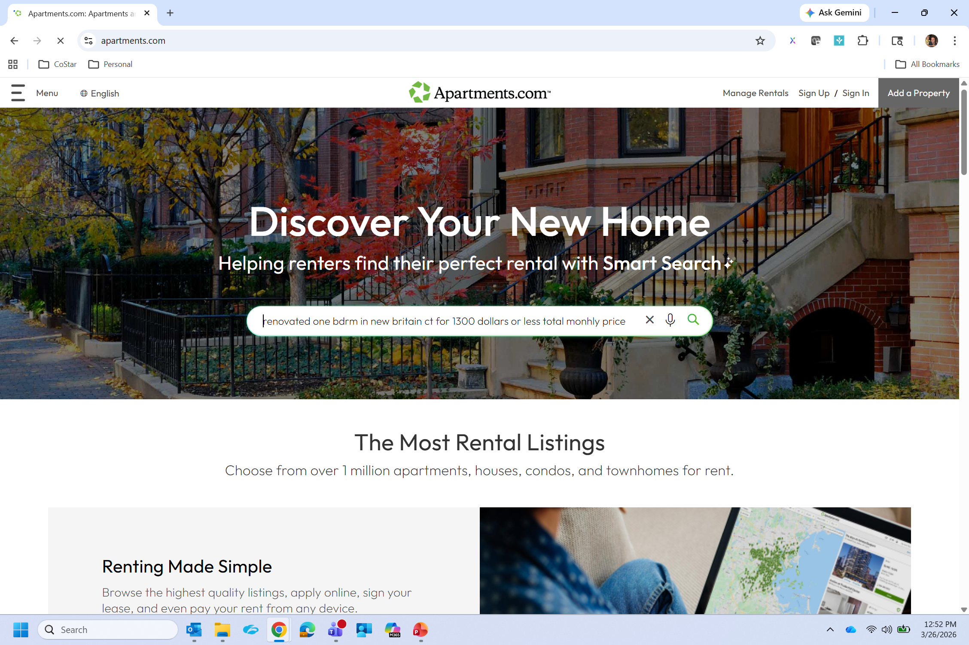
AI search on Apartments.com
Source: Apartments.com internal analytics

Slide 23
Prompts renters are entering – without being prompted!
Charlotte NC apartments total monthly price $1180 or under with washer and dryer included
Studio Lincoln Park Chicago under 1400 month total monthly price
1 bedroom in bluffdale area. price max is 1500 with fees included
Total monthly price of $2600 in Streeterville neighborhood, has to have in unit laundry
2b 2ba apartment under $2k monthly total price around Apex, Garner or Fuquay Varina
Apartments in Jonesboro Georgia total monthly price under 1599
Renovated one bdrm in New Britain CT for 1300 dollars or less total monthly price
1 bed 1 bath max rent of 1800 Tampa, Florida total monthly price indoor hallways
Lower Michigan apartments with in unit washer and dryer with total monthly price under $1,300
Will your property
show up?

Slide 24
Displaying TMLP aligns with consumer expectations

Slide 25





Overview: September 2025 – March 2026
Control Group
Test Group
12.2
67%
171
209
LEASES PER PROPERTY
HIGHER LEASE VOLUME
PROPERTIES
PROPERTIES
DIY SEO: 7.3 LEASES
THAN DIY SEO
BASE RENT ONLY
TMLP
GA4 + CRM LEAD/LEASE DATA | 380 PROPERTIES | 7 MONTHS

Slide 26


Finding one: Year over year changes in leads & leases
Both groups operated over identical market conditions
BASE RENT ONLY
Control Group
TMLP
Test Group
-16%
LEADS
+96%
12.2
LEASES PER PROPERTY
+122%
-7%
LEASES
DIY SEO: 7.3 LEASES

Slide 27
Properties displaying TMLP consistently outperform those showing base rent only

Slide 28
Lease volume peaks when
TMLP is displayed

Slide 29
Finding two: Engagement Rate
Consumers stayed and engaged at the same rate where total monthly leasing price is available
Adding total monthly leasing price increased engagement rate
Properties without TMLP had a -14% drop in engaged sessions.
FLOOR PLAN PAGE ENGAGEMENT | DESKTOP DEVICE SEGMENT

Slide 30
TMLP & cost calculators increase engagement
Price detail pages record consistently high engagement rates across all devices (93 - 96%)
Cost calculators, that adjust based on user input, receive engagement upwards of 90%
Percent of sessions from floor plans to TMLP hit 10% beginning January 2026 and continues to increase.
Sessions and engagement on total monthly leasing price pages are increasing rapidly

Slide 31



Finding three: Bottom-of-funnel clicks accelerating
View Floor Plans
View TMLP
Apply Now
APPLY NOW CLICKS ORIGINATING FROM /RENTESTIMATE/ PAGES

Slide 32
Allocation of fees
Fees per Unit
Fee Breakdown
21
12.2
67%
26
PROPERTY
LEASES PER PROPERTY
TOTAL FEES
5
UNIT
DIY SEO: 7.3 LEASES
THAN DIY SEO
Fee structures need to be simplified

Slide 33

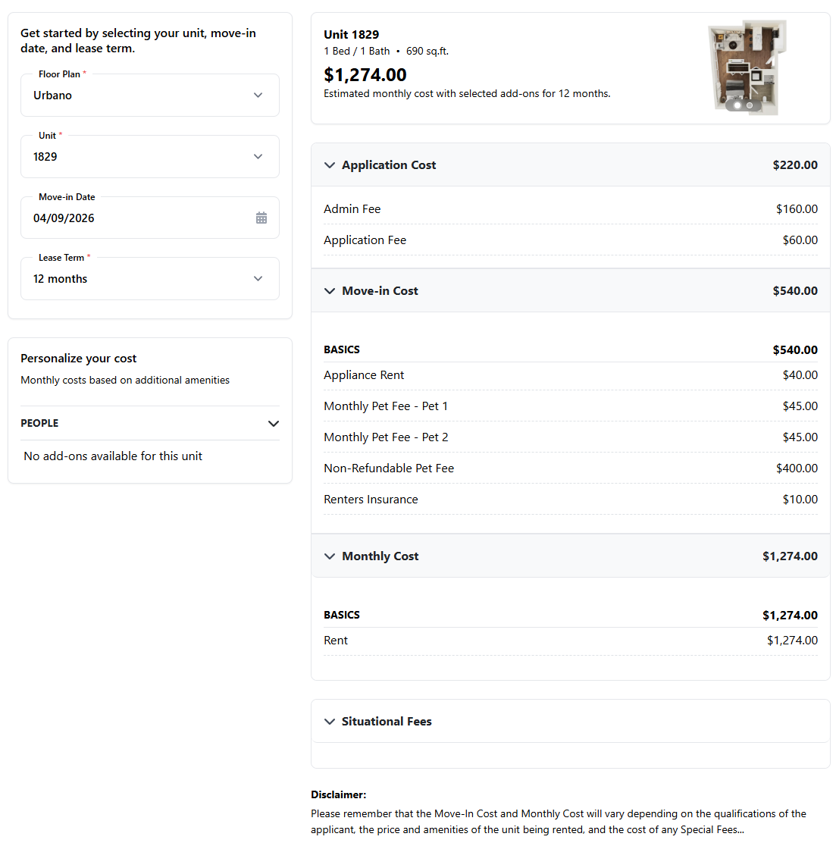
Optimizing for SEO and AI search
Accuracy & consistency
Structured data
Click events & parameters
Navigation & findability

Slide 34
Key Takaways
1
Displaying TMLP is correlated with a dramatic lift in leads and leases
Properties displaying total leasing cost saw +122% leases YoY, while the control group declined.
2
Consumers are actively using the total monthly leasing price feature
Share of floor plan visitors clicking to TMLP page grew from <1% to 8-11%, with 93-96% engagement
3
Optimize TMLP page for better SEO & AI indexing
Implement technical architecture to support pricing for better indexing across engines.
4
The bottom of the funnel is responding strongly
Apply Now clicks from the TMLP page grew nearly 50x in 6 months, and still growing.
Note: Self-selection bias present – properties opted into the feature. This is not a randomized experiment

Slide 35
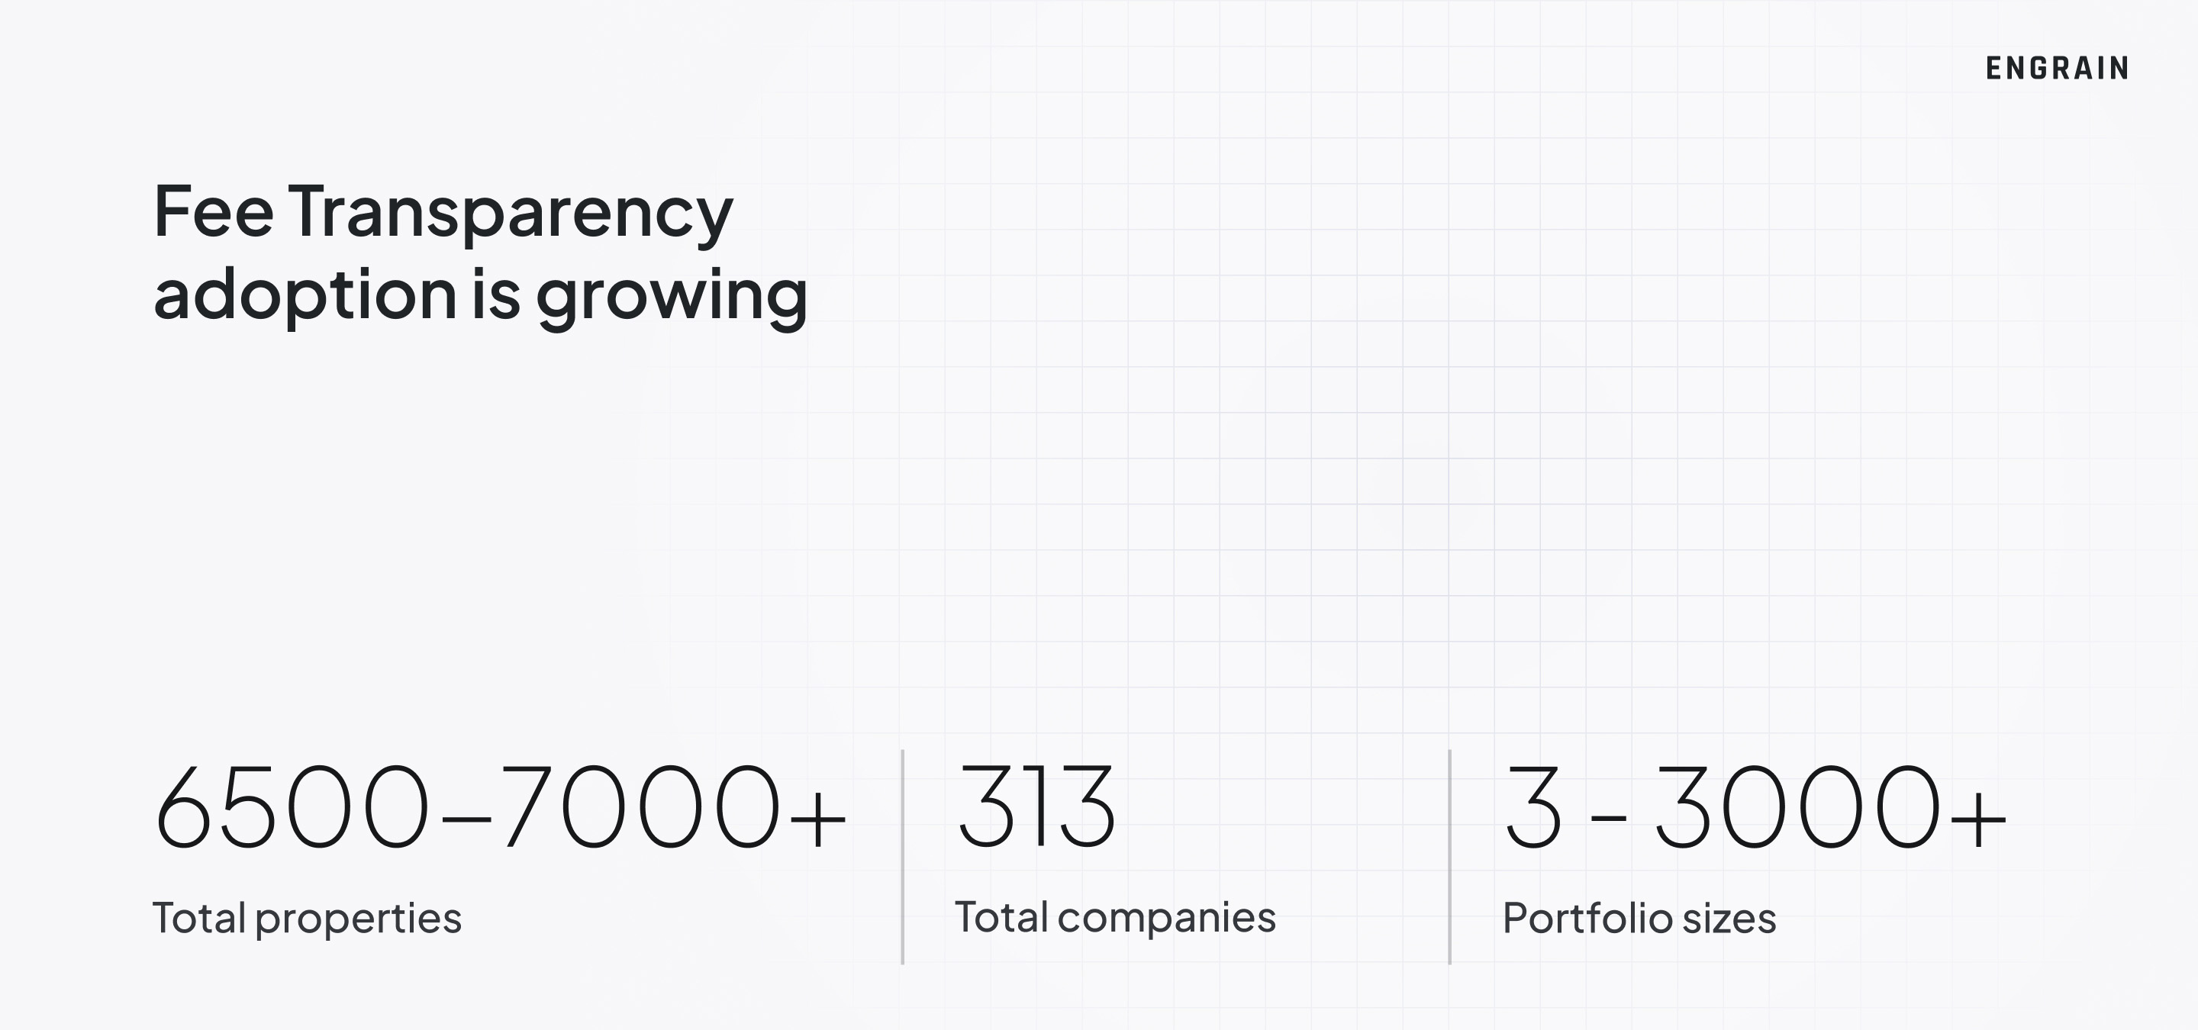

Slide 36
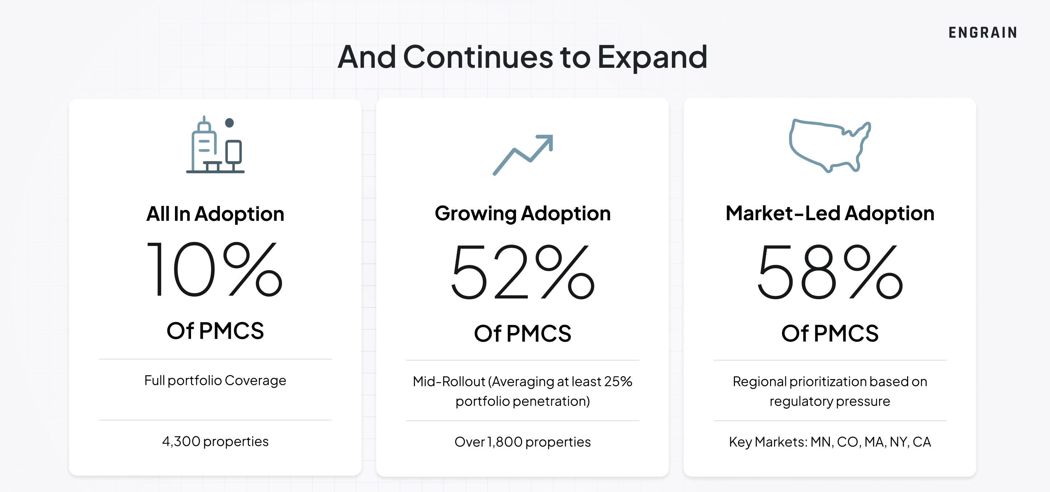

Slide 37
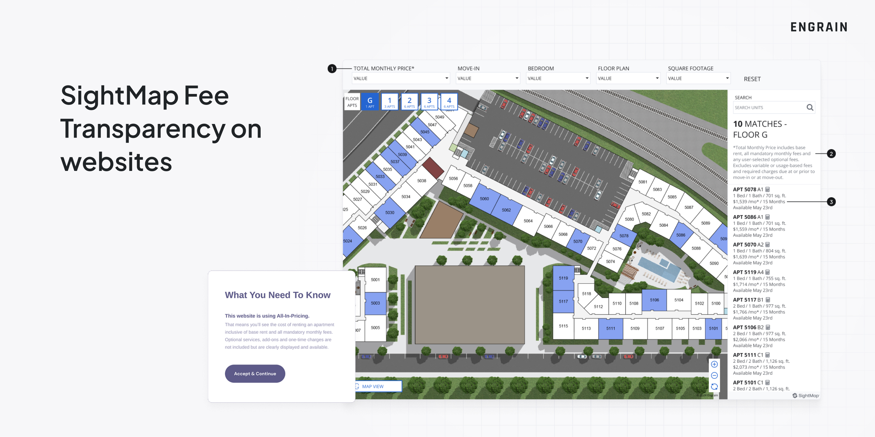

Slide 38
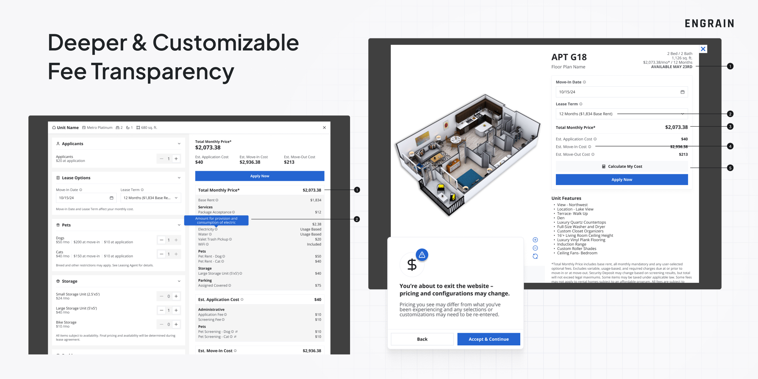

Slide 39
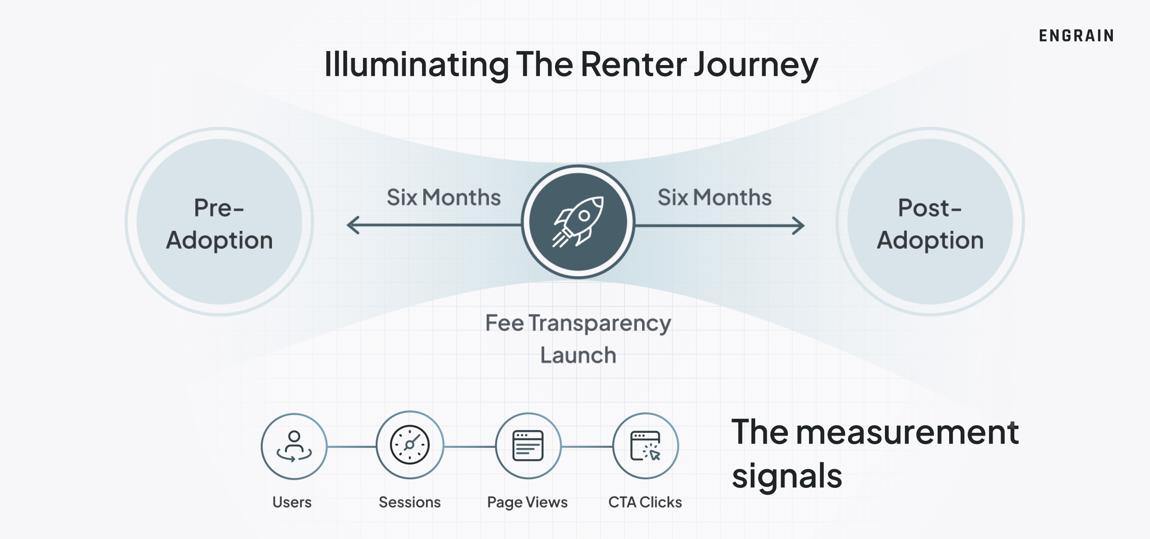

Slide 40
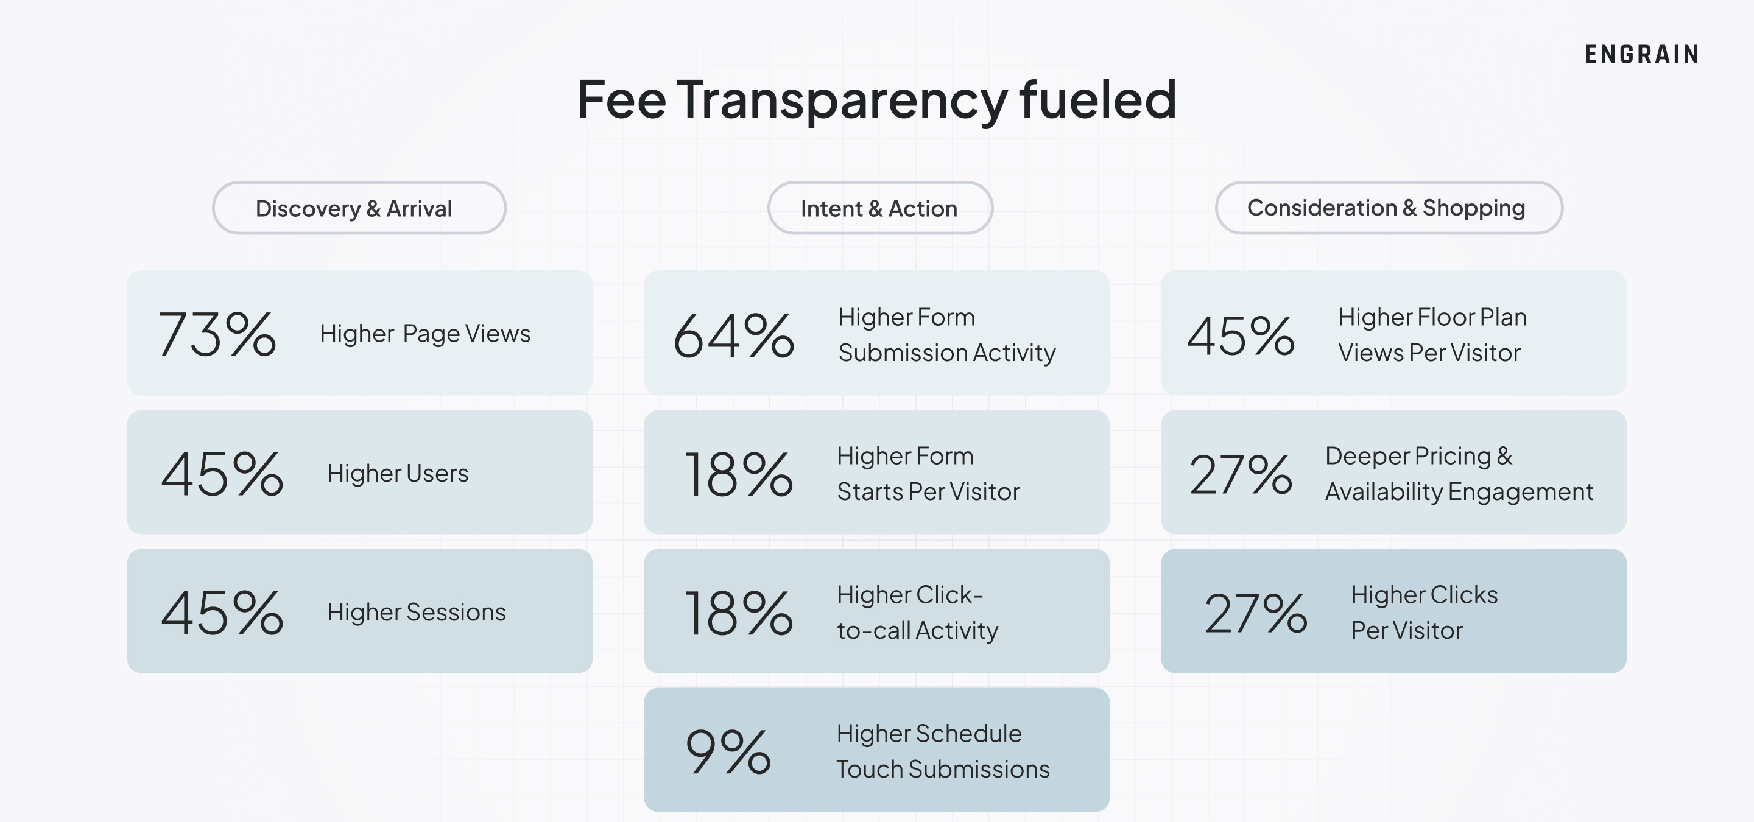

Slide 41
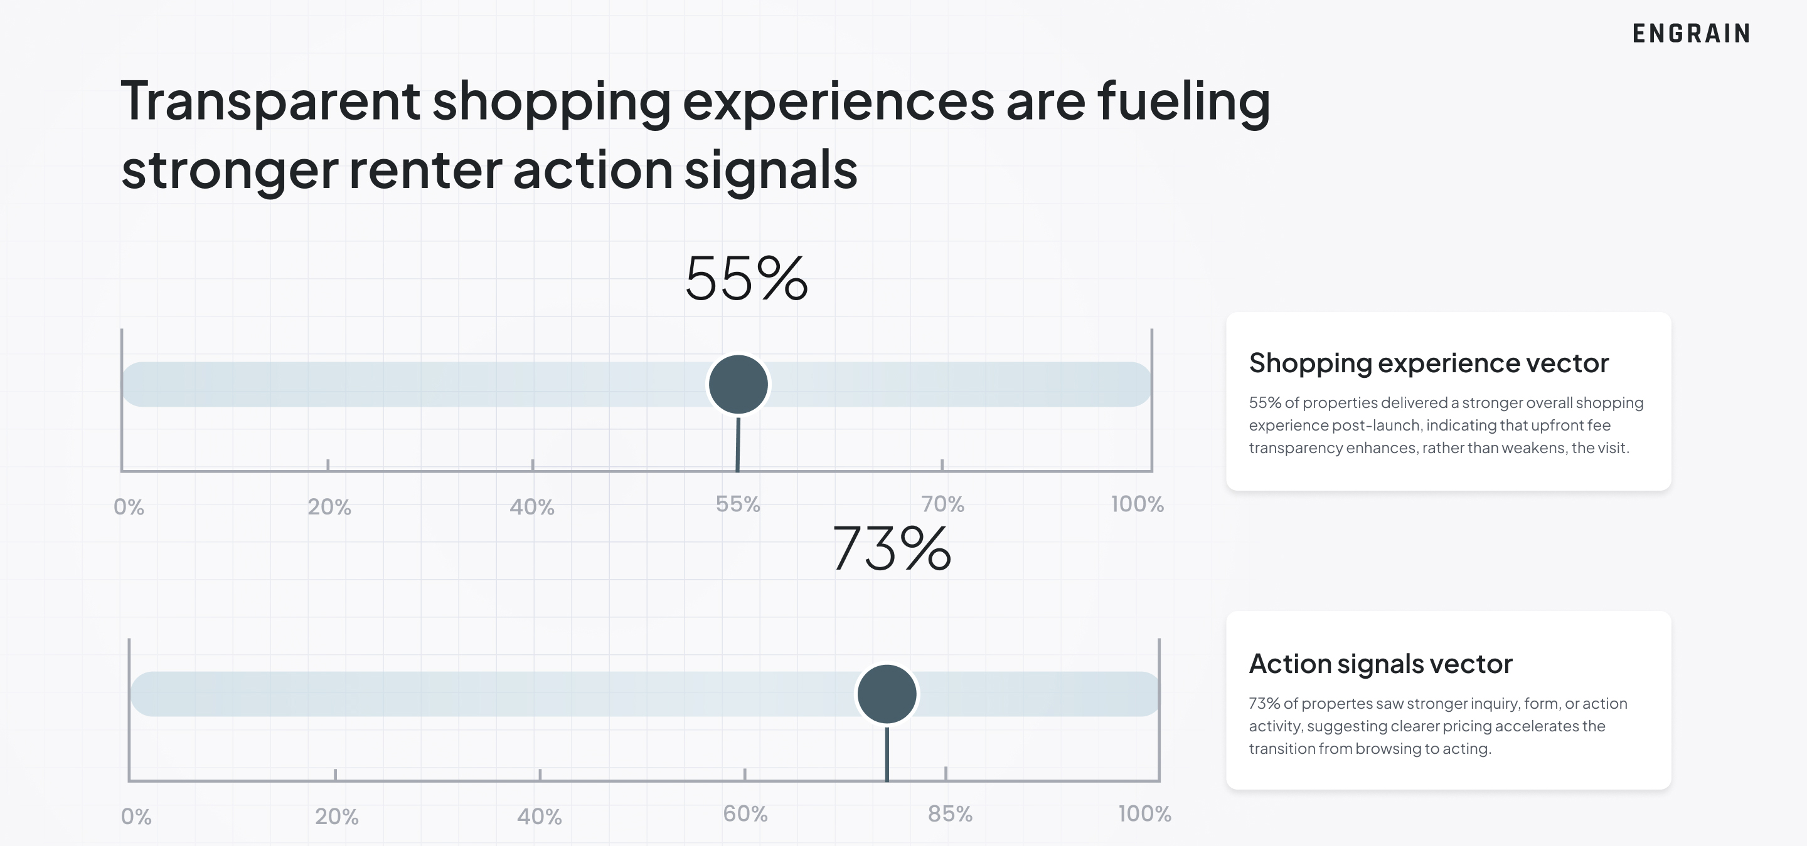

Slide 42
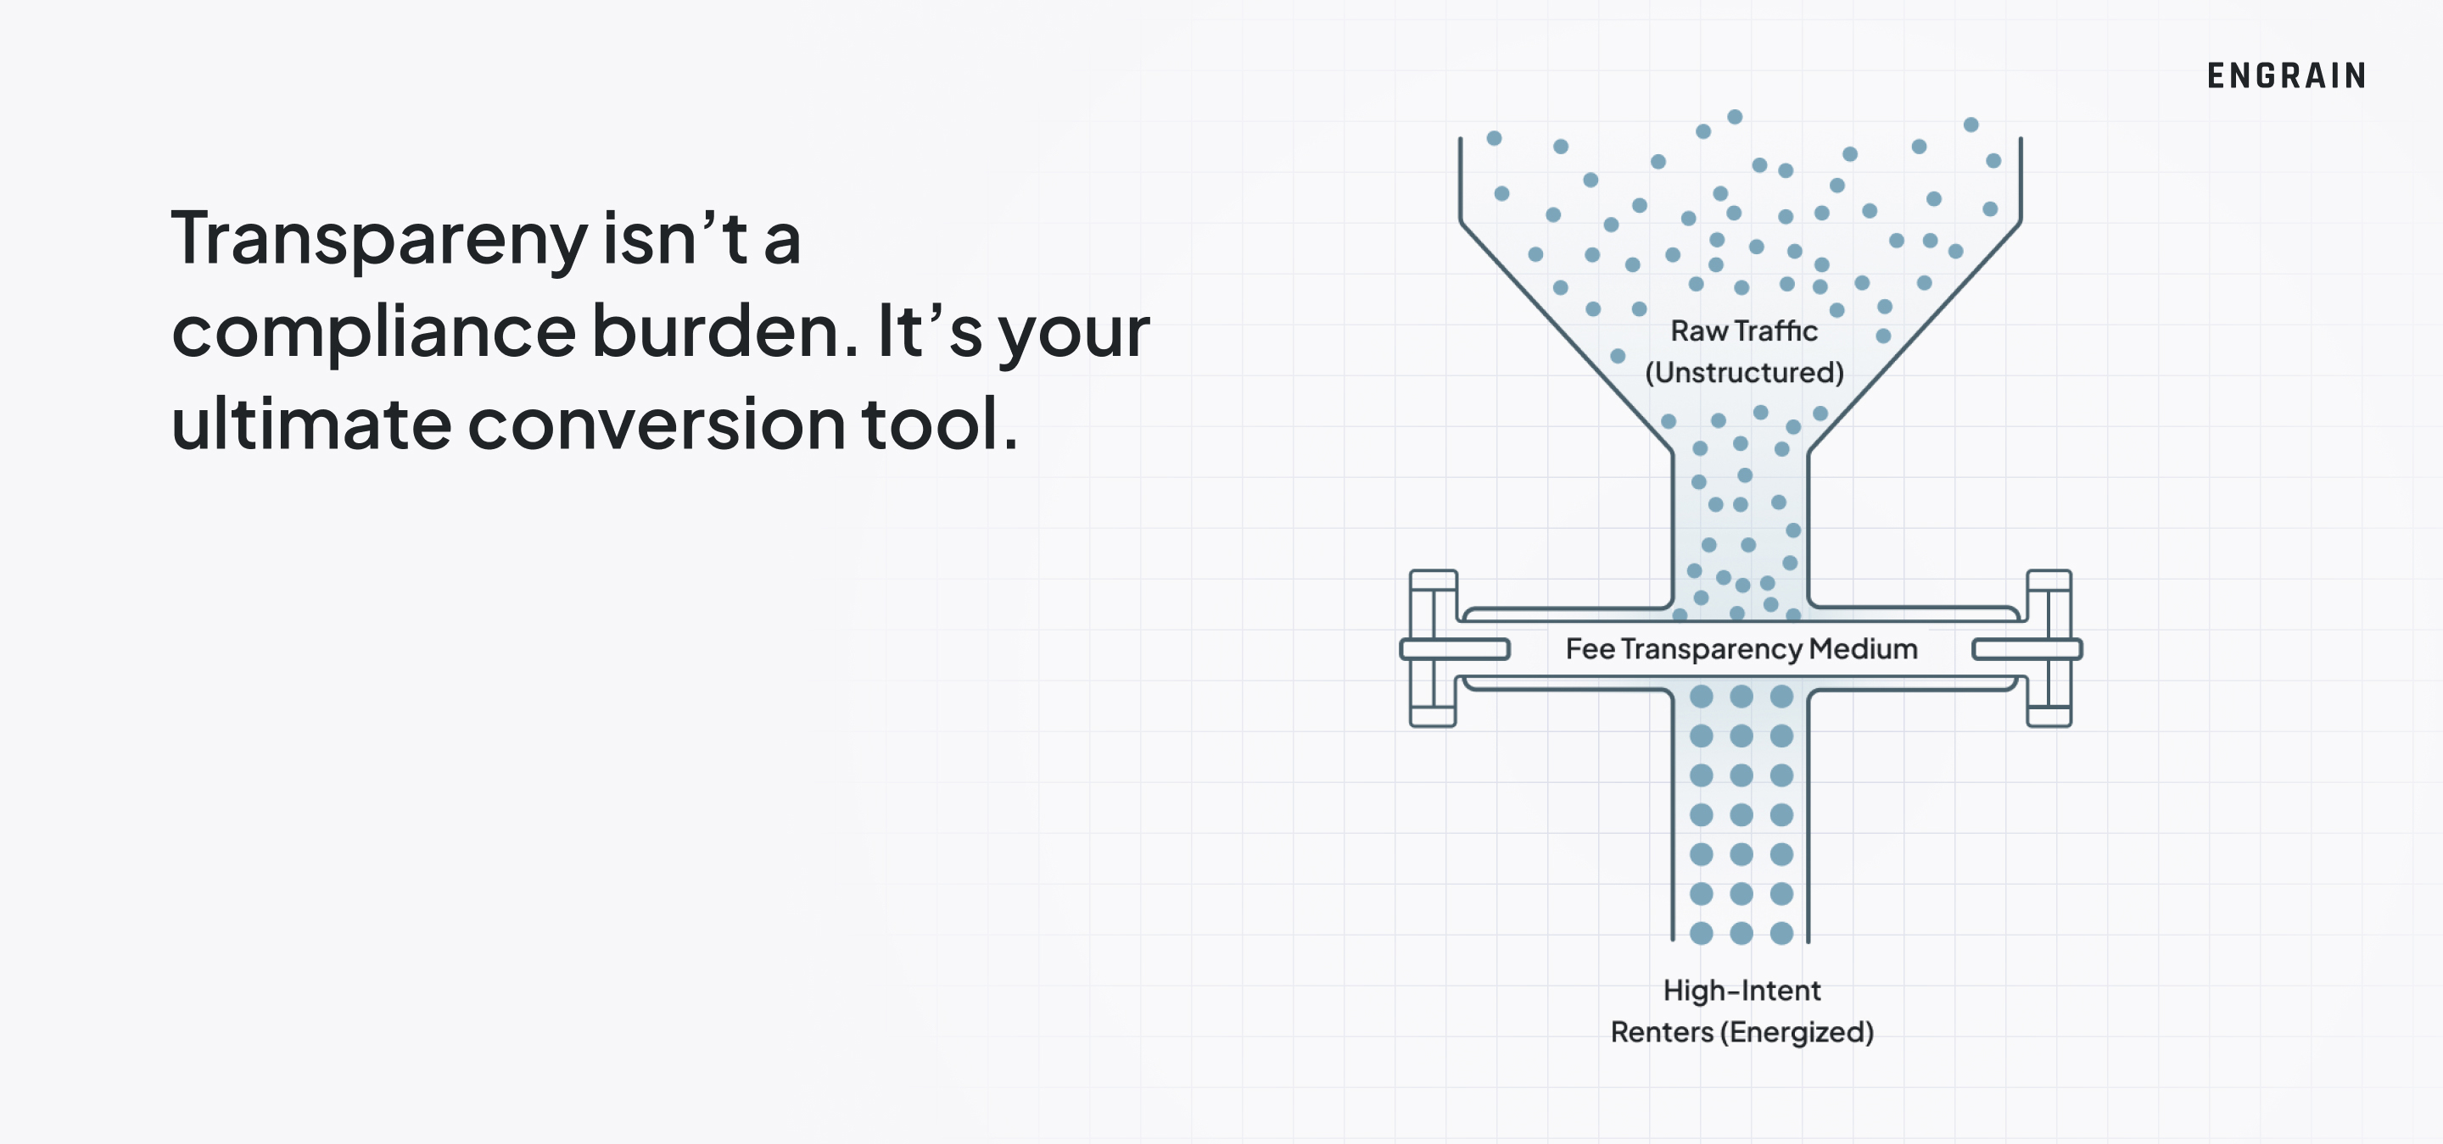

Slide 43

Total Monthly Leasing Price Pilot
A Case Study
What We Tested
Replaced all mandatory add-on fees with one all-in monthly price
Used a single price for marketing + quoting
Pilot ran 12 months across 3 communities
Where We Tested
Mix of Class A, B, and C assets
Located in small to mid-sized markets
Before the Pilot
Residents paid $23–$107/month in extra fees
Survey scores showed friction on this subject

Slide 44
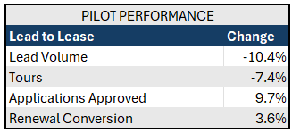
Total Monthly Leasing Price Pilot
What it looked like:
  Reduced lead volume
  Lead quality improvement
  Higher renewal conversion
  Lower application cancels and denials

Slide 45
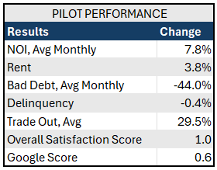
Total monthly leasing price pilot
The results:
  Increased NOI
  Decreased delinquency
  Reduced bad debt
  Overall satisfaction improvement

Slide 46
Total Monthly Leasing Price Pilot
The experience
"I have been highly satisfied with the TMLP program, as it has substantially reduced the time and effort spent tracking and ensuring the accurate billing of miscellaneous fees." - Community Manager
"From an advertising perspective, we have received considerable positive feedback regarding the transparency of presenting all charges upfront. This eliminates issues such as residents requesting to opt out of specific services, such as valet trash. By incorporating charges behind the scenes, we can enhance the customer service experience." - Community Manager
"TMLP simplifies things for our residents by providing a single, clear price when they budget and make rent payments—no surprises or misunderstandings."- Community Manager
"TMLP takes the guesswork out of renting by offering one straightforward monthly rate—making the experience easier for both residents and onsite teams" - Regional Manager
"BH has had a lot of roll outs of new programs, but I must say TMLP has been the most well received than any. My teams have embraced this program and really love the one price they can quote. RPP seems to have caught on making leasing so much easier without prospects feeling nickeled and dimed." - Regional Vice President

Slide 47
Key Takeaways
Renters
Love It
&
are embracing
the tools
ILS & Website Performance Metrics Improve
Total Price
Vital for
AI-Optimized Search
Positive
Resident &
Financial
Outcomes
Better Lead Quality
Higher Conversions
from total price experiences
Notes:
GREG – 2 mins
If we’ve done our job today, you now understand that there’s no reason to panic.
In fact, the data says you should be joyful and eager to embrace enhanced transparency.
Eliminating surprise fees and disclosing total price earlier in the renter shopping experience builds trust and has a positive impact on your reputation, and your bottom line.
We also hope you’ll feel more confident advocating for enhanced price transparency in your organizations.
Before we wrap up, I want to thank our experts for sharing their data, and I thought it would be nice to surprise them with a lightning round. You’ll each get 15 seconds to respond.

Slide 48
Notes:
GREG – 3 mins for responses
Here’s your question to respond to…
What should attendees do next to Drive Greater Consumer Engagement?
Stuart: Get on board, roll out TMLP
Cat: Optimize your website/pricing for SEO and AI search
Brent: Role of website with AI and new experience
Brandy: Eliminate or Consolidate fees
Greg: Be prepared for the next wave of transparency demands and stay abreast of consumer needs. Monitor the FTC proposed rule and state legislatures.

Slide 49





Thank you
Stuart Richens
VP Product | Apartments.com
Catriona Banks-Orosco
Sr Director |
REACH by RentCafe
Brent Steiner
Founder & CEO| Engrain
Brandy Daniel
Chief Strategy Officer| BH Management
Greg Benson
Managing Director| Greystar

Slide 52
Notes:
GREG
the industry focused on building technology and tools to meet legal requirements.
Given tight regulatory deadlines and product development cycles, customer experience wasn’t the primary goal for these solutions. Where do we go next?
This session is focused on what we’ve learned in the last year about renters and how they’ve reacted to enhanced disclosure of fees and total monthly leasing price. I’m going to be joined by several experts who will share their learnings across the renter journey from shopping to leasing.

Slide 53
Ai search on Apartments.com

Slide 54
Prompts renters are entering –- without being prompted!
Charlotte NC apartments total monthly price $1180 or under with washer and dryer included
Studio Lincoln Park Chicago under 1400 month total monthly price
1 bedroom in bluffdale area. price max is 1500 with fees included
Total monthly price of $2600 in Streeterville neighborhood, has to have in unit laundry
2b 2ba apartment under $2k monthly total price around Apex, Garner or Fuquay Varina
Apartments in Jonesboro Georgia total monthly price under 1599
Renovated one bdrm in New Britain CT for 1300 dollars or less total monthly price
1 bed 1 bath max rent of 1800 Tampa, Florida total monthly price indoor hallways
Lower Michigan apartments with in unit washer and dryer with total monthly price under $1,300
Will your property show up???

Slide 55
Using total monthly price to attract renters as they begin their search

Slide 56
Price is #1 most important factor in renter search
Among top 3 considerations when selecting next rental residence
Source: Apartments.com Renter Survey

Slide 57
We asked!
Renters want to see the total price with all fees included.
I can’t afford hidden or unexpected charges. I must stay within my budget.
— Renter in Texas
85%

Slide 58
48% of renters tell us that they have actually stopped considering a property when presented with new fees!
Source: Apartments.com Renter Survey

Slide 59
Our customers are seeing real benefits when they present a "Total Monthly Price"

Slide 60

~20% improvement in lead-to-lease conversion
Source: Apartments.com internal analytics

Slide 61
1/3 of Apartments.com customers utilize our Cost Calculator
Renters that use Cost Calculators are:
2.4X more likely to submit a lead
2X more likely to submit a higher intent lead (unit/floor plan level)
Source: Apartments.com internal analytics

Slide 62
Displaying TMLP Aligns with Consumer Expectations

Slide 63
Overview: September 2025 – March 2026
Control Group
Test Group
12.2
67%
171
209
LEASES PER PROPERTY
HIGHER LEASE VOLUME
PROPERTIES
PROPERTIES
DIY SEO: 7.3 LEASES
THAN DIY SEO
BASE RENT ONLY
TMLP
GA4 + CRM Lead/Lease Data | 380 properties | 7 months

Slide 64

Finding 1: YoY Changes in Leads & Leases
Control Group
Test Group
-16% Leads
+96%
12.2
67%
-7% Leases
+122%
LEASES PER PROPERTY
HIGHER LEASE VOLUME
DIY SEO: 7.3 LEASES
THAN DIY SEO
BASE RENT ONLY
TMLP
Both groups operated over identical market conditions

Slide 65
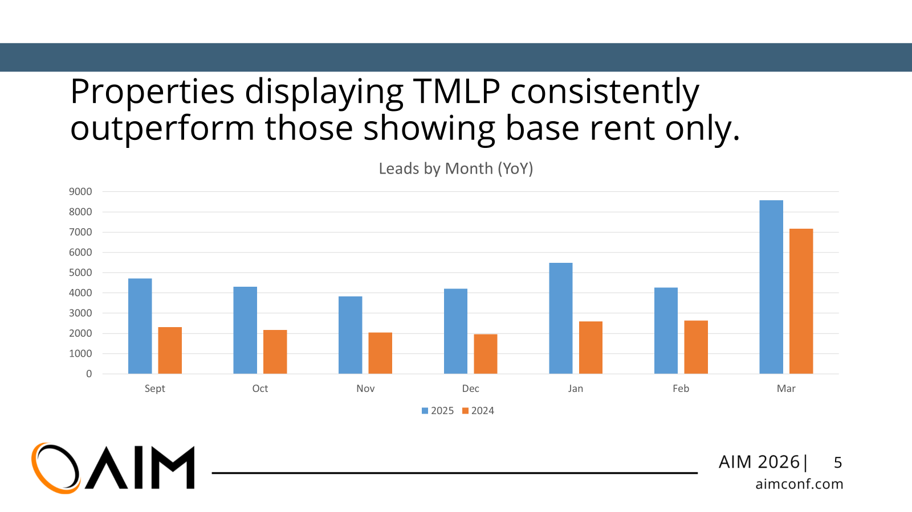
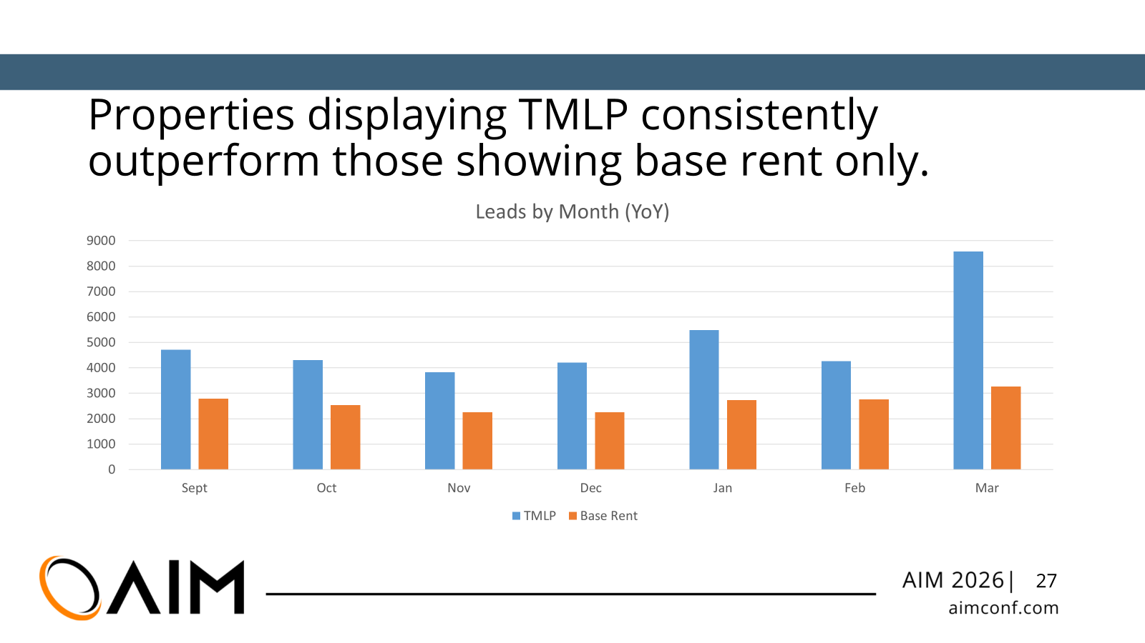
Finding 1: YoY Changes in Leads & Leases
Control Group
Test Group
-16% Leads
+96%
12.2
67%
-7% Leases
+122%
LEASES PER PROPERTY
HIGHER LEASE VOLUME
DIY SEO: 7.3 LEASES
THAN DIY SEO
BASE RENT ONLY
TMLP
Both groups operated over identical market conditions

Slide 66
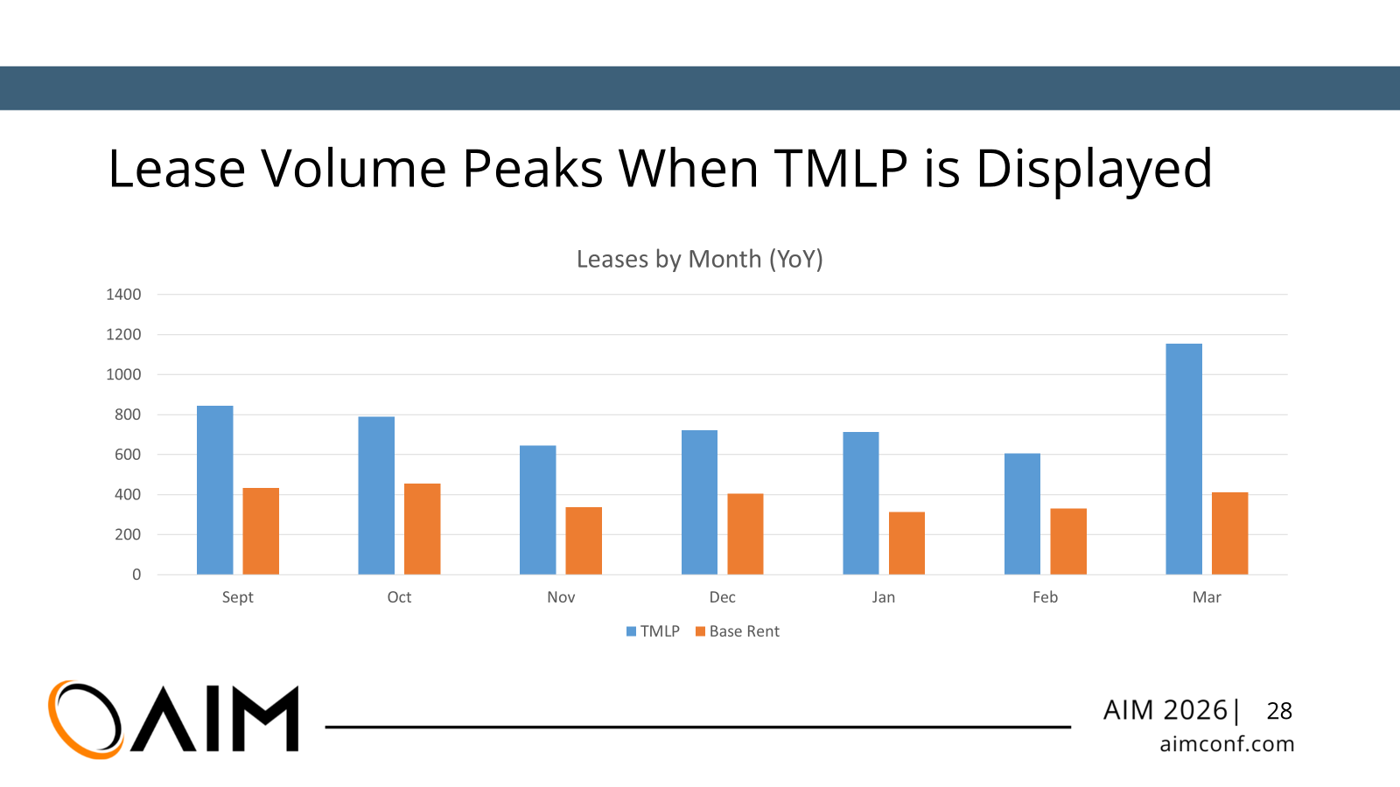
Higher demand does not come at the expense of lease conversions

Slide 67

Finding 2: Engagement Rate
Consumers stayed and engaged at the same rate where total monthly leasing price is available.
Adding total monthly leasing price did NOT reduce engagement rate
Properties without TMLP had a -14% drop in engaged sessions.
Floor plan page engagement | Desktop device segment

Slide 68
TMLP & cost calculators increase engagement.
Price detail pages record consistently high engagement rates across all devices (93 - 96%)
Cost calculators, that adjust based on user input, receive engagement upwards of 90%
Percent of sessions from floor plans to TMLP hit 10% beginning January 2026 and continues to increase.
Sessions and engagement on total monthly leasing price pages are increasing rapidly

Slide 69
# 3: Bottom-of-Funnel Clicks Accelerating
View Floor Plans
View TMLP
Apply Now
Apply Now clicks originating from /rentestimate/ pages

Slide 70
Allocation of Fees
Fees per Unit
Fee Breakdown
12.2
21PROPERTY
26
67%
LEASES PER PROPERTY
HIGHER LEASE VOLUME
TOTAL FEES
5 UNIT
DIY SEO: 7.3 LEASES
THAN DIY SEO
Fee structures need to be simplified

Slide 71
Optimizing for SEO and AI search
Accuracy & consistency
Structured data
Click events & parameters
Navigation & findability

Slide 72
Key Takeaways
1
Displaying TMLP is correlated with a dramatic lift in leads and leases
Properties displaying total leasing cost saw +122% leases YoY, while the control group declined.
2
Consumers are actively using the total monthly leasing price feature
Share of floor plan visitors clicking to TMLP page grew from <1% to 8-11%, with 93-96% engagement
3
Optimize TMLP page for better SEO & AI indexing
Implement technical architecture to support pricing for better indexing across engines.
4
The bottom of the funnel is responding strongly
Apply Now clicks from the TMLP page grew nearly 50x in 6 months, and still growing.
Note: Self-selection bias present – properties opted into the feature. This is not a randomized experiment

Slide 73
Total Monthly Leasing Price Pilot
What It Looked Like
Reduced Lead Volume
Lead Quality Improvement
Higher Renewal Conversion
Lower Application Cancels and Denials

Slide 74
Total Monthly Leasing Price Pilot
The Results
Increased NOI
Decreased Delinquency
Reduced Bad Debt
Overall Satisfaction Improvement

Slide 75
Total Monthly Leasing Price Pilot
The Experience
"I have been highly satisfied with the TMLP program, as it has substantially reduced the time and effort spent tracking and ensuring the accurate billing of miscellaneous fees." - Community Manager
"From an advertising perspective, we have received considerable positive feedback regarding the transparency of presenting all charges upfront. This eliminates issues such as residents requesting to opt out of specific services, such as valet trash. By incorporating charges behind the scenes, we can enhance the customer service experience." - Community Manager
"TMLP simplifies things for our residents by providing a single, clear price when they budget and make rent payments—no surprises or misunderstandings."- Community Manager
"TMLP takes the guesswork out of renting by offering one straightforward monthly rate—making the experience easier for both residents and onsite teams" - Regional Manager
"BH has had a lot of roll outs of new programs, but I must say TMLP has been the most well received than any. My teams have embraced this program and really love the one price they can quote. RPP seems to have caught on making leasing so much easier without prospects feeling nickeled and dimed." - Regional Vice President

