Slide 1



PRESENTED BY
THE GOLDILOCKS EFFECT:
FINDING THE “JUST RIGHT” IN MARKETING SPEND AND ROI
www.reallygreatsite.com

Slide 2
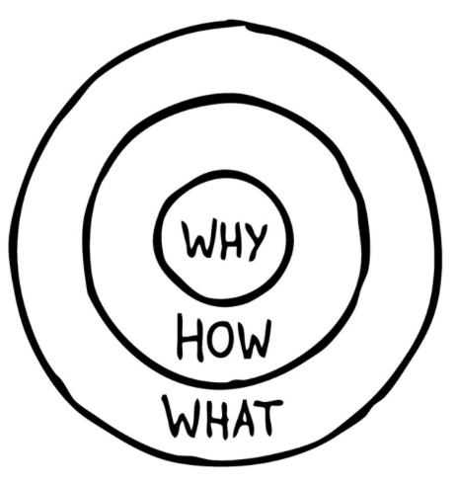

THE GOLDEN CIRCLE
AIM 2026| Slide 2
aimconf.com

Slide 3
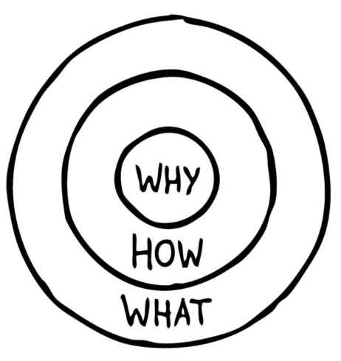
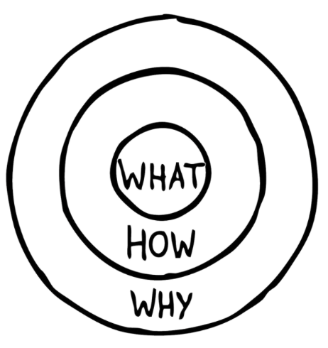

THE GOLDEN CIRCLE
AIM 2026| Slide 3
aimconf.com

Slide 4

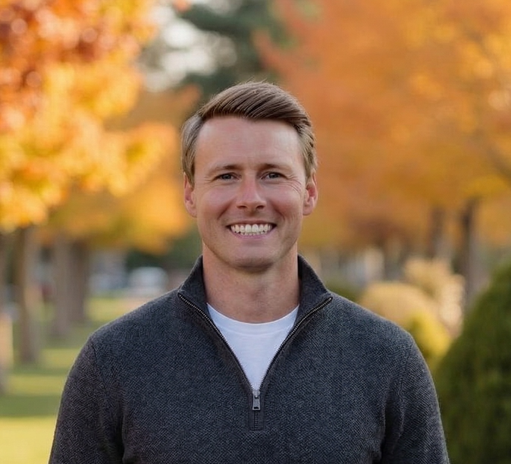


Annika Navac
Marketing Manager
The Bainbridge Companies
Andrew Cederlind
President & COO Conversion Logix
Heidi Jehlicka
VP of Marketing
The Bainbridge Companies
Laurel Zacher
CEO
LZ Strategic
PRESENTED BY
www.reallygreatsite.com

Slide 5
TOO HOT
TOO COLD
JUST RIGHT
AIM 2026 | Slide 5
aimconf.com

Slide 6
THE CONTEXT CHANGES EVERYTHING
SUN BELT SUBURBAN
COASTAL URBAN
SECONDARY MARKET
COST PER LEAD $65-$100
COST PER LEAD $90-$150
COST PER LEAD $40-$70
LEASE-UP
~$1,650
~$2,400
~$780
5% CONVERSION
5% CONVERSION
7% CONVERSION
COST PER LEAD $45-$70
COST PER LEAD $65-$110
COST PER LEAD $30-$50
VALUE-ADD
~$720
~$1,460
~$400
8% CONVERSION
6% CONVERSION
10% CONVERSION
COST PER LEAD $35-$55
COST PER LEAD $60-$95
COST PER LEAD $20-$35
STABILISED
~$410
~$970
~$225
11% CONVERSION
8% CONVERSION
12% CONVERSION
$225 to $2,400 per lease
Same asset class. Same product. The context changes everything.
AIM 2026| Slide 6
aimconf.com

Slide 7
TOO HOT
TOO COLD
JUST RIGHT
AIM 2026 | Slide 7
aimconf.com

Slide 8
“JUST RIGHT” = ALIGNMENT
AIM 2026| Slide 8
aimconf.com

Slide 9
WHAT SHOULD YOU DO NEXT?
Evaluate spend as an investment
Not an expense — measure impact on NOI
Focus on cost per lease
Not just cost per lead
Use all three metrics together
Cost per Lease | Conversion | % of EGI
Diagnose before you adjust
Fix the problem, not just the spend
AIM 2026| Slide 9
aimconf.com

Slide 10
THANK YOU!
PRESENTED BY
www.reallygreatsite.com

