Slide 1
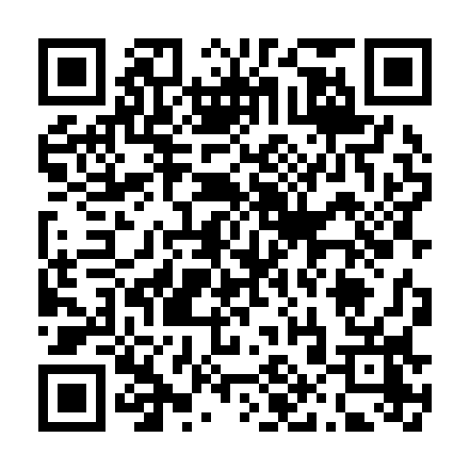

Welcome, and thanks for coming!
While you wait, enter for a chance to win a MacBook Neo!
Notes:
11-11:15 AM

Slide 2


Protecting NOI starts with the resident experience
Notes:
11:15 AM

Slide 3

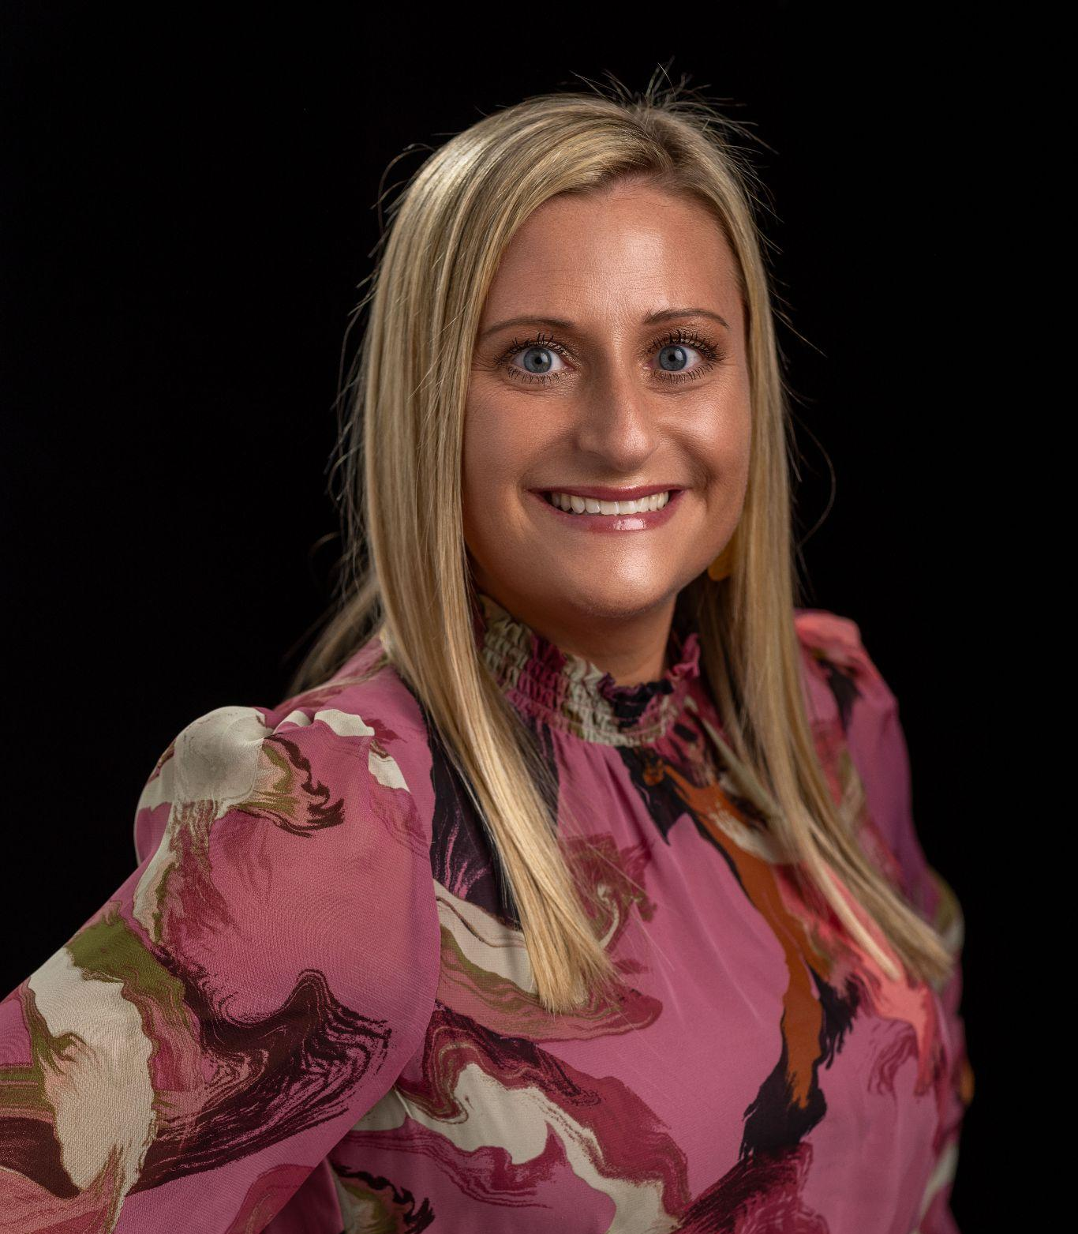
Meet Courtney Bagwell
Ancillary Revenue Manager
$6M+
108K+
in on-time rent paid through Flex a month
student housing beds owned and managed
Notes:
When introducing

Slide 4

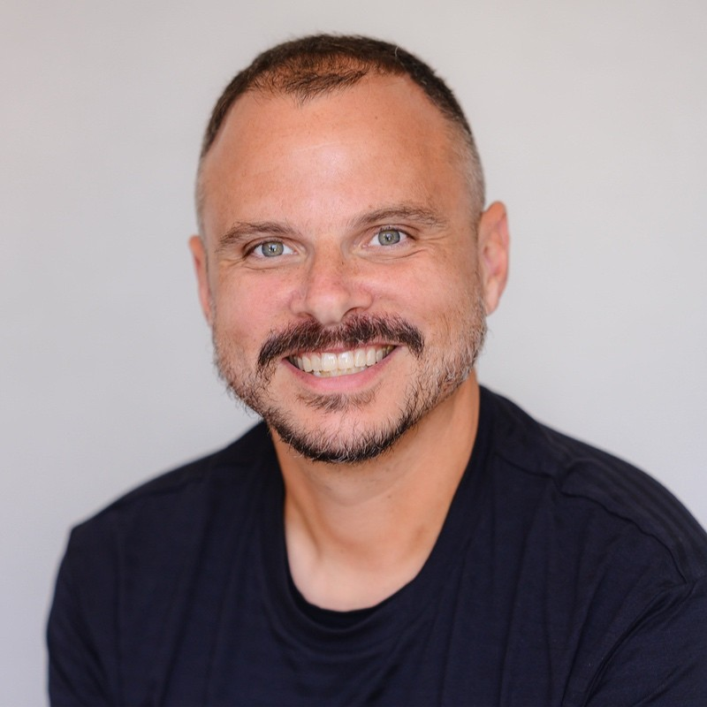
Meet Ryan Raser
Director of Operations
90%
3rd
reduction in delinquency since pandemic peak
ever Flex client, partnering in 2019
Notes:
When introducing

Slide 5


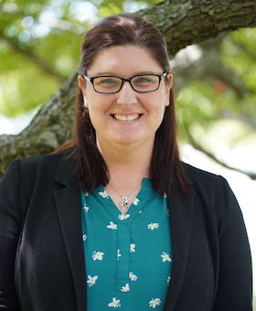
Meet Kristina Super
Director of Strategic Services
lowest
highest
count of new signups for Flex in April 2026
64
amount of rent collected in a month through Flex
$2M+
Notes:
When introducing

Slide 6
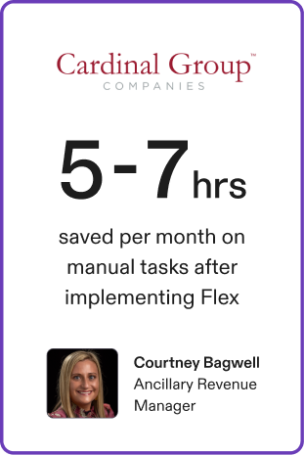
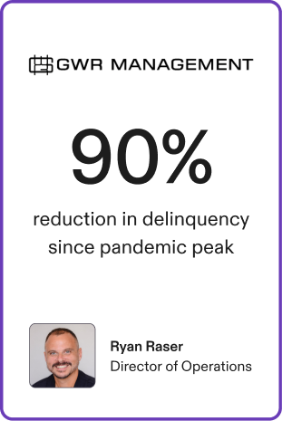
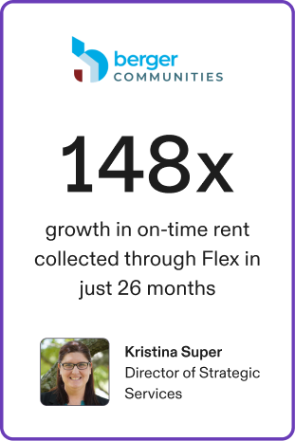
Notes:
Stays up during presentation

Slide 7

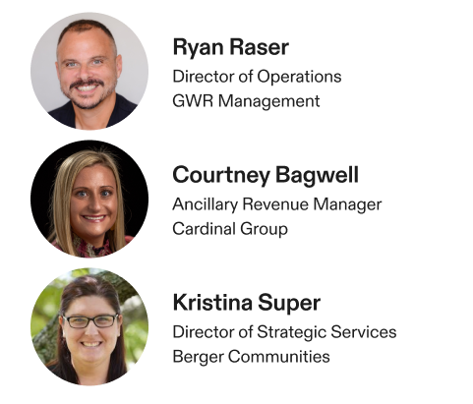
Q&A

Slide 8
Thank you!

