Slide 1
FROM SAAS TO RAAS:
WHY RESULTS ARE THE ONLY SOLUTION THAT MATTERS
Notes:
"Good afternoon, AIM! Welcome to the main stage.
For the last few years, we have been living in the whirlwind of 'shiny object syndrome.' We’ve been told that if we just added one more chatbot, one more dashboard, or one more 'automated' workflow, our problems would vanish. But let’s be honest: your residents don’t care about your tech stack. Your investors don’t care about your UI. And your site teams? They definitely don’t care about another tool that adds more work to their day.
In chasing features, many of us have accidentally created 'tech fatigue' for our teams and 'digital friction' for our residents.
Today, we are here to kill the 'SaaS for the sake of SaaS' mindset. We are officially entering the era of RaaS: Results as a Solution. We are moving past what AI is and focusing entirely on what AI does. Because if the technology doesn't move the needle on your NOI, shorten your delinquency, or give your property manager thirty minutes of their life back—it’s just noise.
We’re going beyond the leasing office and into the guts of the business—from debt collection and bookkeeping to predictive scheduling. We’re going to look at the thin line between 'efficient' and 'robotic,' and why Trust is the only metric that actually determines your ROI.
AI isn't replacing humans, but the humans who know how to use it to drive results? They aren’t just keeping up—they’re winning.

Slide 2
Let’s meet the panel
Notes:
To help us navigate this shift from 'features' to 'outcomes,' I am joined by three leaders who are moving past the hype and into the results…and since it’s Cinco de Mayo, I’m also joined by a few Margaritas to welcome our panelist up to the stage (play Gasolina or Bandoleros or Danza Kuduro or Mas Que Nada)

Slide 3


Leah Downie
Atlanta, Georgia
Managing Director at Gallery Residential
Fun Fact: Fresh out of high school, she was the youngest contestant at the Miss New York USA Pageant in Albany.

Slide 4
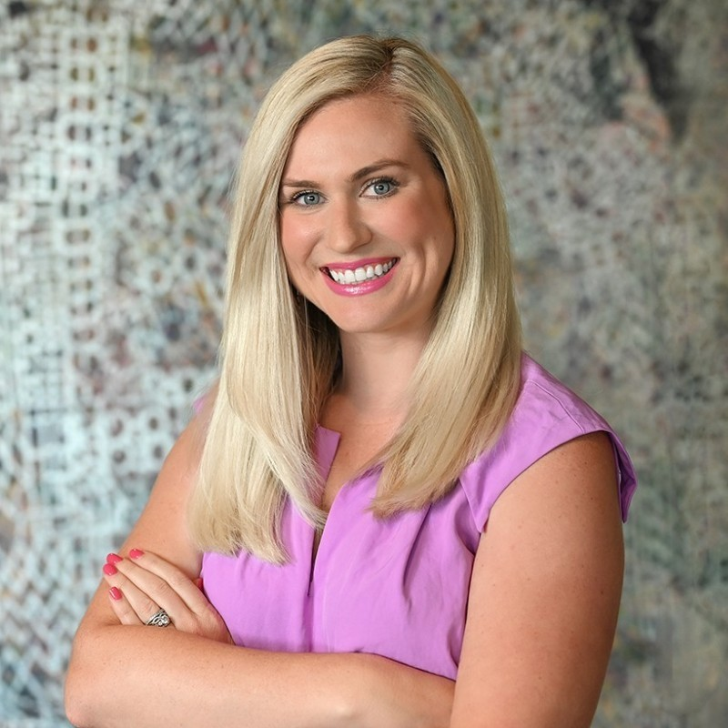

Chelsea Proehl
Atlanta, Georgia
VP Marketing, RangeWater
Fun Fact: She started her career in press on Capitol Hill, working for two U.S. Senators before moving into marketing.

Slide 5
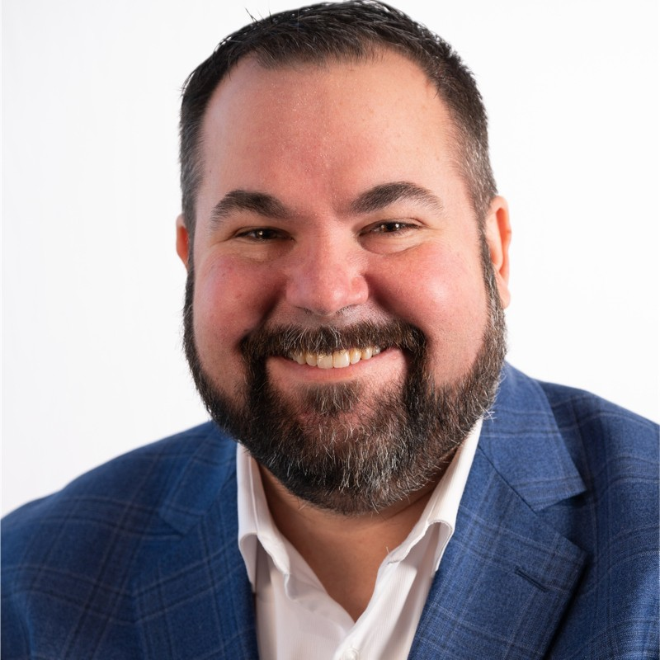

Ian Bingham
Tampa, Florida
SVP, Daniel Management Group
Fun Fact: 🤷

Slide 6


Scott Allan
Las Vegas, Nevada
CRO, Property Vista
Fun Fact: He paid for several semesters of his college by imitating Michael Jackson. (Dancing)

Slide 7


Slide 8


Slide 9
Trust, Transparency, & the Bottom Line

Slide 10
Choosing The Right Partner

Slide 11
Lightning Round

Slide 12
Q & A
Notes:
"Ladies and gentlemen, the takeaway today is simple: Software is a line item; Results are a strategy. We are officially done with the era of 'What can this tool do?' and we’ve entered the era of 'What did this tool solve?'
If you leave this room with one mission, let it be this: Go back to your tech stack, look at every dashboard you’re paying for, and ask: 'Is this giving me a chart, or is it giving me a check?' AI isn't here to replace the heart of multifamily; it’s here to strip away the noise so we can get back to the business of people. The tools are evolving—make sure your expectations are, too.
Thank you to our incredible panel, Ian, Chelsea, and Leah…and thank you, AIM!"
Let’s go drive some results!

